Slide 1

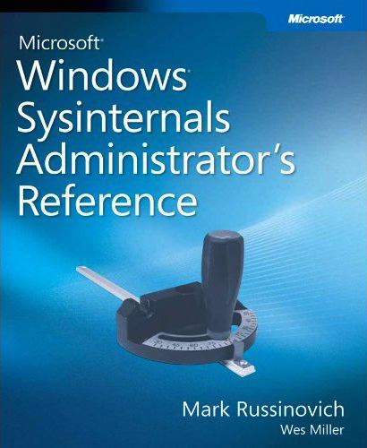
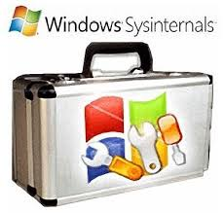
OS
Sysinternals
http://technet.microsoft.com/en-us/sysinternals
live.sysinternals.com - /

Slide 2

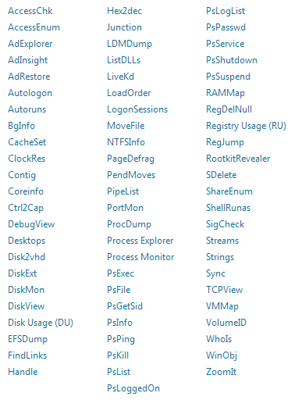
OS
Sysinternals
Mark Russinovich
Windows Sysinternals is a part of the Microsoft TechNet website which offers technical resources and utilities to manage, diagnose, troubleshoot, and monitor a Microsoft Windows environment.

Slide 3
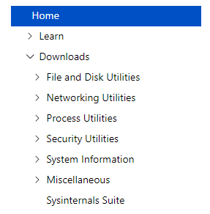
OS
Sysinternals

