Slide 1

OS
Windows API
WPF and Win32 Interoperation
Import function Win32 to .Net
The term PInvoke is derived from the phrase "Platform Invoke".
PInvoke.net is primarily a wiki, allowing developers to find, edit and add PInvoke signatures, user-defined types, and any other information related to calling Win32 and other unmanaged APIs from managed code (written in languages such as C# or VB.NET).
Access PInvoke.net directly from Visual Studio
We provide an Add-in to Visual Studio 2010 - 2015, to make the insertion of PInvoke signatures an easy, fast operation. Download the PInvoke.net Add-in for FREE now.

Slide 2

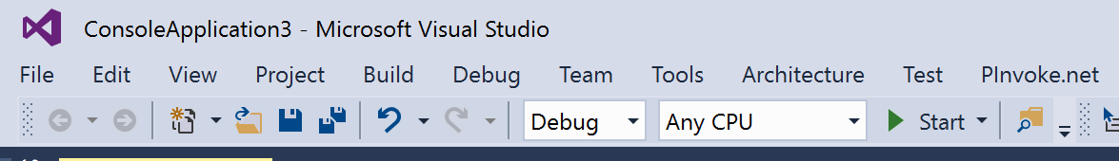
OS
Windows API
Access PInvoke.net directly from within Visual Studio
https://marketplace.visualstudio.com/items?itemName=vs-publisher-306627.PInvokenetVisualStudioExtension

Slide 3
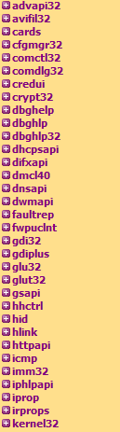

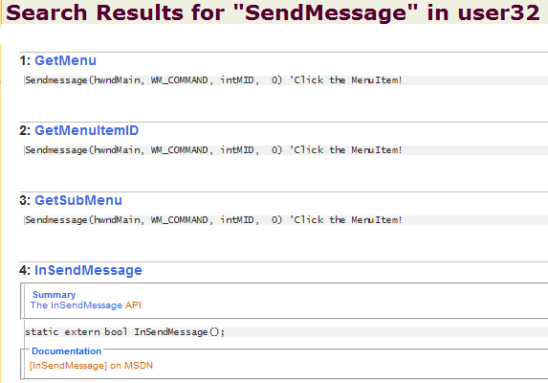
OS
Windows API

Slide 4
OS
Windows API
Import function Win32 to .Net
using System;
using System.Runtime.InteropServices;
namespace MessageBox
{
class Program
{
[DllImport("user32.dll", EntryPoint = "MessageBox", SetLastError = true, CharSet = CharSet.Auto)]
public static extern int MessageBox(int hWnd, String strMessage, String strCaption, uint uiType);
static void Main(string[] args)
{
MessageBox(0,"Calling function Win32 !",".NET",0);
}
}
}

Slide 5
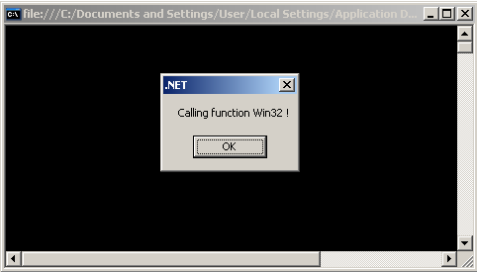
OS
Windows API

