Slide 1
OS
Windows API
The Windows API (WinAPI), is Microsoft's core set of application programming interfaces (APIs) available in the Microsoft Windows
operating systems.
The name Windows API collectively refers to a number of different platform implementations that are often referred to by their own names (for example, Win32 API).
Almost all Windows programs interact with the Windows API
Waze API, Google API, OpenGL API, DirectX API, Unix API, Java platform API, IOS API,…

Slide 2
OS
Windows API
Versions
Win16 is the API for the first, 16-bit versions.
Win32 is the 32-bit API for modern versions of Windows. The API consists of functions implemented, as with Win16, in system DLLs. The core DLLs of Win32 are kernel32.dll, user32.dll, and gdi32.dll. Win32 was introduced with Windows NT. The version of Win32 shipped with Windows 95 .
Win64 is the variant of the API implemented on 64-bit platforms of the Windows architecture (as of 2011 AMD64 and IA-64)
WinCE is the implementation of the Windows API for the Windows CE

Slide 3
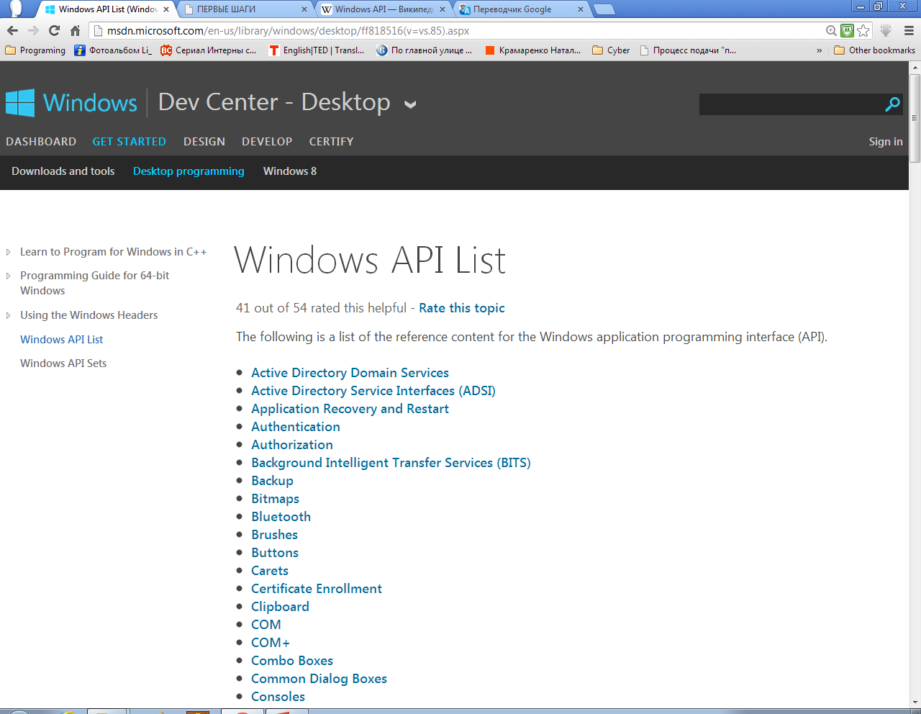
OS
Windows API
Windows API List

Slide 4

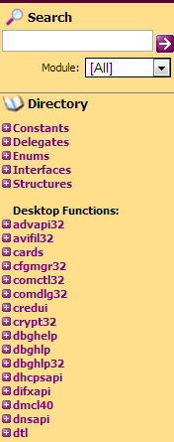
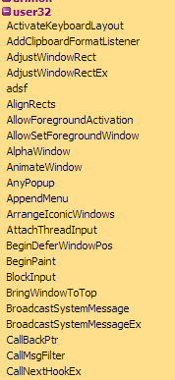
OS
Windows API
Kernel32.dll – files
Addvapi.dll – register
Gdi32.dll – graphics
Comdlg32.dll – windows
Netapi32 – sockets
Msvcrt.dll – “C”
User32.dll –
GDI32 – Graphics Device Interface
GDI+ - subsystem of the Windows XP

Slide 5
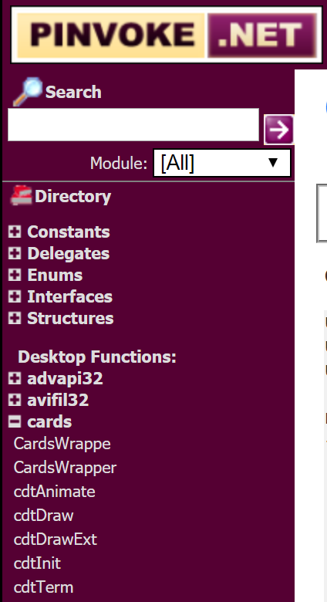

OS
Windows API

