Slide 1

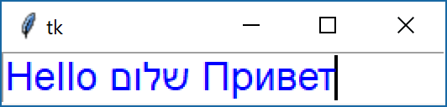
Tkinter
Entry
The Entry widget is a standard Tkinter widget used to enter or display a single line of text.
import tkinter as tk
root = tk.Tk()
entry1=tk.Entry(root, font='Arial 18', fg='blue')
entry1.pack()
root.mainloop()

Slide 2
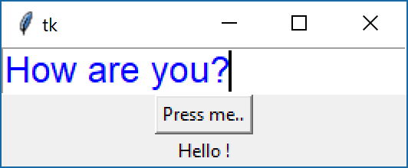
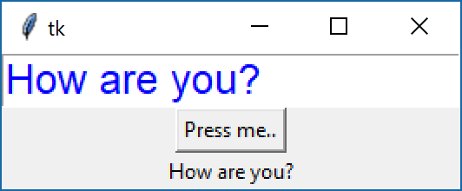
Tkinter
import tkinter as tk
root = tk.Tk()
def test():
lbl1['text'] = entry1.get()
entry1 = tk.Entry(root, font='Arial 18', fg='blue')
entry1.pack()
btn1 = tk.Button(root,text='Press me..', command=test)
btn1.pack()
lbl1 = tk.Label(root,text='Hello !')
lbl1.pack()
root.mainloop()

Slide 3
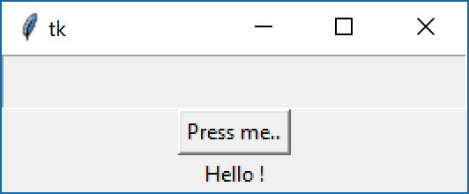
Tkinter
entry1['state']=DISABLED
import tkinter as tk
root = tk.Tk()
def test():
lbl1["text"] = entry1.get()
entry1 = tk.Entry(root, font='Arial 18', fg='blue')
entry1.pack()
entry1['state'] = tk.DISABLED
btn1 = tk.Button(root,text='Press me..', command=test)
btn1.pack()
lbl1 = tk.Label(root,text='Hello !')
lbl1.pack()
root.mainloop()

Slide 4
Tkinter
Calculator
import tkinter as tk
root = tk.Tk()
def calculate():
lbl1["text"] = int(num1.get()) + int(num2.get())
num1 = tk.Entry(root, font='Arial 18', fg='blue')
num1.pack()
num2 = tk.Entry(root, font='Arial 18', fg='blue')
num2.pack()
btn1 = tk.Button(root,text='Calculate', command=calculate)
btn1.pack()
lbl1 = tk.Label(root,text='Hello !')
lbl1.pack()
root.mainloop()

Slide 5
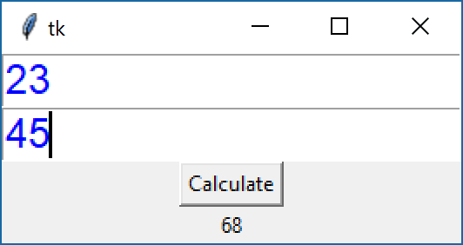
Tkinter
Calculator

Slide 6
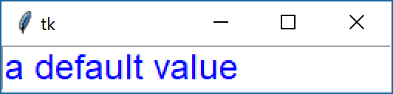
Tkinter
delete, insert
To add entry text to the widget, use the insert method. To replace the current text, you can call delete before you insert the new text.
import tkinter as tk
root = tk.Tk()
txt = tk.Entry(root, font='Arial 18', fg='blue')
txt.delete(0, tk.END)
txt.insert(0, "a default value")
txt.pack()
root.mainloop()

Slide 7
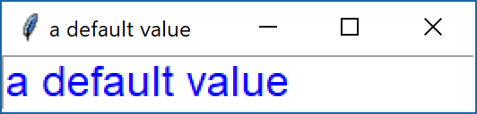
Tkinter
get
To fetch the current entry text, use the get method:
import tkinter as tk
root = tk.Tk()
txt = tk.Entry(root, font='Arial 18', fg='blue')
txt.delete(0, tk.END)
txt.insert(0, "a default value")
txt.pack()
root.title(txt.get())
root.mainloop()

Slide 8
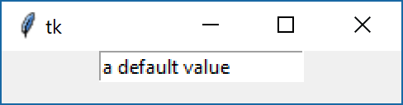
Tkinter
StringVar
You can also bind the entry widget to a StringVar instance, and set or get the entry text via that variable:
import tkinter as tk
root = tk.Tk()
v = tk.StringVar()
txt = tk.Entry(root,textvariable=v)
txt.pack()
v.set("a default value")
s = v.get()
root.mainloop()

