Slide 1

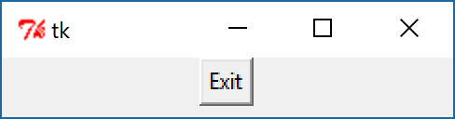
Tkinter
Button
import tkinter as tk
root = tk.Tk()
btn1 = tk.Button(root, text='Exit', command=exit)
btn1.pack()
root.mainloop()

Slide 2
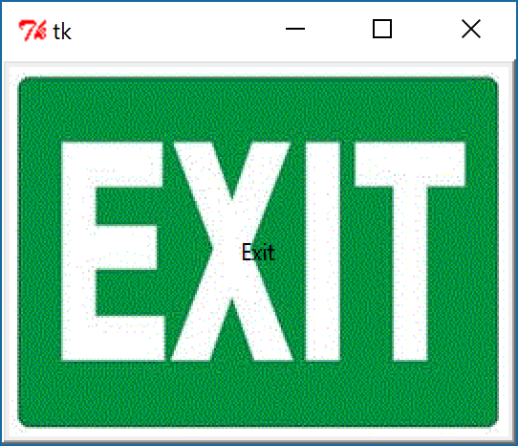
Tkinter
Button
import tkinter as tk
root = tk.Tk()
imgExit = tk.PhotoImage(file='Exit.gif')
btn1 = tk.Button(root, text='Exit',image = imgExit,compound = tk.CENTER, command=exit)
btn1.pack()
root.mainloop()

Slide 3
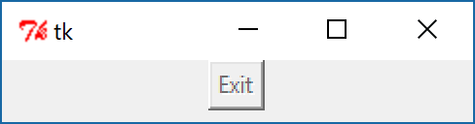
Tkinter
Button
import tkinter as tk
root = tk.Tk()
btn1 = tk.Button(root, text='Exit',state = tk.DISABLED, command=exit)
btn1.pack()
root.mainloop()

Slide 4

Tkinter
Button
import tkinter as tk
def my_quit():
print ('Hello, I must be going...’)
root.destroy()
root = tk.Tk()
btn1 = tk.Button(root, text=' Exit ', command=my_quit)
btn1.pack()
root.mainloop()
Hello, I must be going...

Slide 5
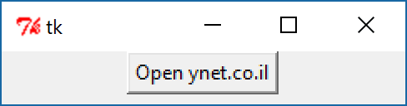

Tkinter
from tkinter import *
import os
def open_www():
os.system("start \"\" http://ynet.co.il")
root = Tk()
btn1=Button(root, text='Open ynet.co.il', command=open_www)
btn1.pack(side=TOP)
root.mainloop()

Slide 6
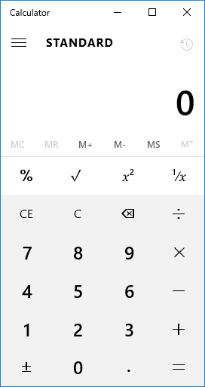
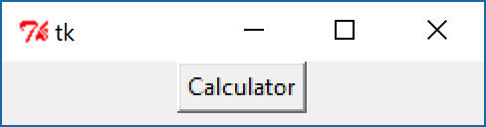
Tkinter
import Tkinter as tk
import os
def open_calc():
os.system("start \"\" calc")
root = tk.Tk()
btn1 = tk.Button(root, text='Calculator', command=open_calc)
btn1.pack()
root.mainloop()

Slide 7
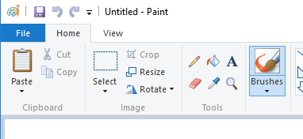
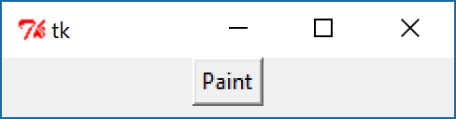
Tkinter
import Tkinter as tk
import os
def open_paint():
os.system("start \"\" mspaint")
root = tk.Tk()
btn1 = tk.Button(root, text='Paint', command=open_paint)
btn1.pack()
root.mainloop()

Slide 8
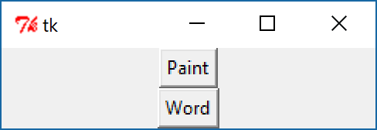
Tkinter
import Tkinter as tk
import os
def open_app(app):
command ='start ' + app
os.system(command)
root = tk.Tk()
btn_paint = tk.Button(root, text='Paint', command =lambda: open_app('mspaint'))
btn_paint.pack()
btn_wordpad = tk.Button(root, text='Word', command =lambda: open_app('wordpad'))
btn_wordpad.pack()
root.mainloop()

Slide 9
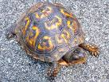
Tkinter
Arrange the widgets according to the picture.
Easy

Slide 10
Tkinter
Arrange the widgets according to the picture.
Medium

Slide 11
Tkinter
Arrange the widgets according to the picture.
Hard

Slide 12

Tkinter
Arrange the widgets according to the picture.
יצירתיות

