Slide 1


Tkinter
Grid Geometry Manager
from tkinter import *
root=Tk()
l1=Label(root,text="Label 1",relief=RIDGE)
l1.grid(row=0, column=1, sticky=NSEW)
l2=Label(root,text="Label 2",relief=RIDGE)
l2.grid(row=1, column=0, sticky=NSEW)
root.mainloop()

Slide 2
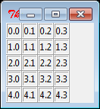
Tkinter
from tkinter import *
root=Tk()
for i in range(5):
for j in range(4):
l=Label(root,text="%d.%d"%(i,j),relief=RIDGE)
l.grid(row=i, column=j, sticky=NSEW)
root.mainloop()

Slide 3
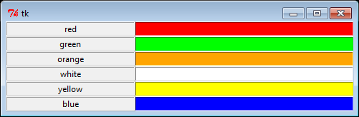
Tkinter
from tkinter import *
root=Tk()
colors = ['red', 'green', 'orange', 'white', 'yellow', 'blue']
r=0
for c in colors:
Label(root,text=c, relief=RIDGE, width=25).grid(row=r, column=0)
Entry(root,bg=c, relief=SUNKEN, width=50).grid(row=r, column=1)
r=r+1
root.mainloop()

