Slide 1

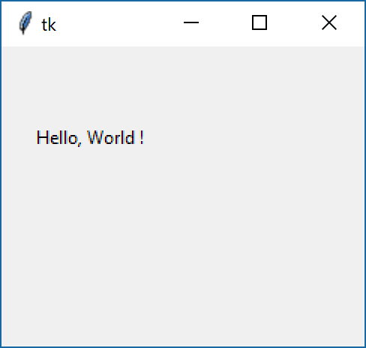
Tkinter
Layout management in Tkinter
Absolute positioning.
import tkinter as tk
root = tk.Tk()
lb1 = tk.Label(root,text="Hello, World !")
lb1.place(x=20, y=50)
root.mainloop()
20x50

Slide 2
Tkinter
Pack Geometry Manager
Python - Widget
JAVA – Components
Microsoft (C#) - Controls
The Pack geometry manager packs widgets in rows or columns. You can use options like fill, expand, and side to control this geometry manager.

Slide 3
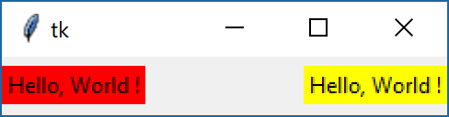
Tkinter
Pack Geometry Manager
import tkinter as tk
root = tk.Tk()
lb1 = tk.Label(root, bg='red',text="Hello, World !")
lb2 = tk.Label(root,bg='yellow',text="Hello, World !")
lb1.pack(side="left")
lb2.pack(side="right")
root.mainloop()

Slide 4
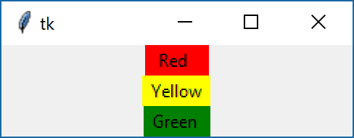
Tkinter
Pack Geometry Manager
import tkinter as tk
root = tk.Tk()
lb1 = tk.Label(root, bg='red', text=" Red ")
lb2 = tk.Label(root,bg='yellow',text=" Yellow ")
lb3 = tk.Label(root,bg='green', text=" Green ")
lb1.pack()
lb2.pack()
lb3.pack()
root.mainloop()

Slide 5
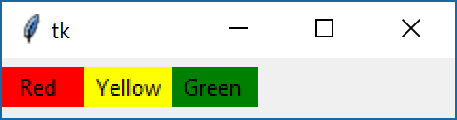
Tkinter
Pack Geometry Manager
import tkinter as tk
root = tk.Tk()
lb1 = tk.Label(root, bg='red', text=" Red ")
lb2 = tk.Label(root,bg='yellow',text=" Yellow ")
lb3 = tk.Label(root,bg='green', text=" Green ")
lb1.pack(side = tk.LEFT)
lb2.pack(side = tk.LEFT)
lb3.pack(side = tk.LEFT)
root.mainloop()
side: TOP (default), BOTTOM, LEFT, or RIGHT.

Slide 6
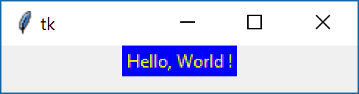
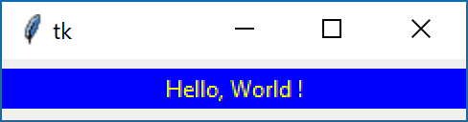
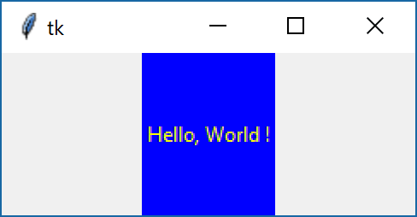
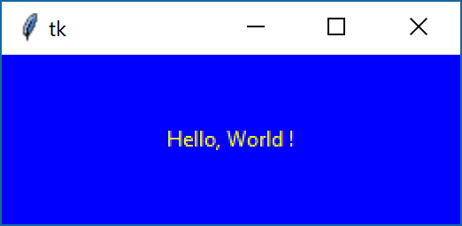
Tkinter
Pack Geometry Manager
lb.pack()
lb.pack(expand="YES", fill="x" )
lb.pack(expand="YES", fill="y" )
lb.pack(expand="YES", fill="both" )

Slide 7
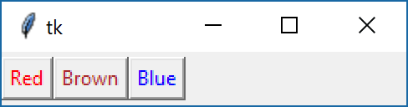
Tkinter
Frame.
The Frame widget is very important for the process of grouping and organizing other widgets.
import tkinter as tk
root = tk.Tk()
frame = tk.Frame(root)
frame.pack(side = tk.LEFT)
redbutton = tk.Button(frame, text="Red", fg="red")
redbutton.pack(side = tk.LEFT)
greenbutton = tk.Button(frame, text="Brown", fg="brown")
greenbutton.pack(side = tk.LEFT)
bluebutton = tk.Button(frame, text="Blue", fg="blue")
bluebutton.pack(side = tk.LEFT)
root.mainloop()

Slide 8
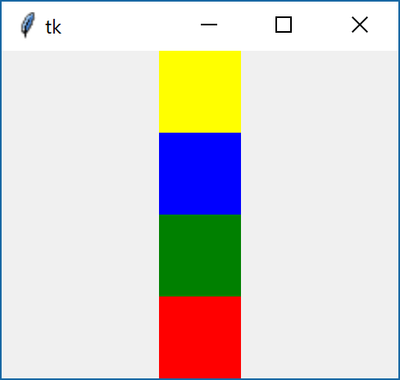
Tkinter
Arrange the widgets according to the picture.
Easy

Slide 9
Tkinter
Arrange the widgets according to the picture.
Easy
import tkinter as tk
root = tk.Tk()
f_1 = tk.Frame(root,width=50,height=50,bg="Yellow")
f_2 = tk.Frame(root,width=50,height=50,bg="Blue")
f_3 = tk.Frame(root,width=50,height=50,bg="Green")
f_4 = tk.Frame(root,width=50,height=50,bg="Red")
f_1.pack()
f_2.pack()
f_3.pack()
f_4.pack()
root.mainloop()

Slide 10
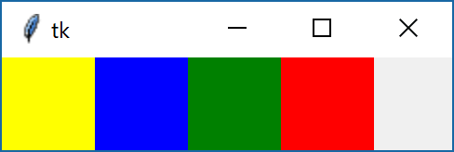
Tkinter
Arrange the widgets according to the picture.
Easy

Slide 11
Tkinter
Arrange the widgets according to the picture.
Easy
import tkinter as tk
root = tk.Tk()
f_1 = tk.Frame(root,width=50,height=50,bg="Yellow")
f_2 = tk.Frame(root,width=50,height=50,bg="Blue")
f_3 = tk.Frame(root,width=50,height=50,bg="Green")
f_4 = tk.Frame(root,width=50,height=50,bg="Red")
f_1.pack(side=tk.LEFT)
f_2.pack(side=tk.LEFT)
f_3.pack(side=tk.LEFT)
f_4.pack(side=tk.LEFT)
root.mainloop()

Slide 12
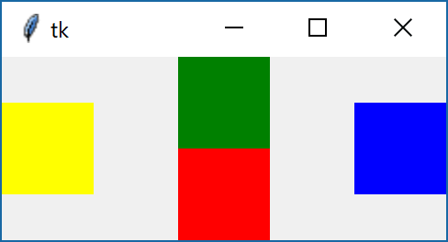
Tkinter
Arrange the widgets according to the picture.
Medium

Slide 13
Tkinter
Arrange the widgets according to the picture.
Medium
import tkinter as tk
root = tk.Tk()
f_1 = tk.Frame(root,width=50,height=50,bg="Yellow")
f_2 = tk.Frame(root,width=50,height=50,bg="Blue")
f_3 = tk.Frame(root,width=50,height=50,bg="Green")
f_4 = tk.Frame(root,width=50,height=50,bg="Red")
f_1.pack(side=tk.LEFT)
f_2.pack(side=tk.RIGHT)
f_3.pack(side=tk.TOP)
f_4.pack(side=tk.BOTTOM)
root.mainloop()

Slide 14
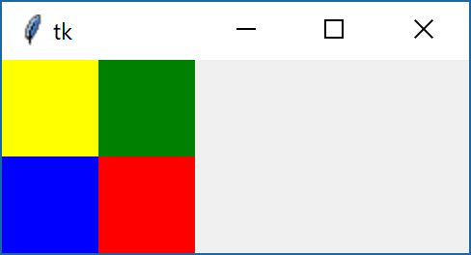
Tkinter
Arrange the widgets according to the picture.
Hard

Slide 15
Tkinter
Arrange the widgets according to the picture.
Hard
import tkinter as tk
root = tk.Tk()
f_01=tk.Frame(root)
f_02=tk.Frame(root)
f_1=tk.Frame(f_01,width=50,height=50,bg="Yellow")
f_2=tk.Frame(f_01,width=50,height=50,bg="Blue")
f_3=tk.Frame(f_02,width=50,height=50,bg="Green")
f_4=tk.Frame(f_02,width=50,height=50,bg="Red")
f_01.pack(side=tk.LEFT)
f_02.pack(side=tk.LEFT)
f_1.pack()
f_2.pack()
f_3.pack()
f_4.pack()
root.mainloop()

Slide 16
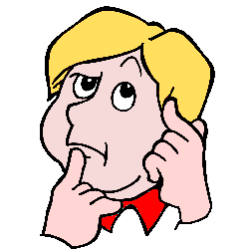
Tkinter
Arrange the widgets according to the picture.
יצירתיות

