Slide 1

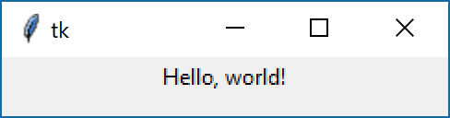
Tkinter
Label תווית
The Label widget is a standard Tkinter widget used to display a text or image on the screen.
import tkinter as tk
root = tk.Tk()
lb = tk.Label(root, text="Hello, world!")
lb.pack()
root.mainloop()

Slide 2
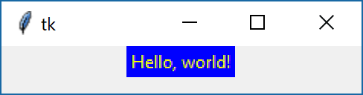
Tkinter
background, foreground
Background and foreground colors. A synonym for background is bg; a synonym for foreground is fg
import tkinter as tk
root = tk.Tk()
lb = tk.Label(root, text="Hello,world!",bg="blue",fg="yellow")
lb.pack()
root.mainloop()

Slide 3
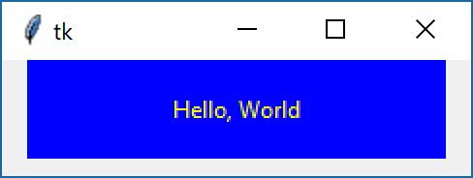
Tkinter
width, height
Background and foreground colors. A synonym for background is bg; a synonym for foreground is fg
import tkinter as tk
root = tk.Tk()
root.geometry("%dx%d" %(80,60))
lbl = tk.Label(root, text="Hello, World",bg="blue",fg="yellow",width=30, height=3)
lbl.pack()
root.mainloop()

Slide 4
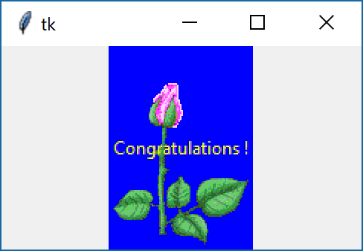
Tkinter
Image & text
The PhotoImage class can read GIF and PGM/PPM images from files.
import tkinter as tk
root = tk.Tk()
img = tk.PhotoImage(file='d:\\Rose.gif')
lbl = tk.Label(root, image = img, text="Congratulations !",compound = tk.CENTER,bg="blue",fg="yellow")
lbl.pack()
root.mainloop()

Slide 5
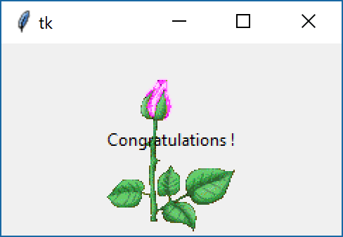
Tkinter
Image & text
The PhotoImage class can read GIF and PGM/PPM images from files.
import tkinter as tk
root = tk.Tk()
img = tk.PhotoImage(file='d:\\Rose.gif')
lbl = tk.Label(root, image = img, text="Congratulations !",compound = tk.CENTER)
lbl.pack()
root.mainloop()

Slide 6
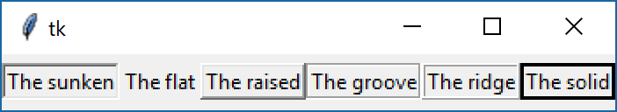
Tkinter
relief
Specifies a 3-D border for the widget.
import tkinter as tk
root = tk.Tk()
lb1 = tk.Label(root,text="The sunken",relief="sunken")
lb2 = tk.Label(root,text="The flat",relief="flat")
lb3 = tk.Label(root,text="The raised",relief="raised")
lb4 = tk.Label(root,text="The groove",relief="groove")
lb5 = tk.Label(root,text="The ridge",relief="ridge")
lb6 = tk.Label(root,text="The solid",relief="solid")
lb1.pack(side = 'left')
lb2.pack(side = 'left')
lb3.pack(side = 'left')
lb4.pack(side = 'left')
lb5.pack(side = 'left')
lb6.pack(side = 'left')
root.mainloop()

Slide 7
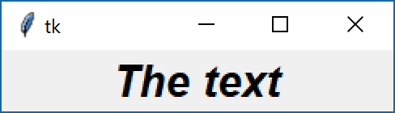
Tkinter
font
The font to use for text drawn inside the widget
import tkinter as tk
from tkinter import font
root = tk.Tk()
fnt= font.Font(family="Helvetica", size=20, weight=font.BOLD, slant=font.ITALIC)
lb1 = tk.Label(root,text="The text",font=fnt)
lb1.pack()
root.mainloop()

Slide 8
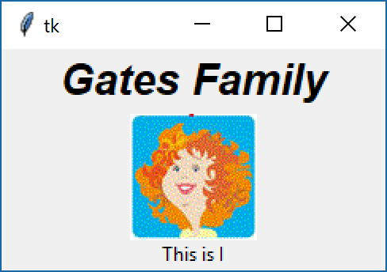
Tkinter
Arrange the widgets according to the picture.
Easy

Slide 9
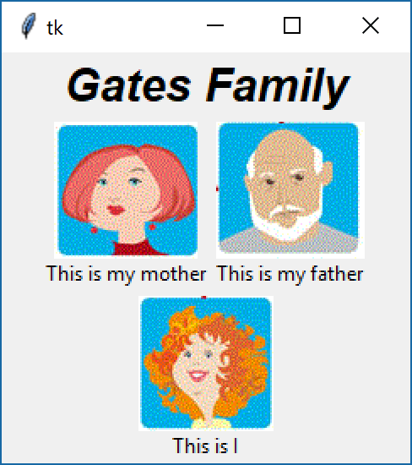
Tkinter
Arrange the widgets according to the picture.
Medium

Slide 10
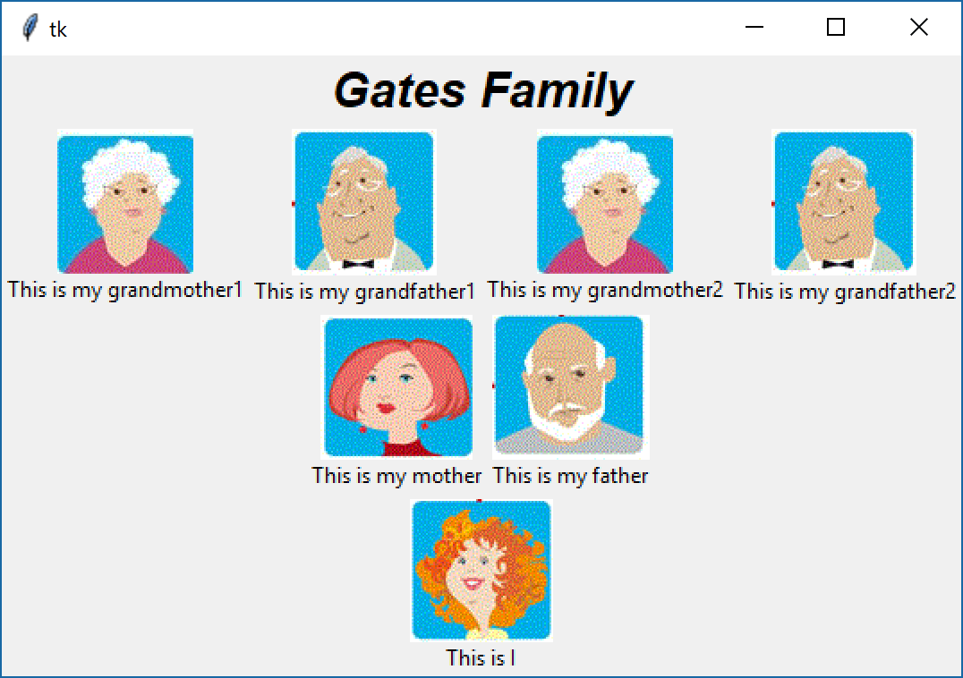
Tkinter
Arrange the widgets according to the picture.
Hard

Slide 11
Tkinter
Arrange the widgets according to the picture.
Hard
import tkinter as tk
from tkinter import font
root = tk.Tk()
fnt= font.Font(family="Helvetica", size=20, weight=font.BOLD, slant=font.ITALIC)
lb1 = tk.Label(root,text="Gates Family",font=fnt)
lb1.pack()
# Grandmothers and grandfathers
first_frame = tk.Frame(root)
first_frame.pack()
img_grandmother1 = tk.PhotoImage(file=r'images\grandmother1.gif')
lbl1 = tk.Label(first_frame, text ="This is my grandmother1", image = img_grandmother1,compound = tk.TOP);
lbl1.pack(side = 'left')
img_grandfather1 = tk.PhotoImage(file=r'images\grandfather1.gif')
lbl2 = tk.Label(first_frame, text ="This is my grandfather1",image = img_grandfather1,compound = tk.TOP);
lbl2.pack(side = 'left')
img_grandmother2 = tk.PhotoImage(file=r'images\grandmother2.gif')
lbl3 = tk.Label(first_frame, text ="This is my grandmother2", image = img_grandmother2,compound = tk.TOP);
lbl3.pack(side = 'left')
img_grandfather2 = tk.PhotoImage(file=r'images\grandfather2.gif')
lbl4 = tk.Label(first_frame, text ="This is my grandfather2",image = img_grandfather1,compound = tk.TOP);
lbl4.pack(side = 'left')
# Parents
second_frame = tk.Frame(root)
second_frame.pack()
img_mother = tk.PhotoImage(file=r'images\mother.gif')
lbl1 = tk.Label(second_frame, text ="This is my mother", image = img_mother,compound = tk.TOP);
lbl1.pack(side = 'left')
img_father = tk.PhotoImage(file=r'images\father.gif')
lbl2 = tk.Label(second_frame, text ="This is my father",image = img_father,compound = tk.TOP);
lbl2.pack(side = 'left')
# My
third_frame = tk.Frame(root)
third_frame.pack()
img_my = tk.PhotoImage(file=r'images\My.gif')
lbl = tk.Label(third_frame, text ="This is I",image = img_my,compound = tk.TOP);
lbl.pack(side = 'left')
root.mainloop()

Slide 12
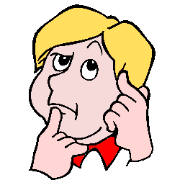
Tkinter
Arrange the widgets according to the picture.
יצירתיות

