Slide 1


Tkinter
from tkinter import *
root = Tk()
root.title('Timer')
sec = 0
def tick():
global sec
sec += 1
time['text'] = sec
# Take advantage of the after method of the Label
time.after(1000, tick)
time = Label(root, fg='green')
time.pack()
Button(root, fg='blue', text='Start', command=tick).pack()
root.mainloop()

Slide 2

Tkinter
from tkinter import *
import time
root = Tk()
root.title('Timer')
#root.state('zoomed')
def tick():
lb_time['text'] = time.strftime("%Y : %m : %d : %H : %M : %S")
# Take advantage of the after method of the Label
lb_time.after(1000, tick)
lb_time = Label(root, fg='yellow', bg='blue')
lb_time.pack()
Button(root, fg='blue', text='Start', command=tick).pack()
root.mainloop()

Slide 3
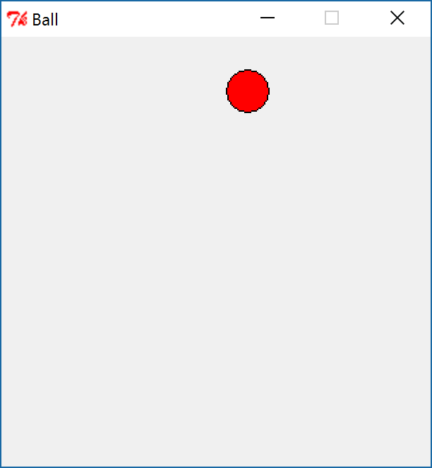
Tkinter
from tkinter import *
def move_ball():
global x, y, dx, dy
if x < r or x > w-r:
dx = -dx
if y < r or y > h-r:
dy = -dy
x = x + dx
y = y + dy
canvas.coords(ball, x-r, y-r, x+r, y+r)
canvas.after(5, move_ball)
root = Tk()
root.title("Ball")
root.resizable(False,False)
w = 300
h = 300
canvas = Canvas(root, width = w, height = h)
canvas.pack()
x = w/2
y = h/2
r =15
dx = 3
dy = 2
ball = canvas.create_oval(x-r, y-r, x+r, y+r, fill="red")
move_ball()
root.mainloop()

Slide 4
Tkinter
if y>HEIGHT:
is_bomb = False
#canvas.delete(bomb)
root.after_cancel(r)
r = root.after(3, bombing)

