Slide 1

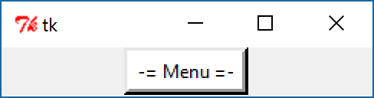
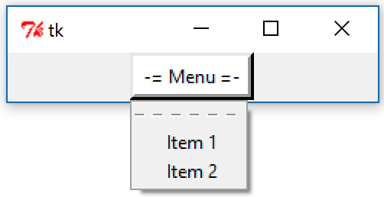
Tkinter
Menubutton

Slide 2
Tkinter
Menubutton
from tkinter import *
root = Tk()
mbutton = Menubutton(root, text='-= Menu =-')
items = Menu(mbutton)
mbutton.config(menu=items)
items.add_command(label='Item 1', command=root.quit)
items.add_command(label='Item 2', command=root.quit)
mbutton.pack()
mbutton.config(bg='white', bd=4, relief=RAISED)
root.mainloop()

Slide 3
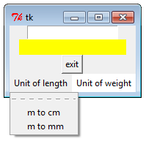
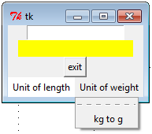
Tkinter
Menubutton

Slide 4
Tkinter
from tkinter import *
root=Tk()
def convertM2CM():
if inputNumber.get()!="":
lb1["text"]=inputNumber.get()+" m = " +str(int(inputNumber.get())*100)+" cm"
def convertM2MM():
lb1["text"]=int(inputNumber.get())*1000
def convertKG2G():
lb1["text"]=inputNumber.get()+" kg = " +str(int(inputNumber.get())*1000)+" g"
inputNumber=Entry(root, text="Enter number")
inputNumber.pack()
lb1=Label(root,bg="yellow", width=20)
lb1.pack()
btnExit=Button(root,text="exit",command=quit)
btnExit.pack()
continue

Slide 5
Tkinter
#-----------------------------------------
mbLength=Menubutton(root, text='Unit of length',bg="white")
mbLength.pack(side=LEFT)
mbLength.menu = Menu(mbLength)
mbLength.menu.add_command(label="m to cm", command=convertM2CM)
mbLength.menu.add_command(label="m to mm", command=convertM2MM)
mbLength['menu'] = mbLength.menu
#----------------------------------------
mbWeight=Menubutton(root, text='Unit of weight',bg="white")
mbWeight.pack(side=LEFT)
mbWeight.menu = Menu(mbWeight)
mbWeight.menu.add_command(label="kg to g", command=convertKG2G)
mbWeight['menu'] = mbWeight.menu
#----------------------------------------------
root.mainloop()
The end

Slide 6
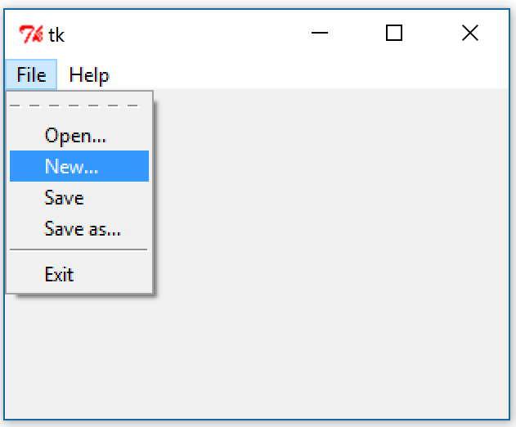
Tkinter

Slide 7
Tkinter
from tkinter import *
from tkinter import messagebox
import sys
def check_menu(item):
print(item)
def about():
messagebox.showinfo("TkMenu","The TkMenu v. 1.0")
root=Tk()
bar=Menu(root)
filem = Menu(bar)
filem.add_command(label="Open...", command = lambda : check_menu('open'))
filem.add_command(label="New...", command =lambda : check_menu('new'))
filem.add_command(label="Save", command =lambda : check_menu('save'))
filem.add_command(label="Save as...", command =lambda : check_menu('saveas'))
filem.add_separator()
filem.add_command(label="Exit", command=exit)
continue

Slide 8
Tkinter
helpm = Menu(bar)
helpm.add_command(label="Index...", command = lambda : check_menu('index'))
helpm.add_separator()
helpm.add_command(label="About", command = about)
bar.add_cascade(label="File", menu=filem)
bar.add_cascade(label="Help", menu=helpm)
root.config(menu=bar)
root.mainloop()
end

