Slide 1


Tkinter
scale
from tkinter import *
root=Tk()
global scl
n=1
def sqr(value):
lb1["text"]=int(value)*int(value)
lb1=Label(root,bg="yellow", width=20)
lb1.pack()
intVar =IntVar()
scl=Scale(root, orient=HORIZONTAL,from_=0,to=200,variable=intVar, command=sqr)
scl.pack(side=LEFT)
root.mainloop()

Slide 2
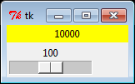
Tkinter
scale

