Slide 1


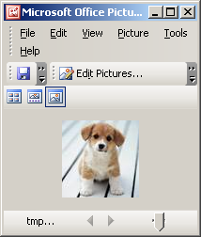
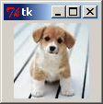
PIL & TKInter
Python Imaging Library & TKINTER

Slide 2
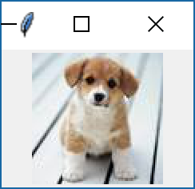
PIL & TKInter
The ImageTk Module
The ImageTk module contains support to create and modify Tkinter BitmapImage and PhotoImage objects from PIL images
from tkinter import *
from PIL import Image, ImageDraw, ImageTk
root = Tk()
#Opens and identifies the given image file.
imageFile = Image.open("d:\Dog.jpg")
#Creates a Tkinter-compatible photo image
img=ImageTk.PhotoImage(imageFile)
lbl1=Label(root, image=img)
lbl1.pack(side=TOP)
root.mainloop()

Slide 3
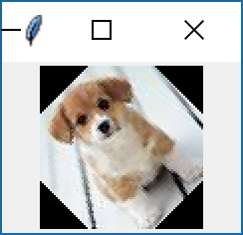
PIL & TKInter
from tkinter import *
from PIL import Image, ImageDraw, ImageTk
root = Tk()
imageFile = Image.open("d:\Dog.jpg")
newImage=imageFile.rotate(45)
img=ImageTk.PhotoImage(newImage)
lbl1=Label(root, image=img)
lbl1.pack(side=TOP)
root.mainloop()

Slide 4
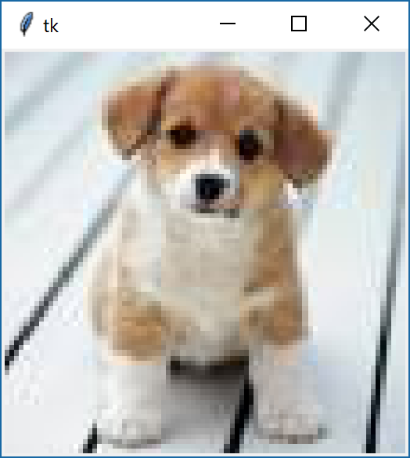
PIL & TKInter
from tkinter import *
from PIL import Image, ImageDraw, ImageTk
root = Tk()
imageFile = Image.open("d:\Dog.jpg")
newImage=imageFile.resize((256,256))
img=ImageTk.PhotoImage(newImage)
lbl1=Label(root, image=img)
lbl1.pack(side=TOP)
root.mainloop()

Slide 5
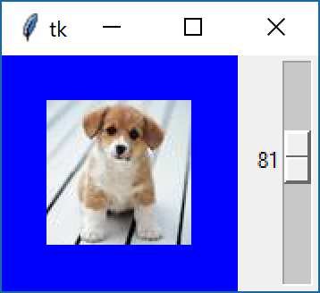
PIL & TKInter
from tkinter import *
from PIL import Image, ImageDraw, ImageTk
def Update(event):
global newPhotoImg
newImage=image.resize((VolumeWidget.get(),VolumeWidget.get()))
newPhotoImg=ImageTk.PhotoImage(newImage)
lbl1["image"]=newPhotoImg
root = Tk()
image = Image.open("d:\Dog.jpg")
lbl1=Label(root,width=128, height=128, text="The Image",bg="blue",fg="yellow")
lbl1.grid(row=0, column=0, sticky=NSEW)
VolumeWidget=Scale(root, from_=1,to=200,orient=VERTICAL, command=Update)
VolumeWidget.grid(row=0, column=1, sticky=NSEW)
root.mainloop()

Slide 6
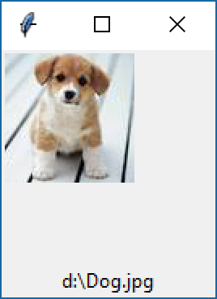
PIL & TKInter
from tkinter import *
from PIL import Image, ImageDraw, ImageTk
filename = "d:\Dog.jpg"
tk = Tk()
c = Canvas(tk, width=128, height=128)
src_img = Image.open(filename)
img = ImageTk.PhotoImage(src_img)
c.create_image(0, 0, image=img, anchor="nw")
c.pack()
Label(tk, text=filename).pack()
tk.mainloop()

Slide 7
PIL & TKInter
חברים שלי
כלב שלי
משפחה שלי
לפחות 5 תמונות !!!
חתול שלי
כיתה שלי
זה מעניין !

