Slide 1
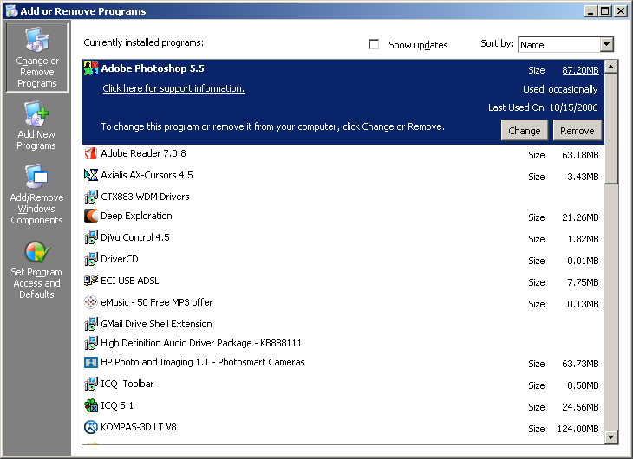
OS
Microsoft Registry Editor
Windows stores its configuration information in a database.
http://www.microsoft.com/technet/prodtechnol/windows2000serv/reskit/regentry/69675.mspx?mfr=true

Slide 2
OS
Microsoft Registry Editor
Using Regedit.exe
The Microsoft Registry Editor (regedit.exe) enables you to view, search for, and change settings in your system registry, which contains information about how your computer runs. Although you can use Registry Editor to inspect and modify the registry, doing so is not recommended, as making incorrect changes can damage your system.
To start Regedit.exe
1. Click Start, and then click Run.
2. Type Regedit, and then click OK.

Slide 3

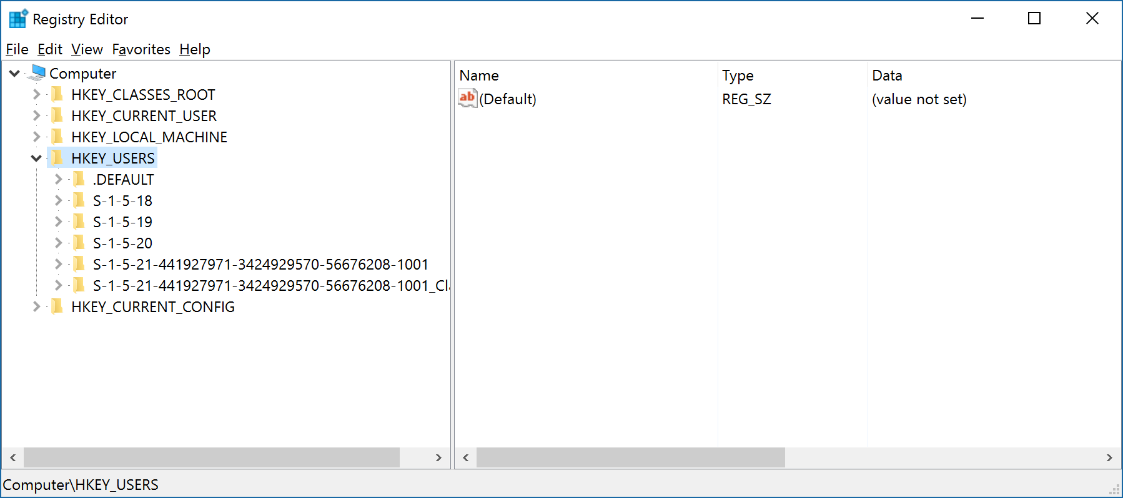
OS
Microsoft Registry Editor
Registry Editor

Slide 4
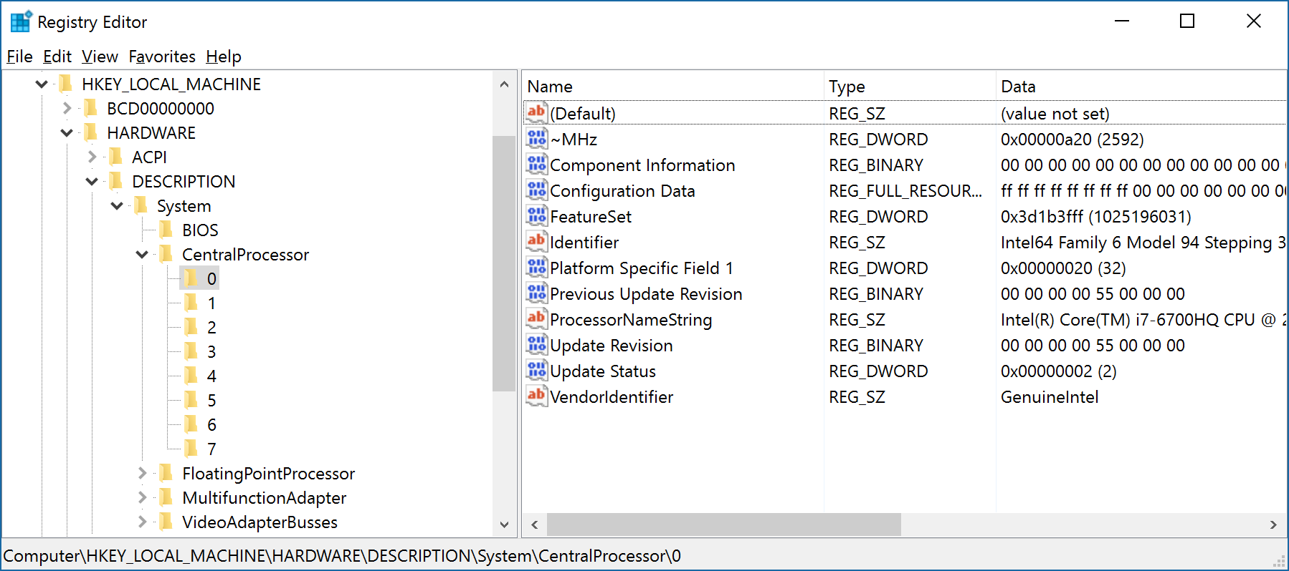
OS
Microsoft Registry Editor

Slide 5
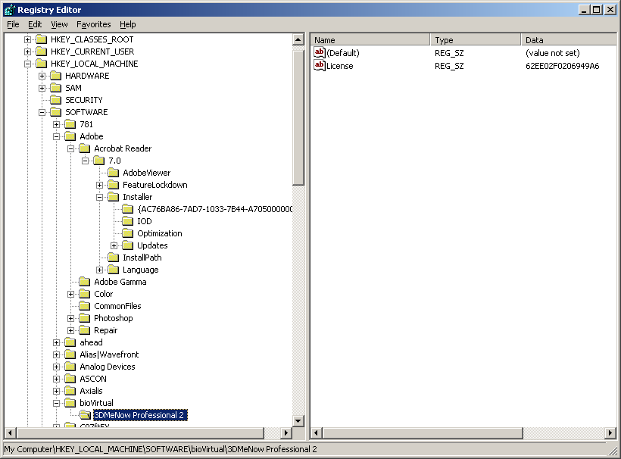
OS
Microsoft Registry Editor

Slide 6
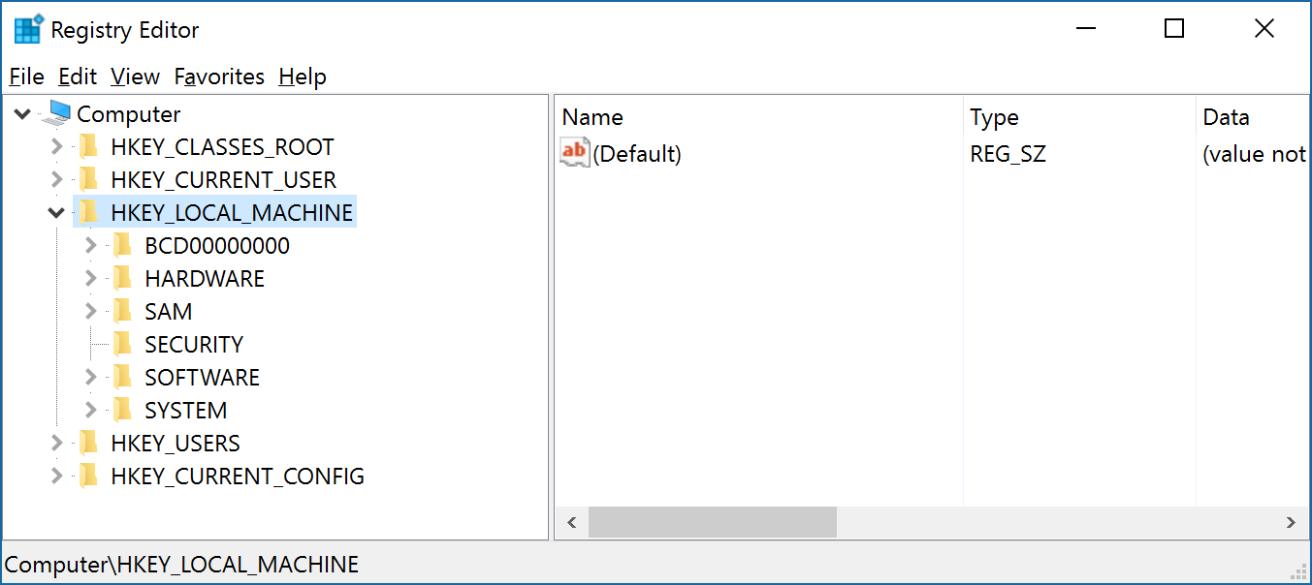
OS
Microsoft Registry Editor
HKEY_LOCAL_MACHINE
Contains information about the local computer system, including hardware and operating system data, such as bus type, system memory, device drivers, and startup control parameters.

Slide 7
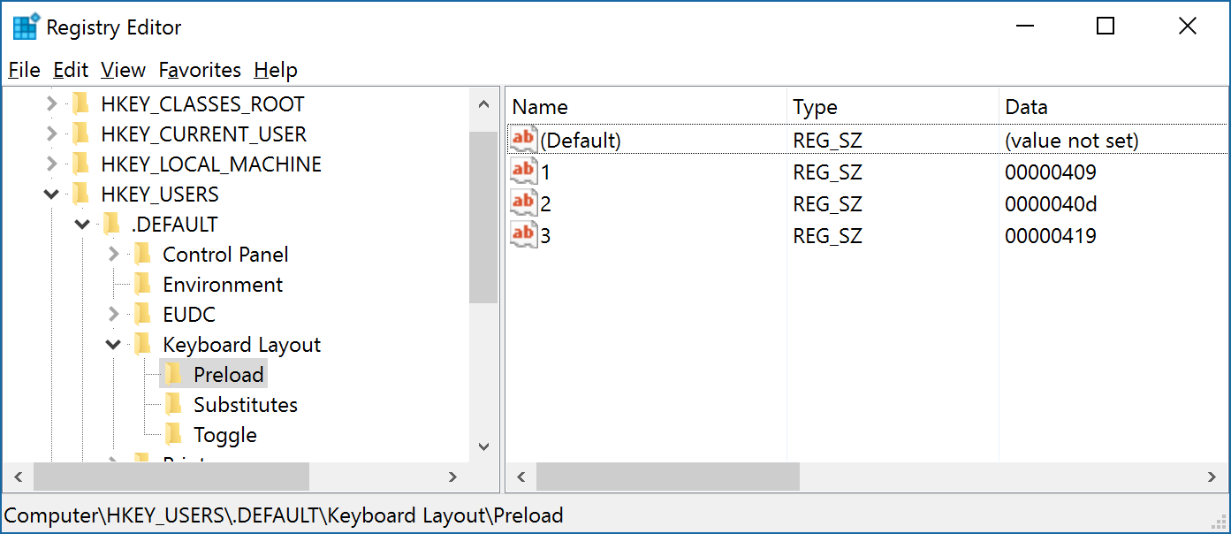
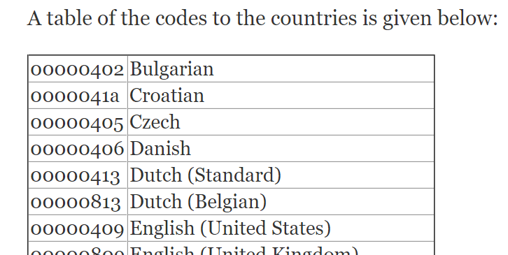
OS
Microsoft Registry Editor
HKEY_USERS
Contains all actively loaded user profiles

Slide 8
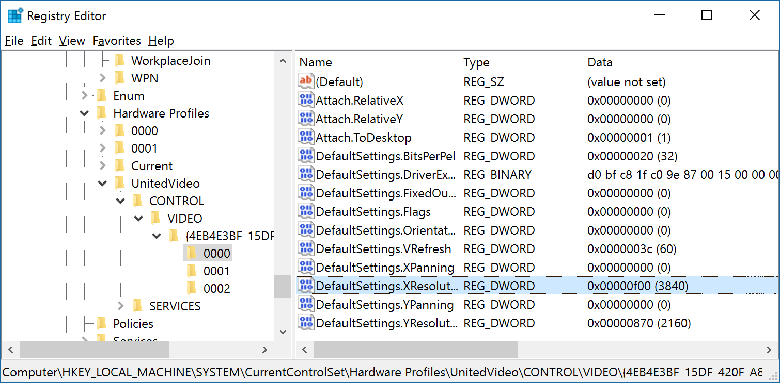
OS
Microsoft Registry Editor
HKEY_CURRENT_CONFIG
Stores configuration data for the current hardware profile
HKEY_CURRENT_CONFIG is a shortcut to the HKEY_LOCAL_MACHINE.

Slide 9
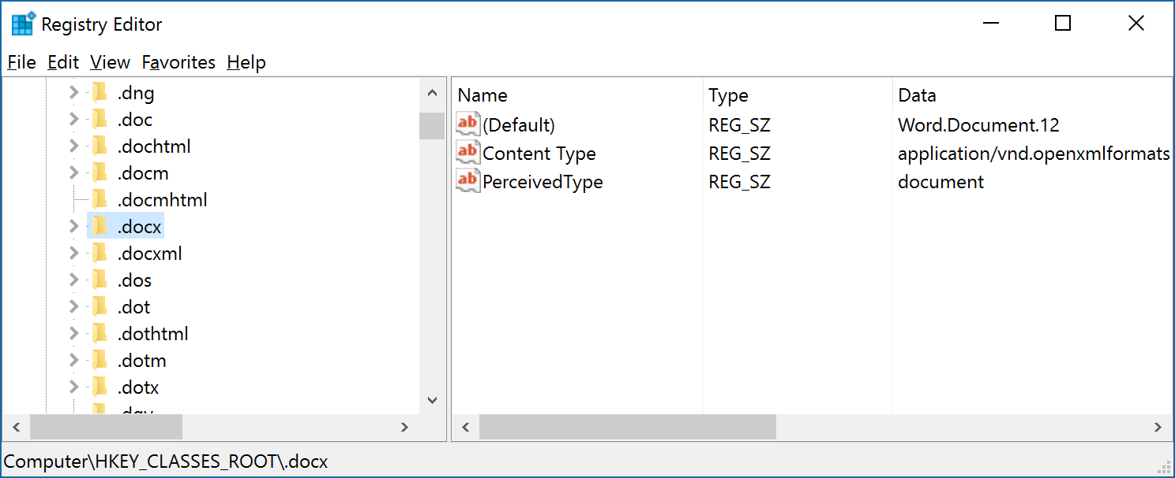
OS
Microsoft Registry Editor
HKEY_CLASSES_ROOT
Data that associates file types with programs

Slide 10
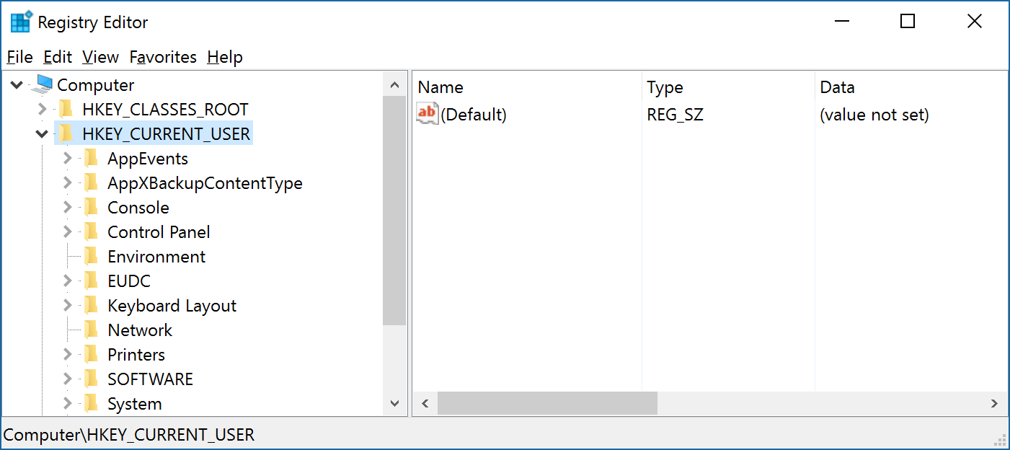
OS
Microsoft Registry Editor
HKEY_CURRENT_USER
Contains the user profile for the user who is currently logged on to the computer

Slide 11
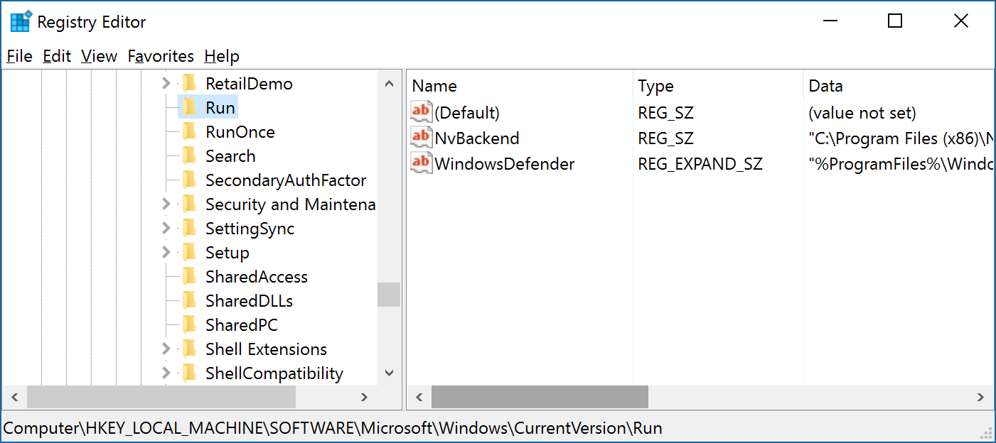
OS
Microsoft Registry Editor
HKEY_LOCAL_MACHINE
SOFTWARE
MICROSOFT
WINDOWS
CURRENT VERSION
RUN

Slide 12
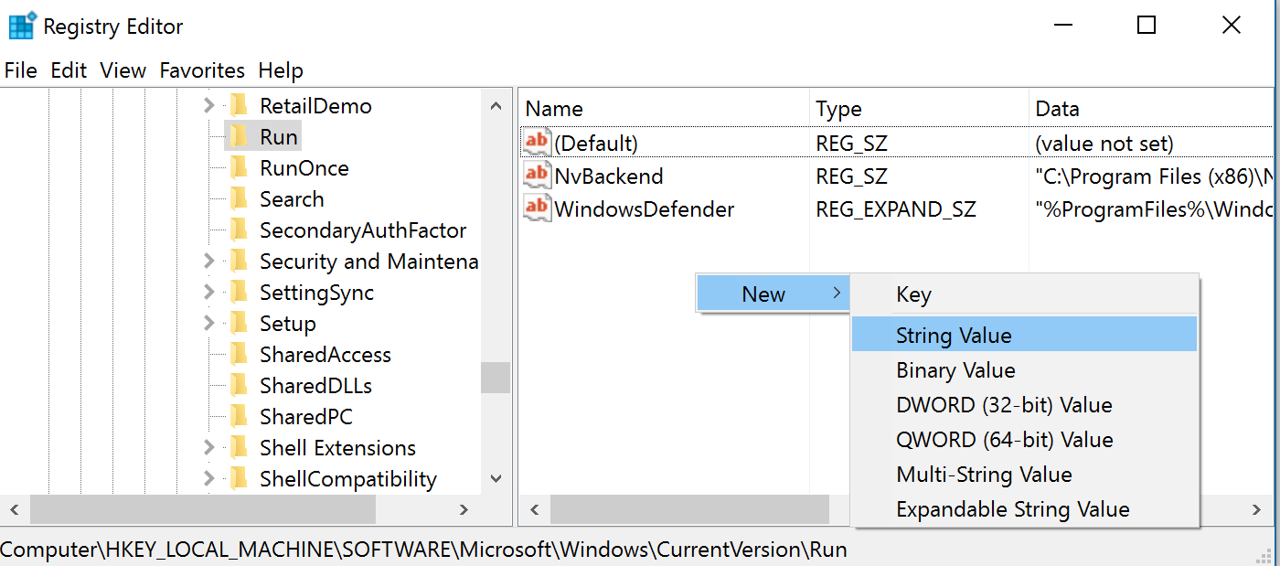
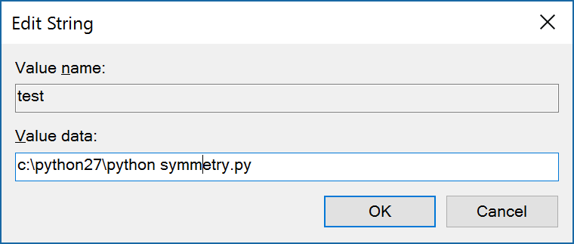
OS
Microsoft Registry Editor

Slide 13
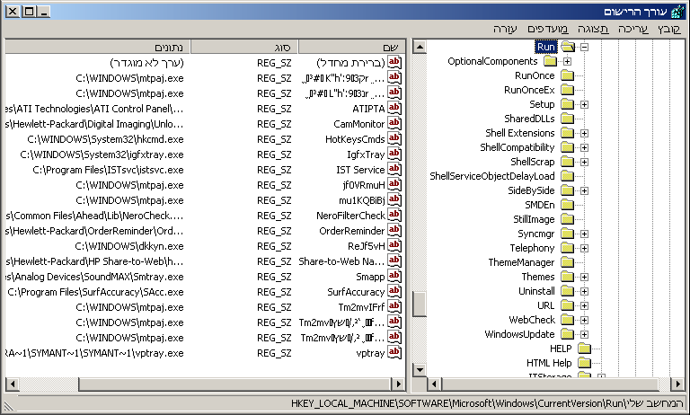
OS
Microsoft Registry Editor

Slide 14
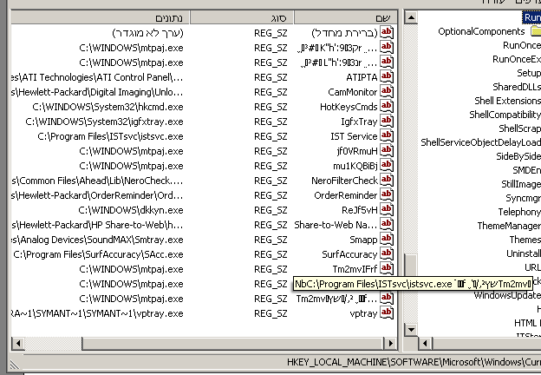
OS
Microsoft Registry Editor

Slide 15

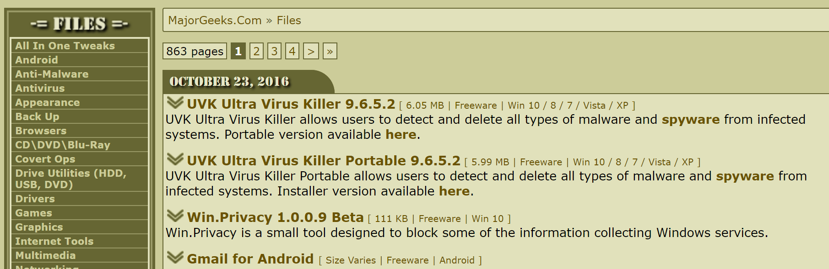
OS
Microsoft Registry Editor
http://www.majorgeeks.com/files/index.html

Slide 16
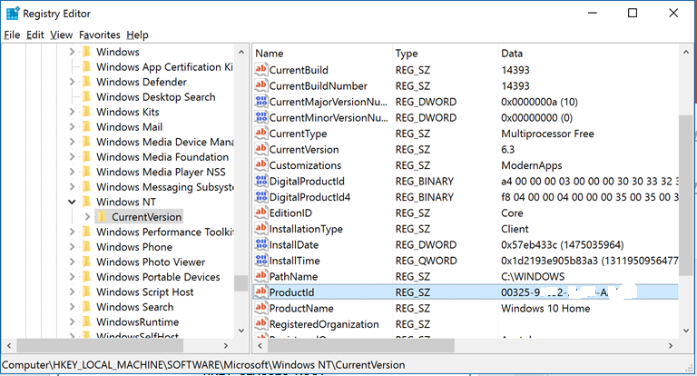
OS
Microsoft Registry Editor
Windows current version

Slide 17
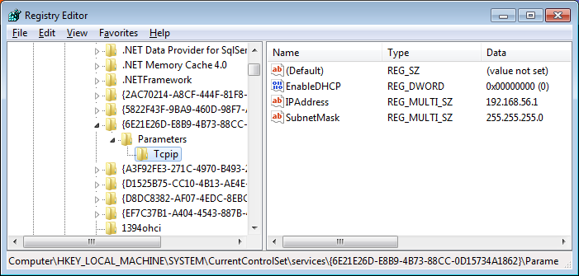
OS
Microsoft Registry Editor
IP address in Windows
HKEY_LOCAL_MACHINE\SYSTEM\CurrentControlSet\Services\{. . . .}\Parameters\Tcpip
Current configuration

Slide 18
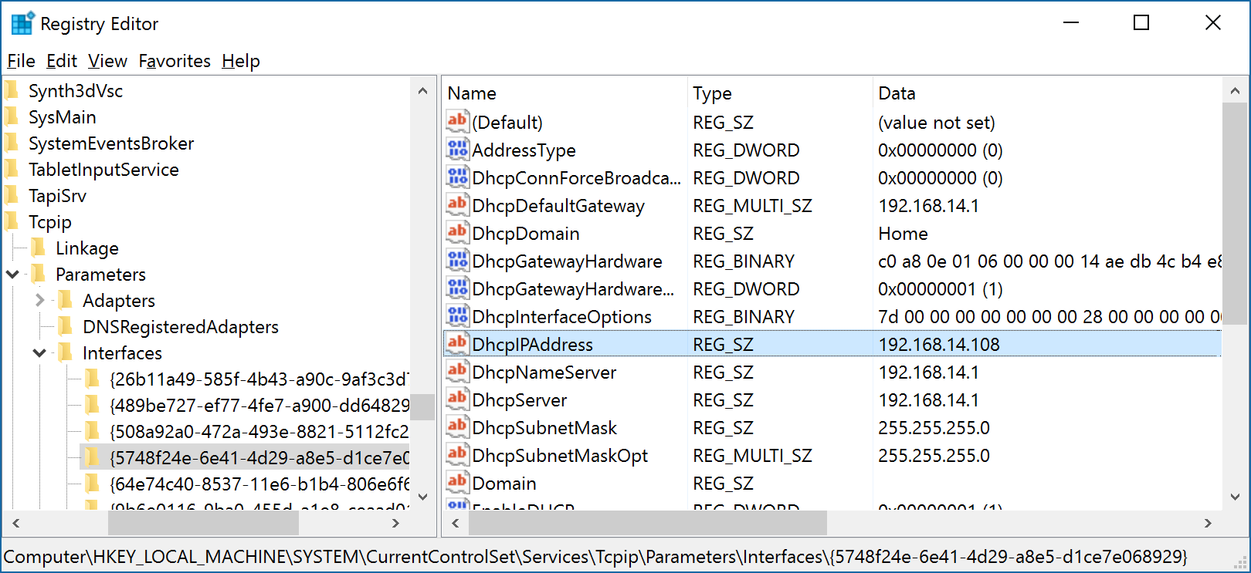
OS
Microsoft Registry Editor
IP address in Windows
HKEY_LOCAL_MACHINE\SYSTEM\CurrentControlSet\Services\Tcpip\Parameters\Interfaces\{. . . .}
Start Windows, Restart Windows

Slide 19
OS
Microsoft Registry Editor
ASSOC - view current file associations
C:\Users\Anatoly>assoc /?
Displays or modifies file extension associations
ASSOC [.ext[=[fileType]]]
.ext Specifies the file extension to associate the file type with
fileType Specifies the file type to associate with the file extension
Type ASSOC without parameters to display the current file associations.
If ASSOC is invoked with just a file extension, it displays the current
file association for that file extension. Specify nothing for the file
type and the command will delete the association for the file extension.
C:\Users\Anatoly>assoc
.001=WinRAR
.386=vxdfile
.3g2=WMP11.AssocFile.3G2
.3gp=WMP11.AssocFile.3GP
.3gp2=WMP11.AssocFile.3G2
.3GPP=WMP11.AssocFile.3GP
.7z=WinRAR

Slide 20
OS
Microsoft Registry Editor
Location of Windows registry files
The location of these registry hives are as follows:
HKEY_LOCAL_MACHINE \SYSTEM : \system32\config\system
HKEY_LOCAL_MACHINE \SAM : \system32\config\sam
HKEY_LOCAL_MACHINE \SECURITY : \system32\config\security
HKEY_LOCAL_MACHINE \SOFTWARE : \system32\config\software
HKEY_USERS \UserProfile : \winnt\profiles\username
HKEY_USERS.DEFAULT : \system32\config\default
Some hives are volatile and don’t have associated files. The system creates and manages these hives entirely in memory; the hives are therefore temporary in nature. The system creates volatile hives every time the system boots. Examples are:
HKEY_LOCAL_MACHINE \HARDWARE : Volatile hive
HKEY_LOCAL_MACHINE \SYSTEM \Clone : Volatile hive

Slide 21
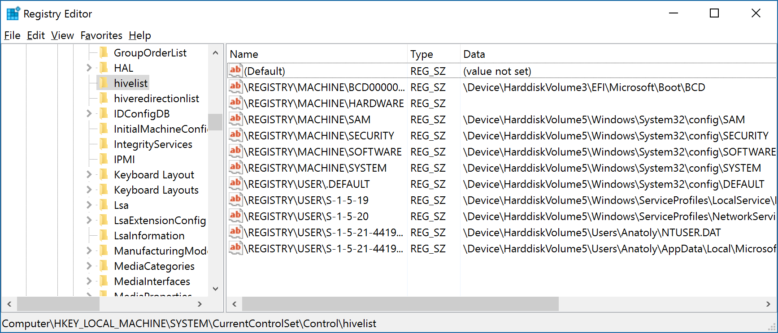
OS
Microsoft Registry Editor
Every Windows got a registry Key which lists every hive in system. Open Regedit and navigate to the following key to get a complete list:
HKEY_LOCAL_MACHINE\SYSTEM\CurrentControlSet\Control\hivelist

Slide 22
OS
Microsoft Registry Editor
SAM Security
The Security Account Manager (SAM) is a database file in Windows that stores users' passwords.
C:\Users\Anatoly\Downloads\PSTools>psexec -s -i -d c:\windows\regedit.exe
PsExec v2.2 - Execute processes remotely
Copyright (C) 2001-2016 Mark Russinovich
Sysinternals - www.sysinternals.com
c:\windows\regedit.exe started on DESKTOP-9CRRB09 with process ID 6504.

Slide 23
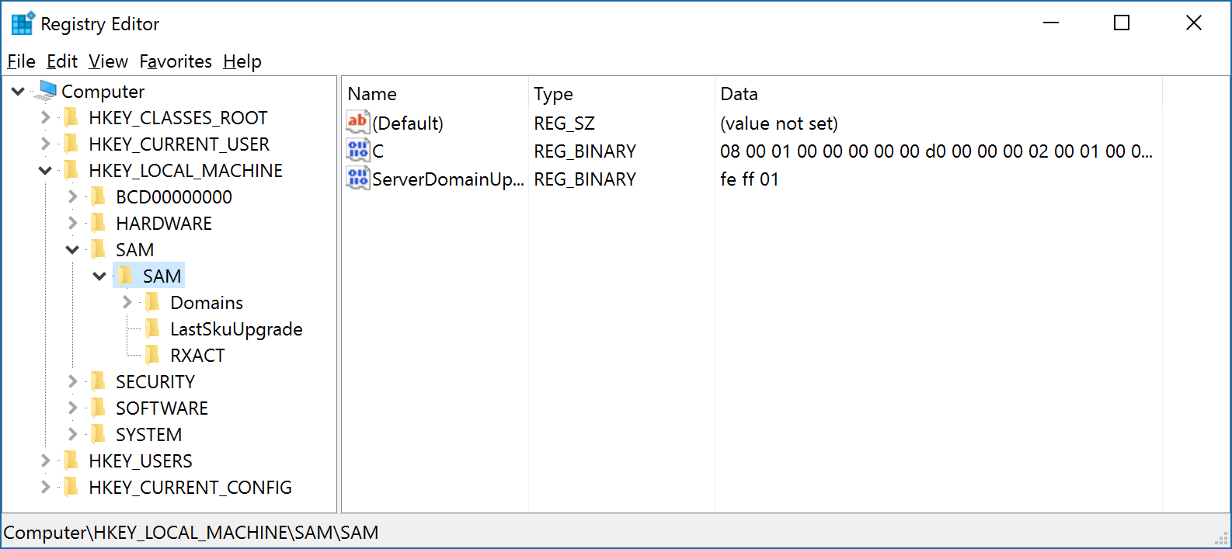
OS
Microsoft Registry Editor

