Slide 1
OS
Microsoft Registry Editor
Editing the registry of a remote computer
from winreg import *
host = "DESKTOP-9CRRB09" # remote MACHINE
key = ConnectRegistry(host, HKEY_LOCAL_MACHINE)
hkey = OpenKey(key, r"Software\Microsoft\Windows\CurrentVersion\Uninstall")
num = QueryInfoKey(hkey)[0]
print ("*** Found %d Software ***" % num)
try:
for x in range(1000):
uninstall = EnumKey(hkey, x)
skey = OpenKey(key,r"Software\Microsoft\Windows\CurrentVersion\Uninstall\%s" % uninstall)
try:
software = QueryValueEx(skey, "DisplayName")[0]
print ("%s-%s" % (uninstall, software))
except:
pass
except:
pass
CloseKey(key)
CloseKey(hkey)

Slide 2
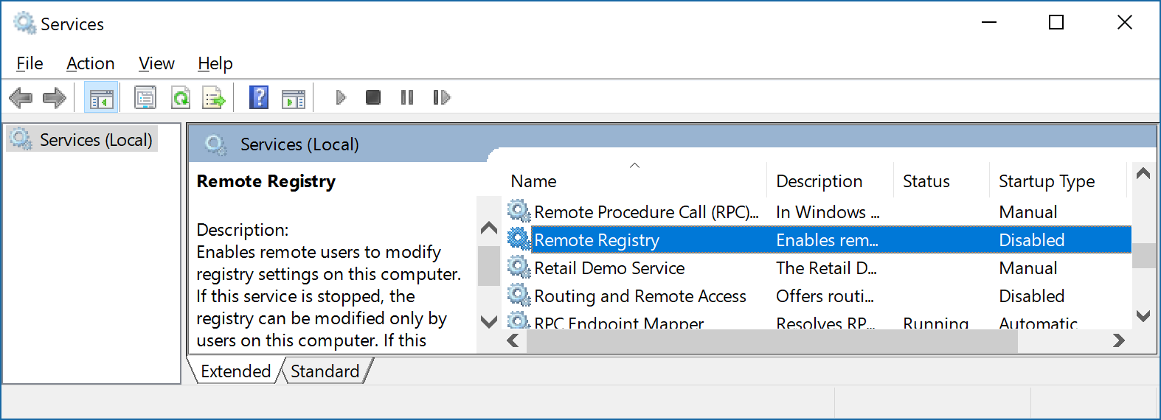
OS
Microsoft Registry Editor
Editing the registry of a remote computer
1. You must be a member of the local administrators group on the remote machine.
2. Running service Remote Registry.

Slide 3
OS
Microsoft Registry Editor
2. Running service Remote Registry.
C:\Users\Anatoly>net start RemoteRegistry
C:\Users\Anatoly>sc start RemoteRegistry

