Slide 1
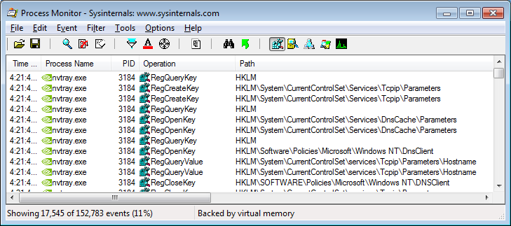
OS
Process Monitor
RegMon and FileMon are no longer available for download. They have been replaced by Process Monitor
capture

Slide 2
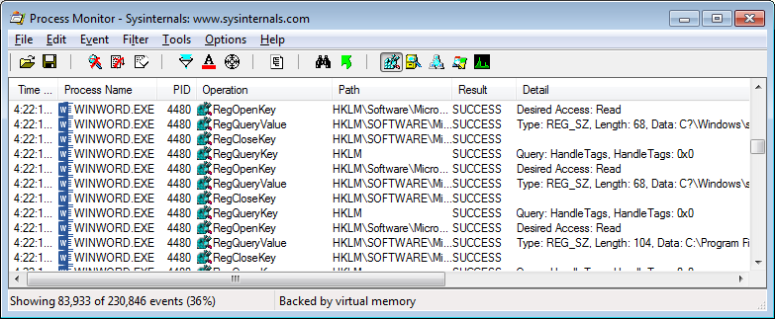
OS
Process Monitor

Slide 3
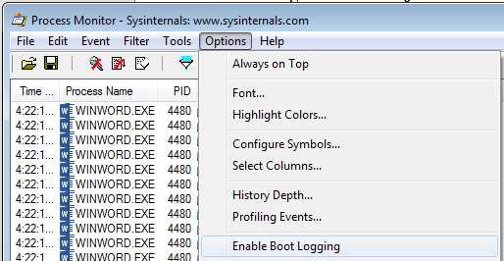
OS
Process Monitor
Enable Boot Logging

Slide 4
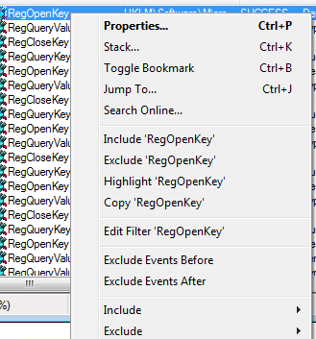
OS
Process Monitor
Filters

Slide 5
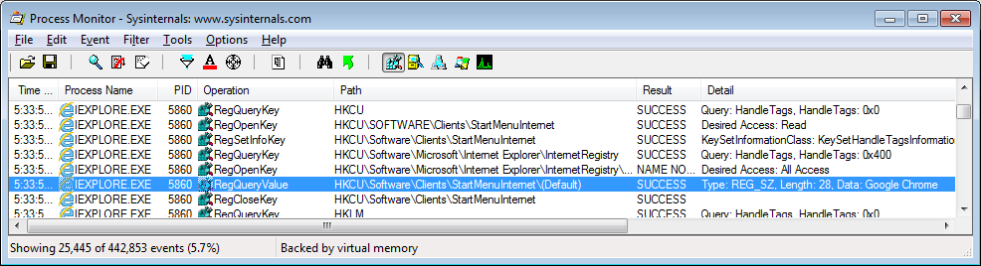
OS
Process Monitor

Slide 6
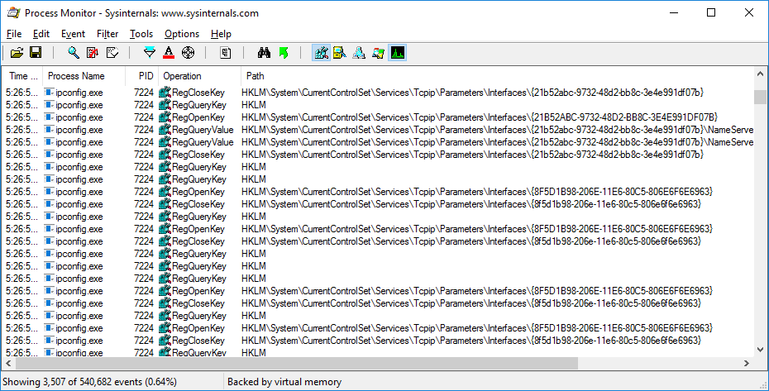
OS
Process Monitor

