Slide 1
OS
Process management
Critical Regions
In 1981, G.L. Peterson discovered a much simpler way to achieve mutual exclusion
The TSL (Test and Set Lock) Instruction
Semaphores
This was the situation in 1965, when E. W. Dijkstra (1965) suggested using an integer variable to count the number of wakeups saved for future use. In his proposal, a new variable type, called a semaphore, was introduced. A semaphore could have the value 0, indicating that no wakeups were saved, or some positive value if one or more wakeups were pending.
https://he.wikipedia.org/wiki/%D7%A1%D7%9E%D7%A4%D7%95%D7%A8_(%D7%9E%D7%93%D7%A2%D7%99_%D7%94%D7%9E%D7%97%D7%A9%D7%91)

Slide 2
OS
Process management
Mutexes
When the semaphore’s ability to count is not needed, a simplified version of the semaphore, called a mutex, is sometimes used. Mutexes are good only for managing mutual exclusion to some shared resource or piece of code. They are easy and efficient to implement, which makes them especially useful in thread packages that are implemented entirely in user space.
https://he.wikipedia.org/wiki/%D7%9E%D7%A0%D7%A2%D7%95%D7%9C_(%D7%AA%D7%95%D7%9B%D7%A0%D7%94)
Monitors
To make it easier to write correct programs, Hoare (1974) and Brinch Hansen (1975) proposed a higher-level synchronization primitive called a monitor.

Slide 3
OS
Process management
Barriers
Our last synchronization mechanism is intended for groups of processes rather than two-process producer-consumer type situations. Some applications are divided into phases and have the rule that no process may proceed into the next phase until all processes are ready to proceed to the next phase. This behavior may be achieved by placing a barrier at the end of each phase. When a process reaches the barrier, it is blocked until all processes have reached the barrier.

Slide 4
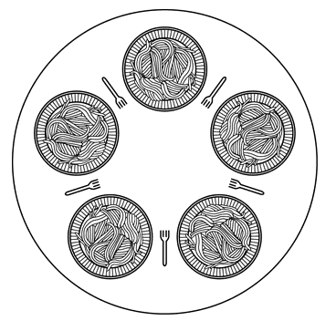
OS
Process management
CLASSICAL IPC PROBLEMS
The Dining Philosophers Problem
In 1965, Dijkstra posed and solved a synchronization problem he called the dining philosophers problem.

Slide 5
OS
Process management
CLASSICAL IPC PROBLEMS
The Readers and Writers Problem
Another famous problem is the readers and writers problem which models access to a database. Imagine, for example, an airline reservation system, with many competing processes wishing to read and write it. It is acceptable to have multiple processes reading the database at the same time, but if one process is updating (writing) the database, no other processes may have access to the database, not even readers.

Slide 6
OS
Process management
CLASSICAL IPC PROBLEMS
The Sleeping Barber Problem
Another classical IPC problem takes place in a barber shop. The barber shop has one barber, one barber chair, and n chairs for waiting customers, if any, to sit on. If there are no customers present, the barber sits down in the barber chair and falls asleep.

Slide 7
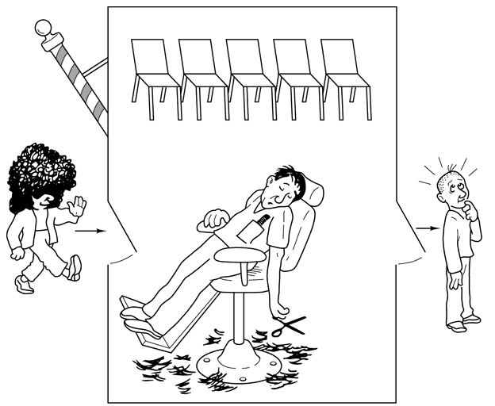
OS
Process management

