Slide 1
OS
Process synchronization
בלי תזמון
import threading
import datetime
class ThreadClass(threading.Thread):
def run(self):
now = datetime.datetime.now()
print "%s says hello, World! at time: %s" % (self.getName(),now)
for i in range(100):
t = ThreadClass()
t.start()

Slide 2
OS
Process synchronization
בלי תזמון
Thread-82 says hello, World! at time: 2015-10-15 18:53:11.554000Thread-83 says h
ello, World! at time: 2015-10-15 18:53:11.555000
Thread-86 says hello, World! at time: 2015-10-15 18:53:11.564000Thread-87 says h
ello, World! at time: 2015-10-15 18:53:11.568000
Thread-88 says hello, World! at time: 2015-10-15 18:53:11.569000Thread-90 says
hello, World! at time: 2015-10-15 18:53:11.571000Thread-89 says hello, World! at
time: 2015-10-15 18:53:11.570000
Thread-91 says hello, World! at time: 2015-10-15 18:53:11.575000 Thread-93 says

Slide 3
OS
Process synchronization
Synchronization primitives.
Event
Mutex
Semaphore
Spin Lock
. . .

Slide 4
OS
Process synchronization
Synchronization primitives.
Event
This is a simple mechanism. A thread signals an event and the other thread(s) wait for it.
An event is a simple synchronization object; the event represents an internal flag, and threads can wait for the flag to be set, or set or clear the flag themselves.
event = threading.Event()
# a client thread can wait for the flag to be set
event.wait()
# a server thread can set or reset it
event.set()
event.clear()
If the flag is set, the wait method doesn’t do anything. If the flag is cleared, wait will block until it becomes set again. Any number of threads may wait for the same event.

Slide 5
OS
Process synchronization
Event
import threading
e = threading.Event()
threads = []
def runner():
tname = threading.current_thread().name
print 'Thread waiting for event: %s' % tname
e.wait()
print 'Thread got event: %s' % tname
for t in range(100):
t = threading.Thread(target=runner)
threads.append(t)
t.start()
raw_input('Press enter to set and clear the event:')
e.set()
e.clear()
for t in threads:
t.join()
print 'All done.'

Slide 6
OS
Process synchronization
Event
Thread waiting for event: Thread-1
Thread waiting for event: Thread-2
Thread waiting for event: Thread-3
Thread waiting for event: Thread-4
Thread waiting for event: Thread-5
Thread waiting for event: Thread-6
Thread waiting for event: Thread-7
Thread waiting for event: Thread-8
Thread waiting for event: Thread-9
Press enter to set and clear the event:Thread waiting for event: Thread-10
Thread got event: Thread-1Thread got event: Thread-2Thread got event: Thread-3Th
read got event: Thread-4Thread got event: Thread-5Thread got event: Thread-7Thre
ad got event: Thread-8Thread got event: Thread-6Thread got event: Thread-9Thread
got event: Thread-10
All done.

Slide 7
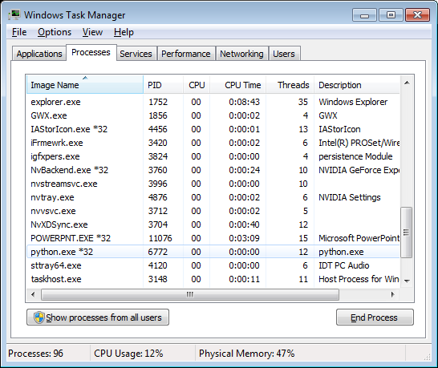
OS
Process synchronization
Event

Slide 8
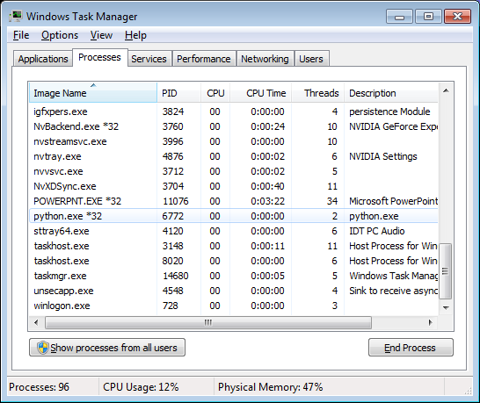
OS
Process synchronization
Event

Slide 9
OS
Process synchronization
Synchronization primitives.
Mutex
(mutually exclusive)
(סותרים)

Slide 10
OS
Process synchronization
Mutex
import time
from threading import Thread
from threading import Lock
def myfunc(i, mutex):
mutex.acquire(1)
time.sleep(1)
print "Thread: %d" %i
mutex.release()
mutex = Lock()
for i in range(0,10):
t = Thread(target=myfunc, args=(i,mutex))
t.start()
print "main loop %d" %i

Slide 11
OS
Process synchronization
Mutex
main loop 0
main loop 1
main loop 2
main loop 3
main loop 4
main loop 5
main loop 6
main loop 7
main loop 8
main loop 9
Press any key to continue . . . Thread: 0
Thread: 1
Thread: 2
Thread: 3
Thread: 4
Thread: 5
Thread: 6
Thread: 7
Thread: 8
Thread: 9

Slide 12
OS
Process synchronization
Synchronization primitives.
Lock
A primitive lock is in one of two states, ‘locked’ or ‘unlocked’.
It has two basic methods acquire() and release().

Slide 13
OS
Process synchronization
Synchronization primitives.
Lock
import threading
import datetime
class ThreadClass(threading.Thread):
def run(self):
now = datetime.datetime.now()
lock = threading.Lock()
lock.acquire()
print "%s says hello, World! at time: %s" % (self.getName(),now)
lock.release()
for i in range(100):
t = ThreadClass()
t.start()

Slide 14
OS
Process synchronization
Lock
Thread-1 says hello, World! at time: 2015-10-15 19:51:38.839000
Thread-2 says hello, World! at time: 2015-10-15 19:51:38.846000
Thread-3 says hello, World! at time: 2015-10-15 19:51:38.854000
Thread-4 says hello, World! at time: 2015-10-15 19:51:38.862000
Thread-5 says hello, World! at time: 2015-10-15 19:51:38.869000
Thread-6 says hello, World! at time: 2015-10-15 19:51:38.877000
Thread-7 says hello, World! at time: 2015-10-15 19:51:38.883000
Thread-8 says hello, World! at time: 2015-10-15 19:51:38.891000
Thread-9 says hello, World! at time: 2015-10-15 19:51:38.897000
Thread-10 says hello, World! at time: 2015-10-15 19:51:38.907000
Thread-11 says hello, World! at time: 2015-10-15 19:51:38.913000
Thread-12 says hello, World! at time: 2015-10-15 19:51:38.923000
Thread-13 says hello, World! at time: 2015-10-15 19:51:38.930000
Thread-14 says hello, World! at time: 2015-10-15 19:51:38.939000
Thread-15 says hello, World! at time: 2015-10-15 19:51:38.947000
Thread-16 says hello, World! at time: 2015-10-15 19:51:38.955000

Slide 15
OS
Process synchronization
Synchronization methods
Semaphore

Slide 16
OS
Process synchronization
Synchronization methods
Semaphore
import threading
import datetime
class ThreadClass(threading.Thread):
def run(self):
now = datetime.datetime.now()
pool.acquire()
print "%s says hello, World! at time: %s" % (self.getName(),now)
pool.release()
pool = threading.BoundedSemaphore(value=1)
for i in range(100):
t = ThreadClass()
t.start()

Slide 17
OS
Process synchronization
Synchronization methods
Semaphore
Thread-77 says hello, World! at time: 2015-10-15 19:25:35.118000
Thread-78 says hello, World! at time: 2015-10-15 19:25:35.119000
Thread-79 says hello, World! at time: 2015-10-15 19:25:35.120000
Thread-80 says hello, World! at time: 2015-10-15 19:25:35.121000
Thread-81 says hello, World! at time: 2015-10-15 19:25:35.122000
Thread-82 says hello, World! at time: 2015-10-15 19:25:35.123000
Thread-83 says hello, World! at time: 2015-10-15 19:25:35.124000
Thread-84 says hello, World! at time: 2015-10-15 19:25:35.125000
Thread-85 says hello, World! at time: 2015-10-15 19:25:35.126000
Thread-86 says hello, World! at time: 2015-10-15 19:25:35.127000
Thread-87 says hello, World! at time: 2015-10-15 19:25:35.128000
Thread-88 says hello, World! at time: 2015-10-15 19:25:35.130000
Thread-89 says hello, World! at time: 2015-10-15 19:25:35.130000
Thread-90 says hello, World! at time: 2015-10-15 19:25:35.132000
Thread-91 says hello, World! at time: 2015-10-15 19:25:35.132000
Thread-92 says hello, World! at time: 2015-10-15 19:25:35.134000
Thread-93 says hello, World! at time: 2015-10-15 19:25:35.135000
Thread-94 says hello, World! at time: 2015-10-15 19:25:35.137000
Thread-95 says hello, World! at time: 2015-10-15 19:25:35.138000

Slide 18
OS
Process synchronization
Condition
This is a synchronization mechanism where a thread waits for a specific condition and another thread signals that this condition has happened. Once the condition happened, the thread acquires the lock to get exclusive access to the shared resource.

Slide 19
OS
Process synchronization

