Slide 1

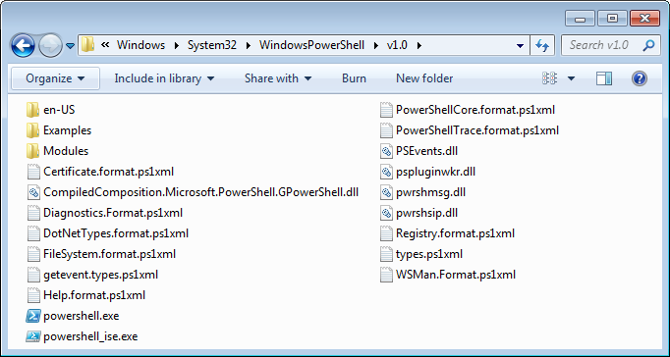
OS
PowerShell
Windows PowerShell is an extensible command-line shell and associated scripting language from Microsoft.
Windows PowerShell 3.0, Windows PowerShell 4.0, Windows PowerShell 5.0

Slide 2
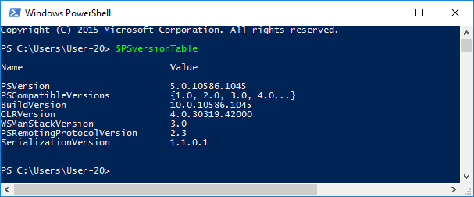
OS
PowerShell
Check PowerShell version

Slide 3
Activate power shell
Type: powershell in the cmd
To get back to the cmd type: exit

Slide 4
OS
PowerShell
Get-Command
Get-Command
Get-Help
Get-Help *
Get-Help about*
Get-Help get-command -detailed
Get-Member
Get-Command more.com | Get-Member

Slide 5
OS
PowerShell
Get-Member
PS C:\Users\Anatoly> Get-Command more.com | Foreach {$_.FileVersionInfo}
ProductVersion FileVersion FileName
-------------- ----------- --------
6.1.7600.16385 6.1.7600.1638... C:\Windows\system32\more.com
PS C:\Users\Anatoly> Get-Date | Get-Member
TypeName: System.DateTime
Name MemberType Definition
---- ---------- ----------
Add Method System.DateTime Add(System.TimeSpan value)
AddDays Method System.DateTime AddDays(double value)
AddHours Method System.DateTime AddHours(double value)
AddMilliseconds Method System.DateTime AddMilliseconds(double value)
(get-date).Second

Slide 6
OS
PowerShell
Get-PSDrive
PS C:\Users\Anatoly> get-psdrive
Name Used (GB) Free (GB) Provider Root
---- --------- --------- -------- ----
Alias Alias
C 168.02 175.82 FileSystem C:\
cert Certificate \
D 126.05 214.00 FileSystem D:\
E FileSystem E:\
Env Environment
F FileSystem F:\
Function Function
H 4.08 10.55 FileSystem H:\
HKCU Registry HKEY_CURRENT_USER
HKLM Registry HKEY_LOCAL_MACHINE
Variable Variable
WSMan WSMan

Slide 7
OS
PowerShell
Output of object.
PS C:\Users\Anatoly> Get-Process PowerShell
Handles NPM(K) PM(K) WS(K) VM(M) CPU(s) Id ProcessName
------- ------ ----- ----- ----- ------ -- -----------
378 25 98276 102484 578 8.74 5276 powershell
PS C:\Users\Anatoly> $procs = Get-Process PowerShell
PS C:\Users\Anatoly> $procs.GetType().Fullname
System.Diagnostics.Process
במשתנה $procs שמור אובייקט מסוג System.Diagnostics.Process

Slide 8
OS
PowerShell
Output of object.
PS C:\Users\Anatoly> $procs = Get-Process PowerShell | Out-String
PS C:\Users\Anatoly> $procs.GetType().Fullname
System.String
PS C:\Users\Anatoly> $procs
Handles NPM(K) PM(K) WS(K) VM(M) CPU(s) Id ProcessName
------- ------ ----- ----- ----- ------ -- -----------
492 25 98364 103000 578 8.83 5276 powershell
במשתנה $procs שמור טקסט.

Slide 9
OS
PowerShell
How much time has passed since Anatoly Peymer was born.
PS C:\Users\Anatoly> ((Get-Date).Year-$born.Year)
63
PS C:\Users\Anatoly> [datetime] $born="23 August 1955"
PS C:\Users\Anatoly> ((Get-Date).Year-$born.Year)
63
PS C:\Users\Anatoly> ((Get-Date)-$born)
Days : 22860
Hours : 9
Minutes : 7
Seconds : 39
Milliseconds : 328
Ticks : 19751368593289358
TotalDays : 22860.3803163071
TotalHours : 548649.127591371
TotalMinutes : 32918947.6554823
TotalSeconds : 1975136859.32894
TotalMilliseconds : 1975136859328.94

