Slide 1



HotKey
Display or hide the Start menu.
+
Break
Display the System Properties dialog box.
+
D
Show the desktop.
+
M
Minimize all windows.
+
Shift
+
M
Restores minimized windows.
+
E
Open My Computer.
+
F
Search for computers.
+
L
Switch User

Slide 2
HotKey
+
R
Open the Run dialog box.
+
U
Open Utility Manager.
+
TAB
Switch to task
(Magnifier) Copy the screen to the Clipboard, including the mouse cursor.
+
Print Scr
(Magnifier) Copy the screen to the Clipboard, without the mouse cursor.
+
Scroll Lock

Slide 3
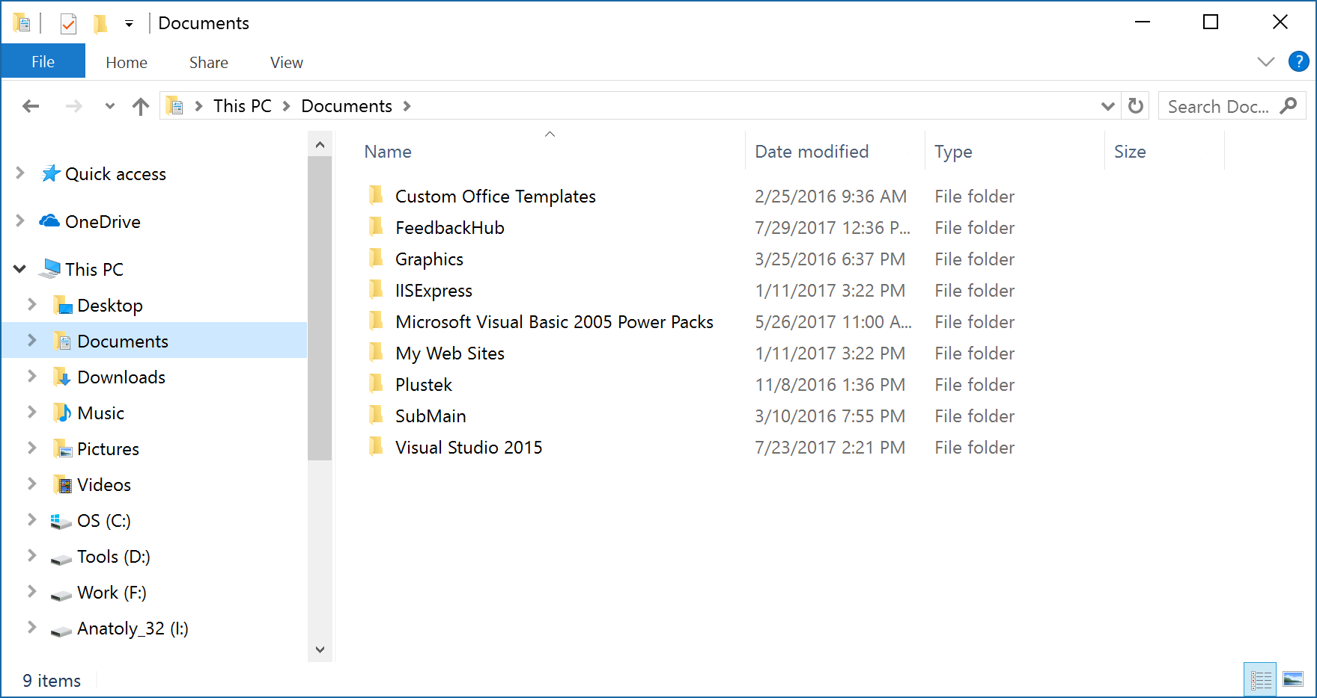
HotKey
Windows explorer

Slide 4
HotKey
F6
Next window
BackSpace
Up
NumLock
+
*
Show all sub folders
NumLock
+
+
Show sub folder
NumLock
+
-
Hide sub folders
→
Display current selection if it's collapsed, or select first subfolder.
←
Collapse current selection if it's expanded, or select parent folder.
End/Home
Display the bottom/top of the active window.

Slide 5
Hot Key
F4
Display the Address bar list in My Computer or Windows Explorer.
ALT
+
Enter
View properties for the selected item.
CTRL
+
A
Select all
CTRL
+
Mouse
Select
CTRL
+
O
Open
CTRL
+
S
Save
F2
Rename
Delete selected item permanently without placing the item in the Recycle Bin.
Shift
+
Delete

Slide 6
HotKey
PrintScr
Copy the entire screen
ALT
+
PrintScr
Copy the window or screen contents
ALT
+
TAB
Switch between open items.
CTRL
+
F4
Close the active document
CTRL
+
W
Close the active document
ALT
+
F4
Close the active document
ALT
+
F5
Restore size of window
CTRL
+
F7
+
Arrow
Move window

Slide 7
HotKey
CTRL
+
F8
+
Arrow
Size window
ALT
+
F10
Full screen
CTRL
+
F10
Full screen
CTRL
+
Shift
+
Arrow
Select word
CTRL
+
+
C
Color/Black-White screen

