Slide 1

Hot Key
ALT
+
LMClick
Vertical select
CTRL
+
I
Find text
CTRL
+
C
Few times
CTRL
+
Shift
+
V
Few times
CTRL
+
M
+
M
Turn block
CTRL
+
M
+
L
Expand block
Drag & Drop to ToolBox
Drag & Drop from ToolBox

Slide 2
Hot Key
CTRL
+
]
Find couple
CTRL
+
/*
Find couple
CTRL
+
X
Delete row
SHIFT
+
ALT
+
Enter
Full screen

Slide 3
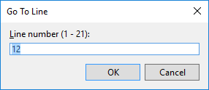
Hot Key
CTRL
+
Arrow
Scroll
CTRL
+
G
CTRL
+
LMClick
Re-dock floating window
CTRL
+
F4
Close active document
WIN
+
Arrow
Windows….
CTRL
+
F
Find – Enter/ Shift + Enter
CTRL
+
H
Replace

Slide 4
Hot Key
F9
Set breakpoint
CTRL
+
F9
Disable breakpoint
CTRL
+
F10
Run to cursor
CTRL
+
Shift
+
F5
Restart debuggin
F12
Go to definition
ALT
+
F12
Peek definition
CTRL
+
Shift
+
>
Zoom

Slide 5
Hot Key
ALT
+
Shift
+
Arrow
Block selection
ALT
+
Up
Move line Up

Slide 6
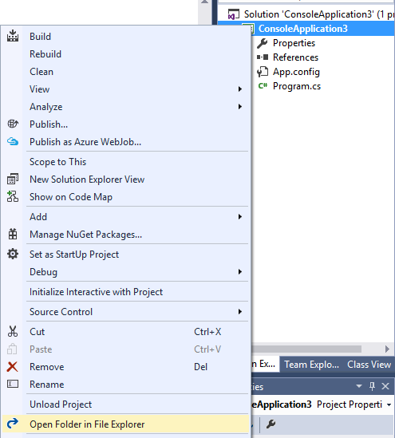
Hot Key

Slide 7
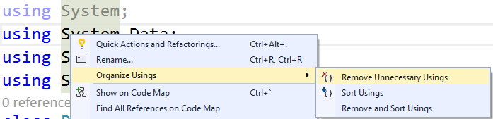
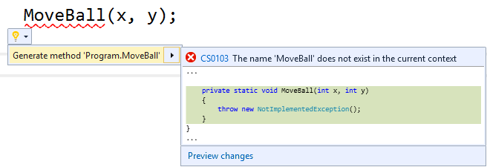
Hot Key

Slide 8
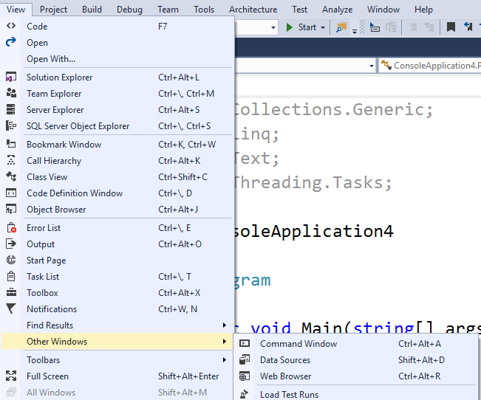

Hot Key
View – Other Windows – C# interactive

Slide 9

Hot Key
Immediate Window
CTRL
+
ALT
+
I
Open Immediate window
>
Command mode (>cls)
?
?varname
psr or Steps Recorder

