Slide 1

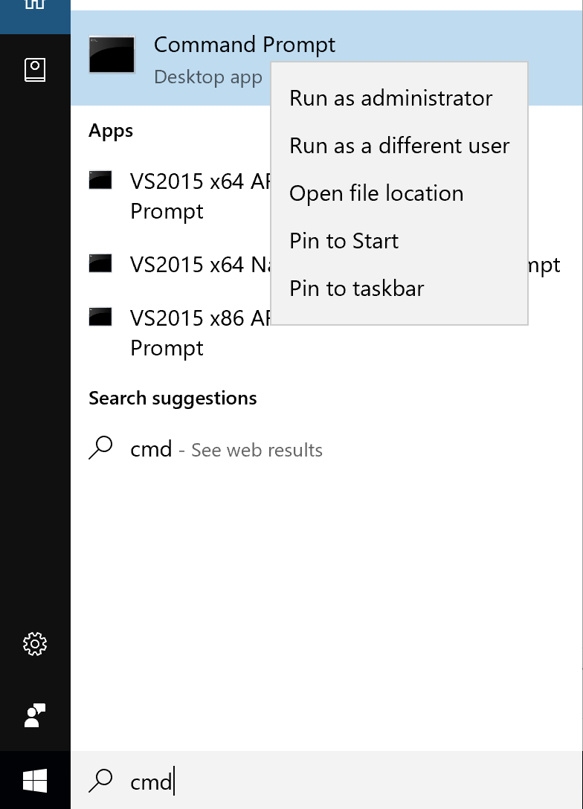

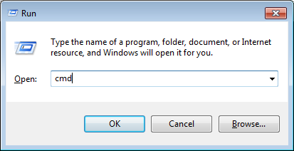
OS
Command prompt
Command Prompt (cmd.exe), the command-line interpreter on Windows operating systems
+
R
Open the Run dialog box.

Slide 2
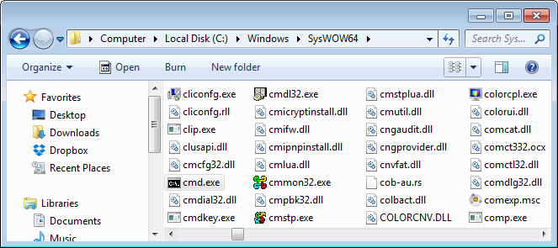
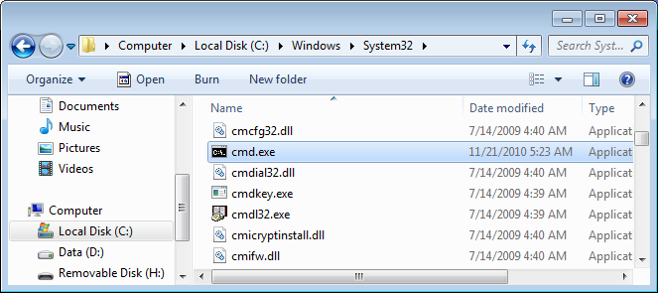
OS
Command prompt
32 bit
64 bit

Slide 3
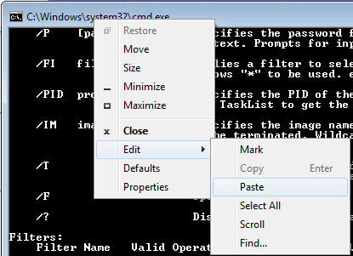
OS
Command prompt
How to copy and paste text in the console:

Slide 4
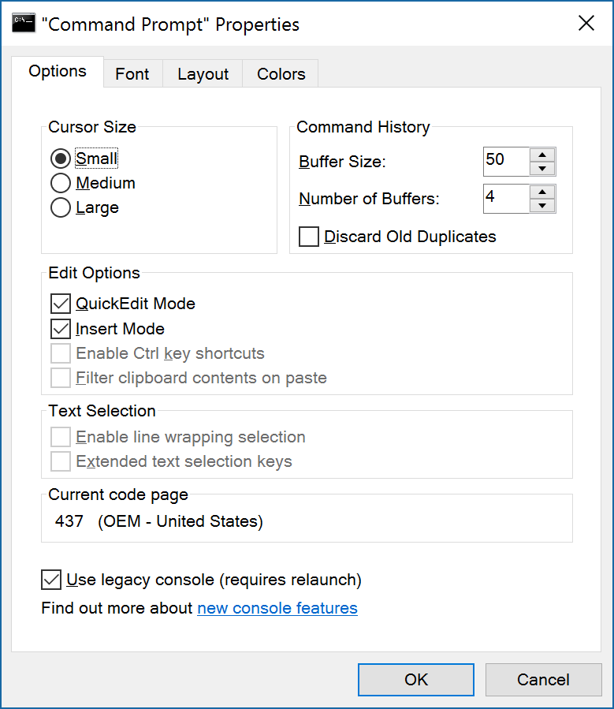
OS
Command prompt
How to copy and paste text in the console:

Slide 5
OS
Command prompt
F7 | Displays all commands for this program stored in memory in a pop-up box. Use the UP ARROW key and the DOWN ARROW key to select the command you want, and press ENTER to run the command. You can also note the sequential number in front of the command and use this number in conjunction with the F9 key.

Slide 6
OS
Command prompt
C:\Users\Anatoly>c:\doc
Press TAB
C:\Users\Anatoly>"c:\Documents and Settings"
Press TAB

Slide 7
OS
Command prompt
Internal commands
DIR Displays a list of files and subdirectories in a directory.
CD Displays the name of or changes the current directory.
RD Removes a directory.
MD Creates a directory.
CLS Clears the screen.
COPY Copies one or more files to another location.
DATE Displays or sets the date.
DEL Deletes one or more files.
. . .

Slide 8
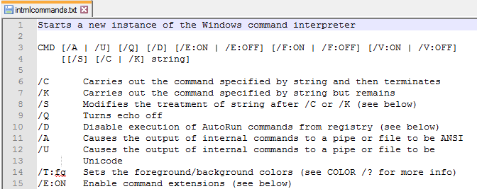
OS
Command prompt
Internal commands
C:\Users\User-20>cmd /?>f:\intrnlcommands.txt

Slide 9
Explain previous cmd /? lists the options for the cmd internal commands
> means piping to a file (creates it or override existing)

Slide 10
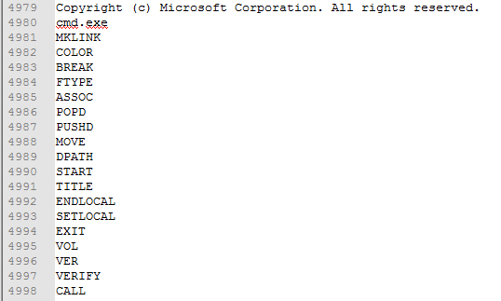
OS
Command prompt
Internal commands
F:\>strings.exe cmd.exe>help.txt

Slide 11
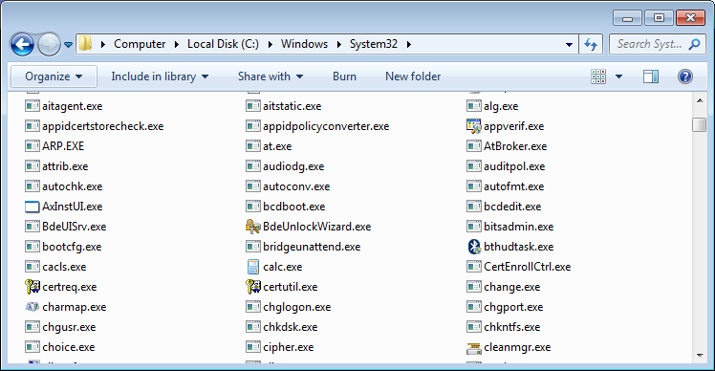
OS
Command prompt
External commands

Slide 12
OS
Command prompt
External commands
PATH=C:\Python34\Lib\site-packages\PyQt4;C:\ProgramData\Oracle\Java\javapath;C:\
Program Files (x86)\Cuminas\Document Express DjVu Plug-in\;C:\Windows\system32;C:\Windows;C:\Windows\System32\Wbem;C:\Windows\System32\WindowsPowerShell\v1.0\;C:\Program Files\Intel\WiFi\bin\;C:\Program Files\Common Files\Intel\WirelessCommon\;C:\Program Files\Microsoft\Web Platform Installer\;C:\Program Files (x86)\Microsoft ASP.NET\ASP.NET Web ages\v1.0\;C:\Program Files (x86)\Windows Kits\8.0\Windows Performance Toolkit\;C:\Program Files\Microsoft SQL Server\110\Tools\Binn\;C:\Program Files (x86)\NVIDIA Corporation\PhysX\Common;C:\Heights\PortableApp
s\PortablePython2.7.6.1\App;C:\Heights\PortableApps\PortablePython2.7.6.1\App\Li
b\idlelib\;C:\Heights\PortableApps\PortablePython2.7.6.1\App\Scripts\;;%WIRESHAR
KPATH%;C:\Program Files (x86)\Skype\Phone\;C:\Program Files\Intel\WiFi\bin\;C:\P
rogram Files\Common Files\Intel\WirelessCommon\

Slide 13
OS
Command prompt
External commands
Internal commands
ATTRIB Displays or changes file attributes.
CACLS Displays or modifies access control lists (ACLs) of files.
CLIP Redirects output of another command to the Windows clipboard.
COMP Compares the contents of two files or sets of files byte-by-byte
FC Compares two files or sets of files, and displays the differences between them.
FIND Searches for a text string in a file or files.
HELP Provides Help information for Windows commands.
TREE Graphically displays the directory structure of a drive or path.
. . .

Slide 14
OS
Command prompt
shutdown
Shut down or restart a local or remote computer
Shutdown the Local Computer with a Delay (time-out) Period of 10 Seconds
C:\>shutdown /s /t 10
systeminfo
Displays detailed configuration information about a computer and its operating system, including operating system configuration, security information, product ID, and hardware properties, such as RAM, disk space, and network cards.
C:\>systeminfo

Slide 15
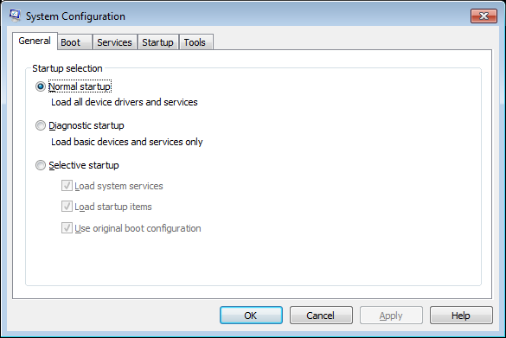
OS
Command prompt
driverquery
Displays a list of all installed device drivers and their properties.
msconfig
Microsoft system configuration utility.

Slide 16
OS
Command prompt
tasklist
Shows all of the different local computer processes currently running.
taskkill
Ends one or more tasks or processes.
taskkill /pid 5860
sfc
System File Checker is a utility in Microsoft Windows that allows users to scan for and restore corruptions in Windows system files.

Slide 17
OS
Command prompt
pathping
The PathPing tool is a route tracing tool that combines features of Ping and Tracert with additional information that neither of those tools provides. PathPing sends packets to each router on the way to a final destination over a period of time, and then computes results based on the packets returned from each hop.
pathping google.com
msinfo32
Displays a comprehensive view of your hardware, system components, and software environment.

Slide 18
OS
Command prompt
Command WHERE
Locate and display files in a directory tree.
Find all files named ‘Python.exe' in the current system path
WHERE python.exe
D:\>WHERE /R d:\ Python.exe
d:\Heights\PortableApps\PortablePython2.7.6.1\App\python.exe
d:\Python26\python.exe
d:\Python27\python.exe
d:\Python271\python.exe
d:\Python36-32\python.exe
Find all files named ‘Python.*' on the remote computer 'Server64' searching its subdirectories:
WHERE /r \\Server64\Share1 Python.*

Slide 19
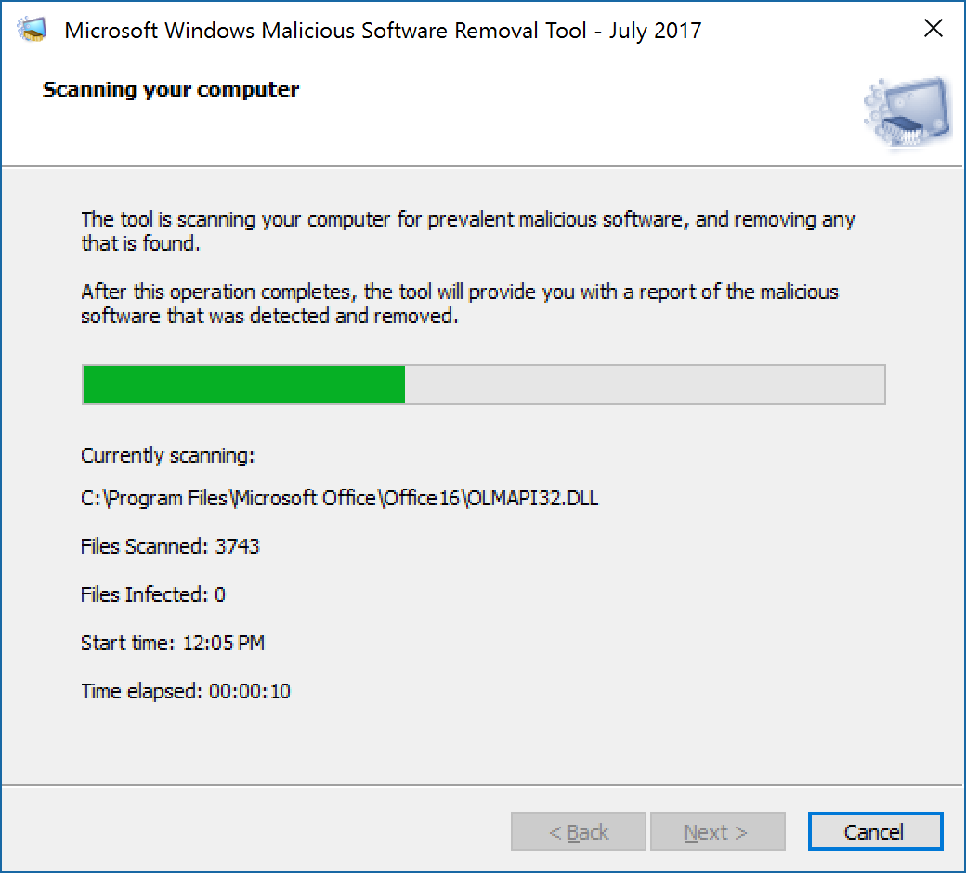
OS
Command prompt
Mrt
Malware Removal Tool

