Slide 1
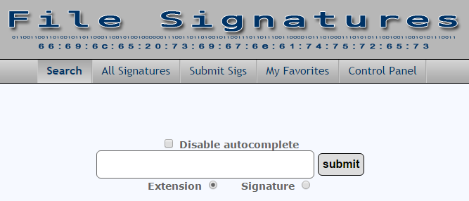
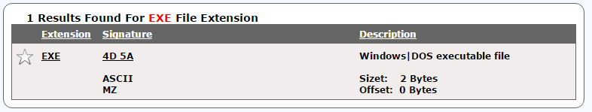
OS
Files
This is a list of file signatures, data used to identify or verify the content of a file

Slide 2

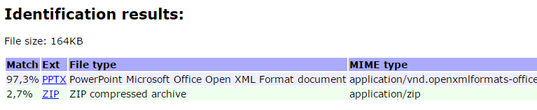
OS
Files
Online TrID File Identifier

Slide 3
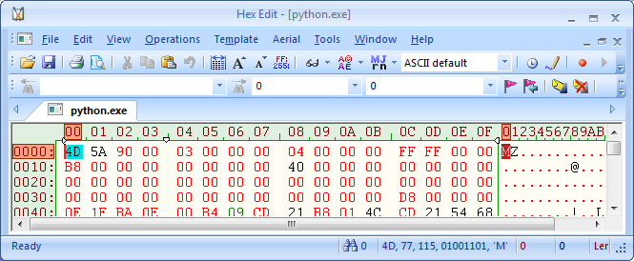
OS
File System
Magic signature
Magic numbers are the first bits of a file which uniquely identify the type of file.
*.exe

Slide 4
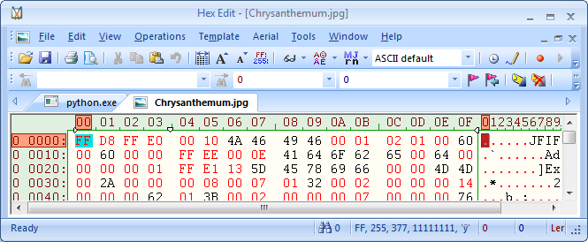
OS
File System
*.jpg
List of file signatures
FILE SIGNATURES TABLE

Slide 5
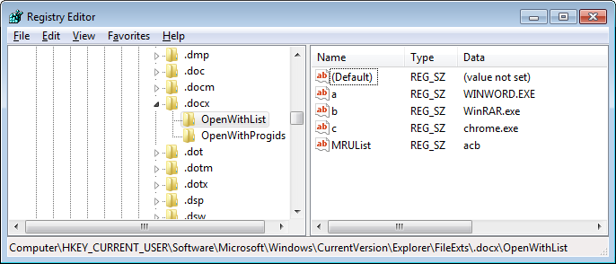
OS
Files
File extension association

Slide 6

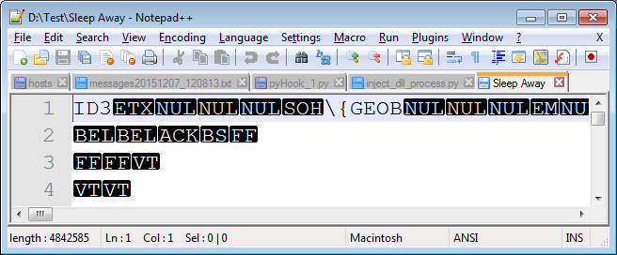
OS
Files
File without extension
.mp3

Slide 7

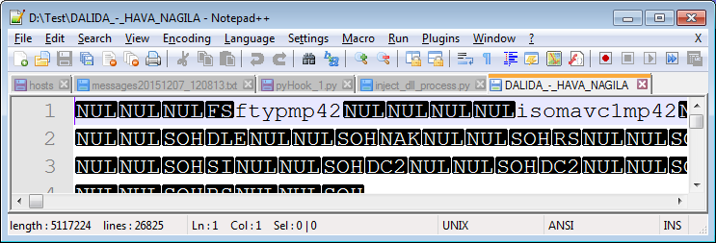
OS
Files
File without extension
.mp4
.mp4

Slide 8

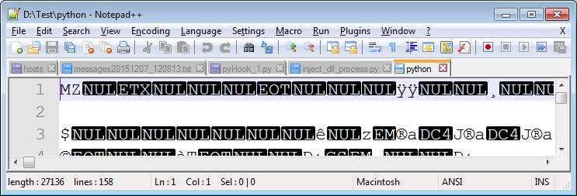
OS
Files
File without extension
.exe

Slide 9

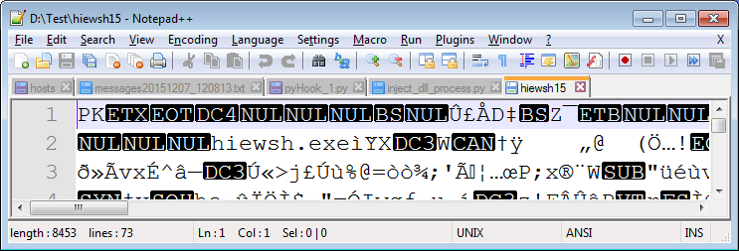
OS
Files
File without extension
.zip

Slide 10

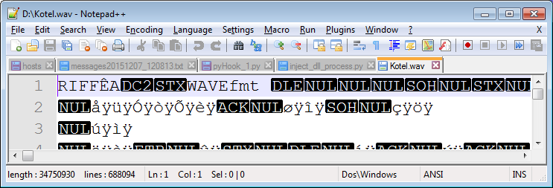
OS
Files
File without extension
.wav

Slide 11

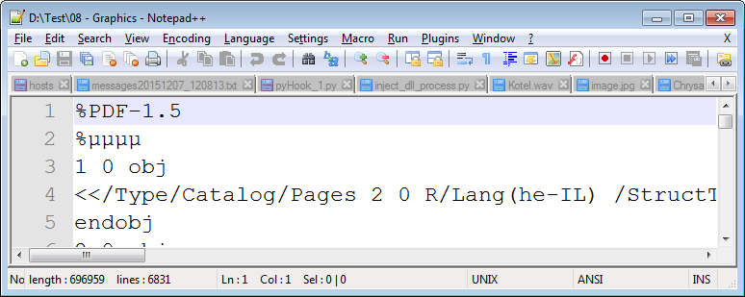
OS
Files
File without extension
.pdf

Slide 12
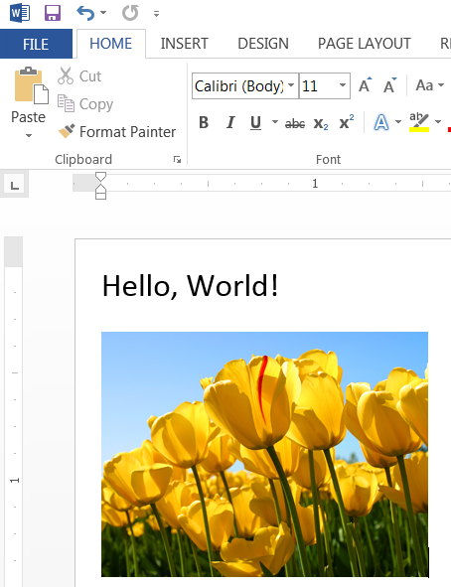
Files
Microsoft Office File

Slide 13

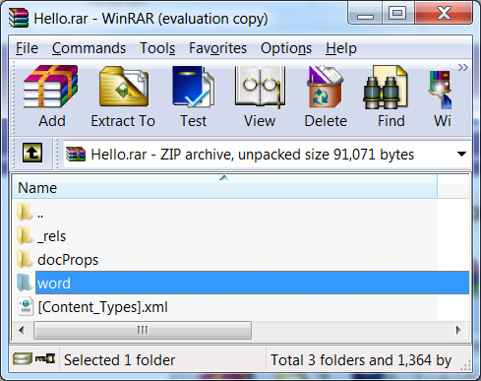
Files
Microsoft Office File

