Slide 1
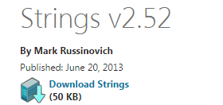
OS
File System
1. Search strings
Check the file for the presence in it of URLs for HTTP and HTTPS.
strings app.exe | findstr /i /r "htt[ps]*://"
GET, POST

Slide 2
OS
File System
C:\Program Files\Microsoft Office\Office15>strings winword.exe | findstr /i /r "htt[ps]*://"
C:\Program Files\Microsoft Office\Office15>strings winword.exe | findstr /i /r "
htt[ps]*://"
<asmv3:windowsSettings xmlns="http://schemas.microsoft.com/SMI/2005/WindowsSetti
ngs">
Chttp://crl.microsoft.com/pki/crl/products/MicrosoftTimeStampPCA.crl0X
<http://www.microsoft.com/pki/certs/MicrosoftTimeStampPCA.crt0
Ehttp://crl.microsoft.com/pki/crl/products/MicCodSigPCA_08-31-2010.crl0Z
>http://www.microsoft.com/pki/certs/MicCodSigPCA_08-31-2010.crt0
?http://crl.microsoft.com/pki/crl/products/microsoftrootcert.crl0T
8http://www.microsoft.com/pki/certs/MicrosoftRootCert.crt0
?http://crl.microsoft.com/pki/crl/products/microsoftrootcert.crl0T
8http://www.microsoft.com/pki/certs/MicrosoftRootCert.crt0
http://office.microsoft.com 0

Slide 3
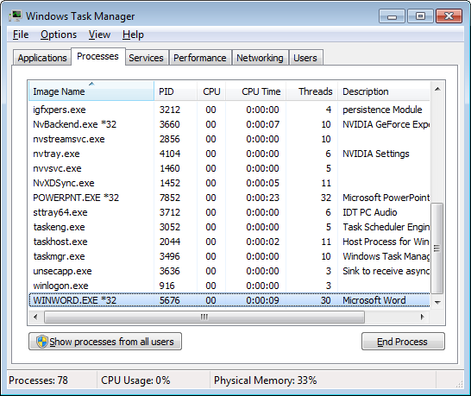
OS
File System
2. We can learn IP-addresses, which interact with the application.

Slide 4
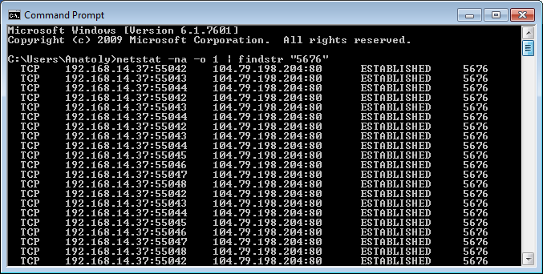
OS
File System
2. We can learn IP-addresses, which interact with the application.

Slide 5
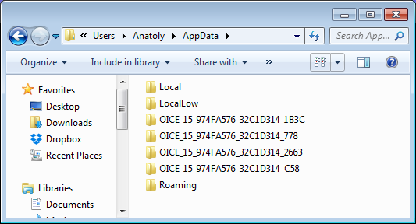
OS
File System
3. Directory AppData

Slide 6
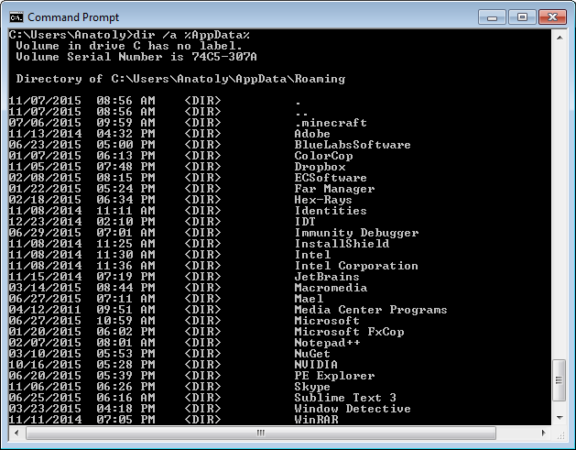
OS
File System
3. Directory AppData
dir /a %AppData%

Slide 7
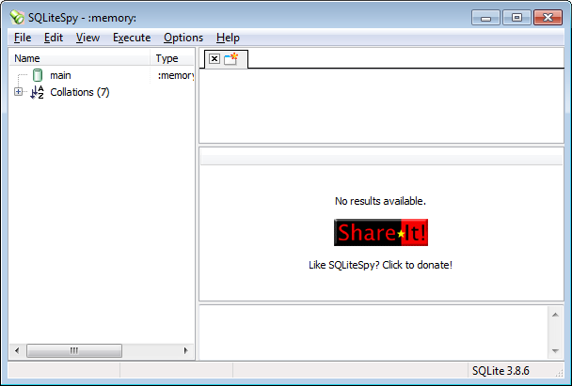
OS
File System
3. Data base sqlite
SQLiteSpy

Slide 8

OS
File System
4. ExifTool
to view metadata
D:\>exiftool.exe picture.jpg
ExifTool Version Number : 10.05
File Name : picture.jpg
Directory : .
File Size : 6.3 kB
File Modification Date/Time : 2015:08:18 15:01:08+03:00
File Access Date/Time : 2015:10:01 13:29:47+03:00
File Creation Date/Time : 2015:10:01 13:29:46+03:00
File Permissions : rw-rw-rw-
File Type : JPEG
File Type Extension : jpg
MIME Type : image/jpeg
JFIF Version : 1.01
Resolution Unit : None
X Resolution : 1
Y Resolution : 1
Image Width : 119
Image Height : 119
Encoding Process : Baseline DCT, Huffman coding
Bits Per Sample : 8
Color Components : 3
Y Cb Cr Sub Sampling : YCbCr4:4:4 (1 1)
Image Size : 119x119
Megapixels : 0.014

Slide 9
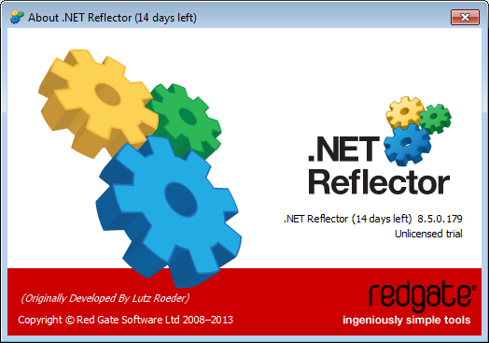
OS
File System
5. Reflector
.NET Reflector Visual Studio Extension

Slide 10
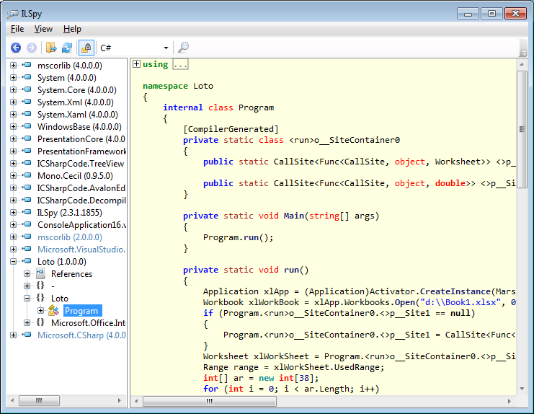
OS
File System
6. ILSpy
ILSpy is the open-source .NET assembly browser and decompiler.

Slide 11
OS
File System
7. UnPyc
Decompile Python 2.7 .pyc
python -i someprogram.py
First run the script, and then control is passed immediately to the interpreter to save the current state of all objects in the script.

