Slide 1
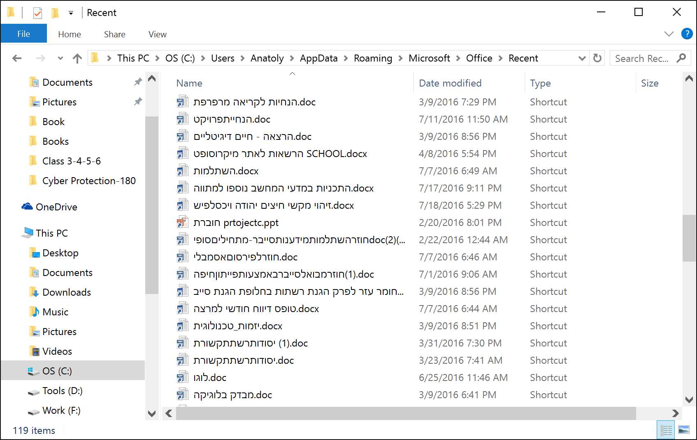

OS
New File System
A list of recently used files

Slide 2
OS
New File System
class MyFolder
{
public string Name;
public MyFolder Parent;
public List<MyFolder> ChildFolders;
public List<string> Files;
}
class Disk
{
}
class File
{
}

Slide 3
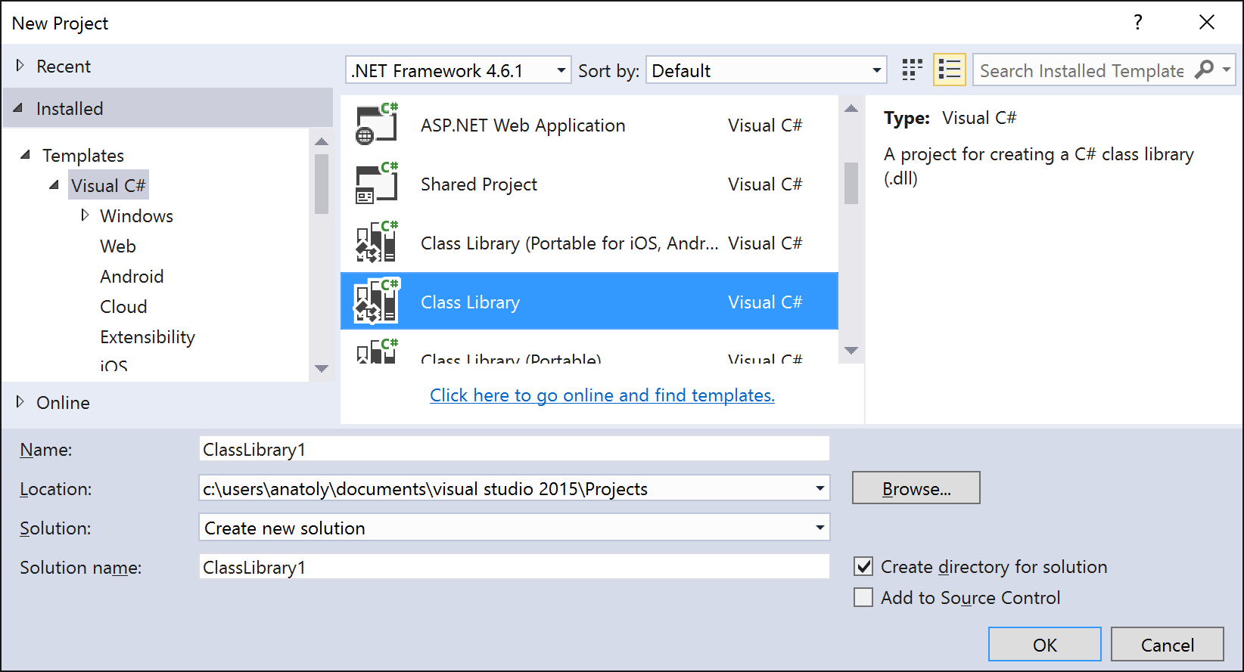
OS
New File System

Slide 4
OS
New File System
CreateDisk, DeleteDisk, RenameDisk, ?
CreateFolder, DeleteFolder, RenameFolder, MoveFolder, ?
CreateFile, DeleteFile, RenameFile, MoveFile, ?
GetAllFiles, IsFileExist, ?
SaveFileDialog, LoadFileDialog, ?
BackUpAll, ?
Serialization is the process of converting the state of an object into a form that can be persisted or transported. The complement of serialization is deserialization, which converts a stream into an object. Together, these processes allow data to be easily stored and transferred.

Slide 5
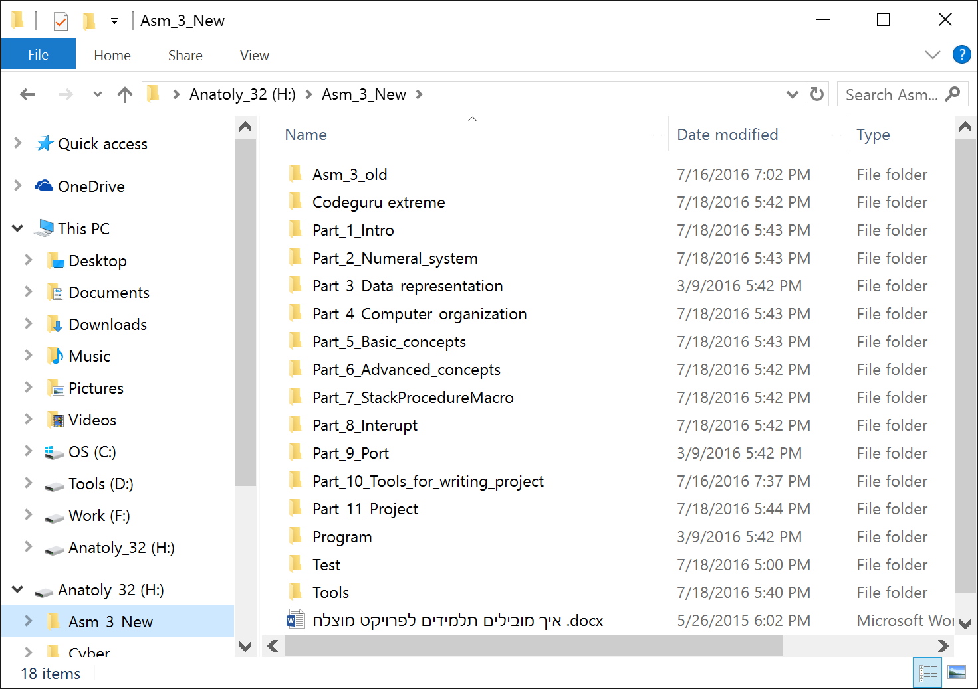
OS
New File System
New File System

Slide 6
OS
New File System

