Slide 1
IL DASM - Disassembly
The Ildasm is an utility in C# which shows the information of Assembly in human-readable format by parsing any .NET Framework DLL. ... The advantage ofILdasm.exe utility is that it can examine some native assemblies like such as Mscorlib.dll, as well as .NET Framework assemblies provided by others or created yourself

Slide 2
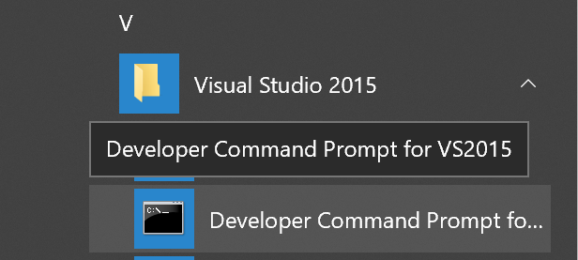
OS
DLL
Open DLL with IL DASM
C:\Program Files (x86)\Microsoft Visual Studio 14.0>ildasm

Slide 3
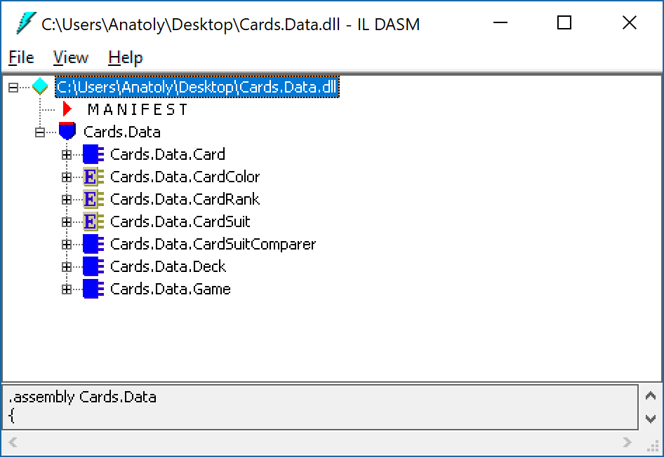
OS
IL DASM

Slide 4
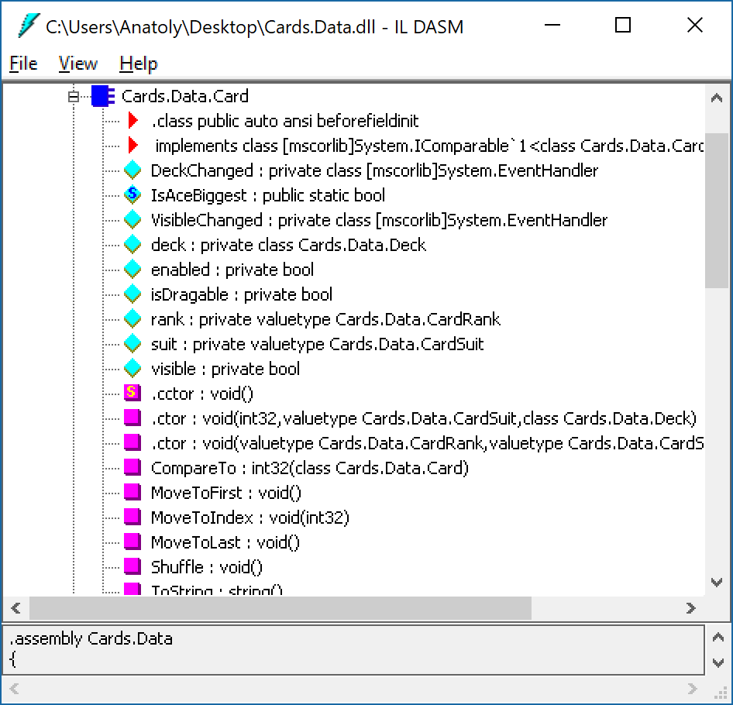
OS
IL DASM

Slide 5
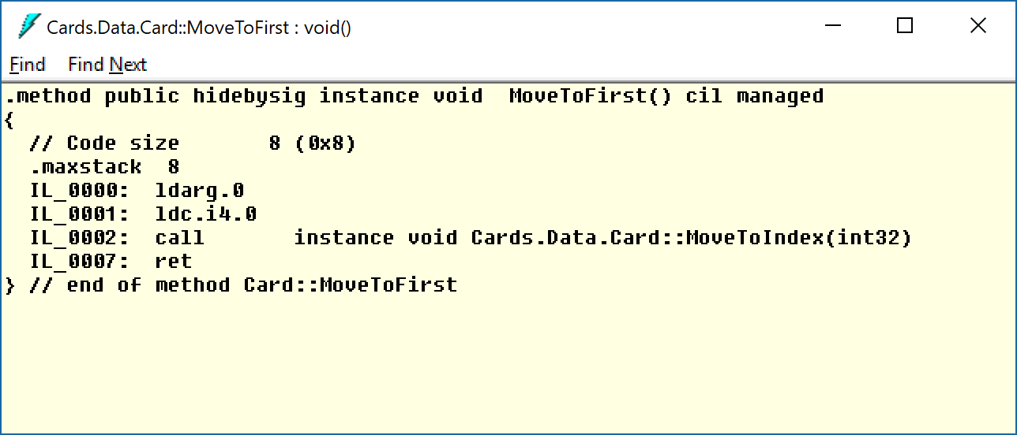
OS
IL DASM

Slide 6


OS
dotPeek
Open DLL with dotPeek
https://www.jetbrains.com/decompiler/

Slide 7
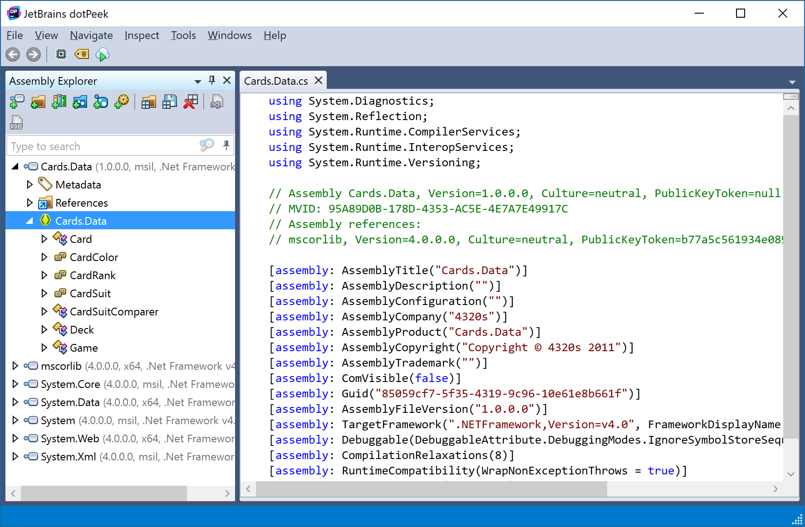
OS
dotPeek

Slide 8
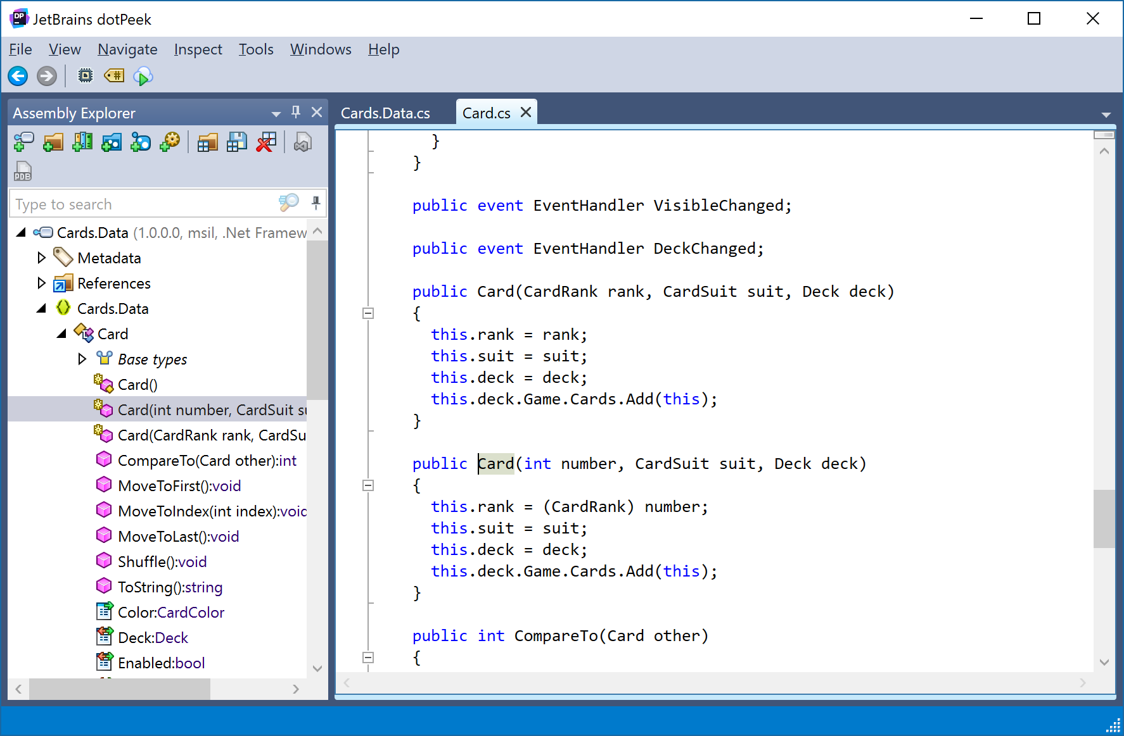
OS
dotPeek

Slide 9
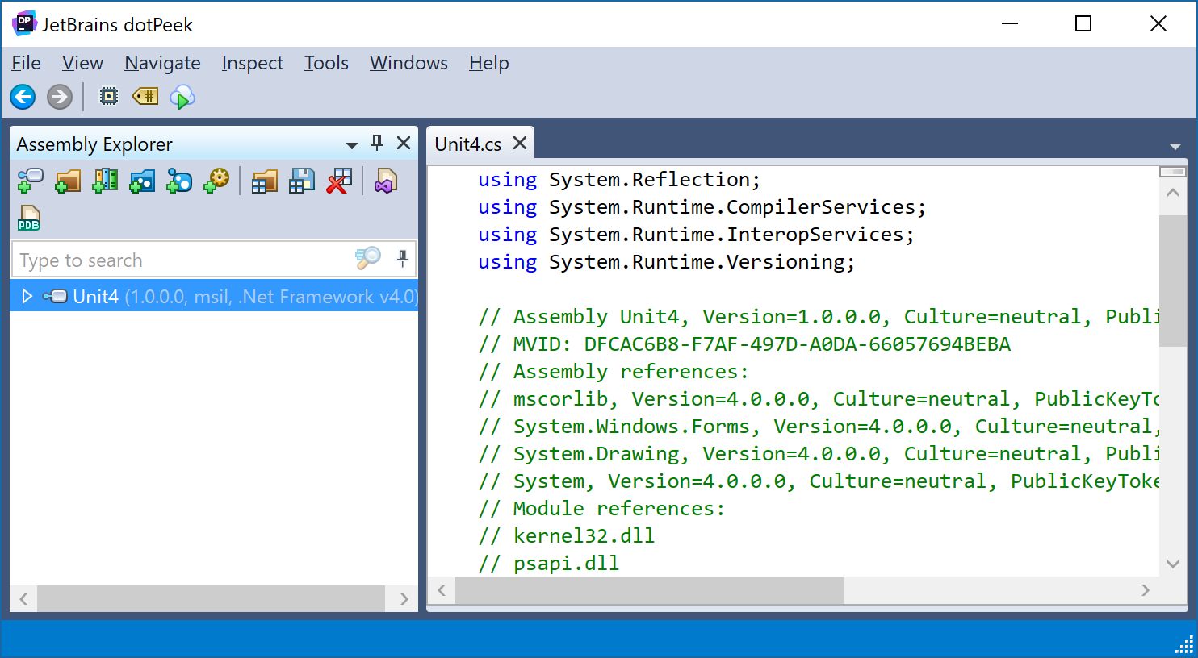
OS
dotPeek

Slide 10
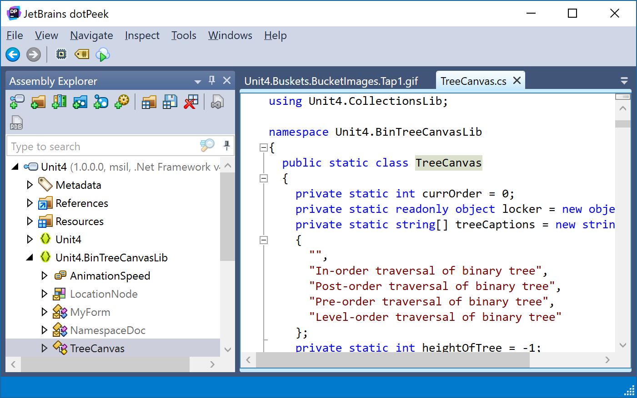
OS
dotPeek

Slide 11
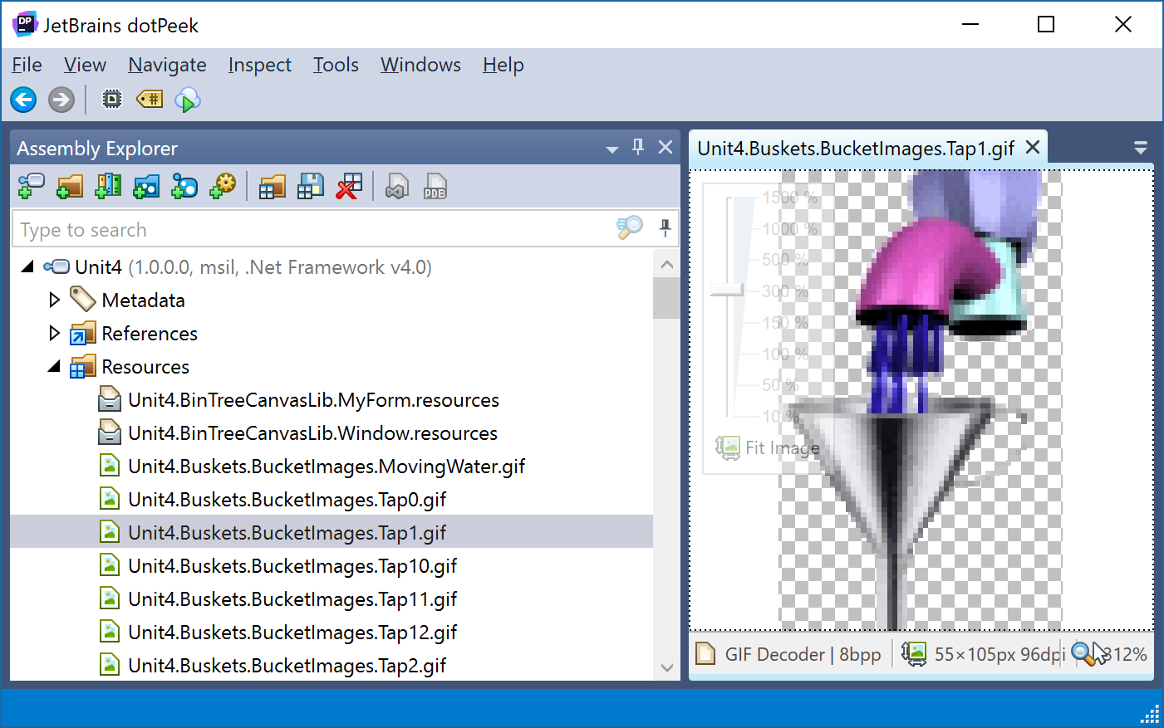
OS
dotPeek

Slide 12
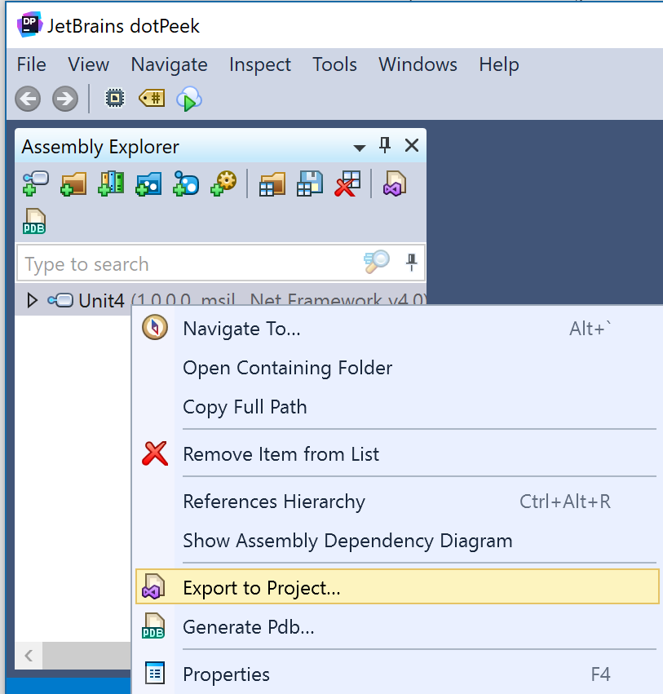
OS
dotPeek

Slide 13
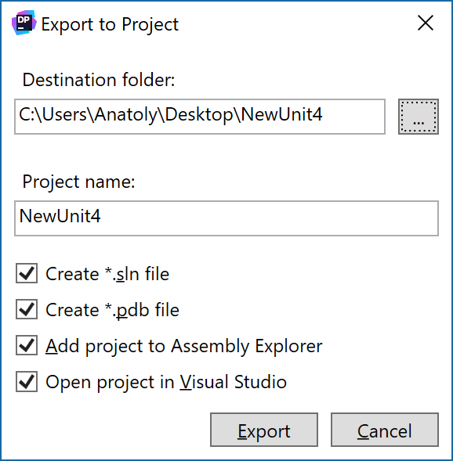
OS
dotPeek

Slide 14
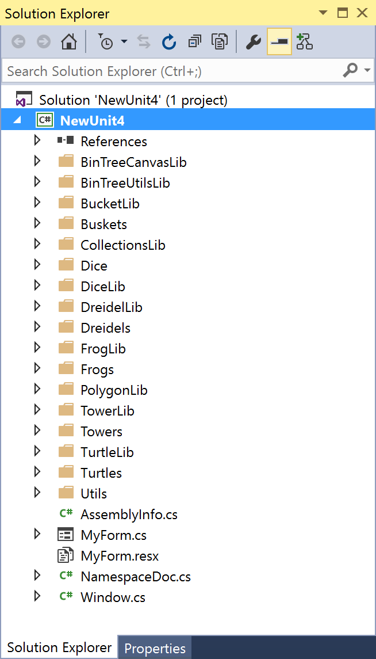
OS
dotPeek
namespace Unit4
{
internal class Window
{
internal static float s_X = 0.0f;
internal static float s_Y = 0.0f;
internal static bool m_Exit = false;
private static Rectangle screenBounds;
private static Thread m_Thread;
private string caption;
internal readonly MyForm m_Instance;
[DllImport("kernel32.dll")]
public static extern bool SetConsoleTitle(string lpConsoleTitle);
[DllImport("User32.dll")]
public static extern int FindWindow(string lpClassName, string lpWindowName);
[DllImport("User32.dll", CharSet = CharSet.Auto)]
private static extern bool MoveWindow(IntPtr hWnd, int x, int y, int cx, int cy, bool repaint);
public static event Window.TickDelegate Tick = null;

Slide 15
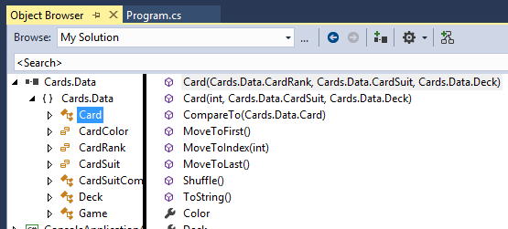
OS
VS
Open DLL with VS

Slide 16
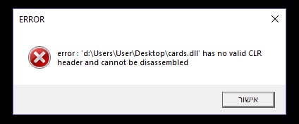
OS
VS
Open DLL with VS

Slide 17
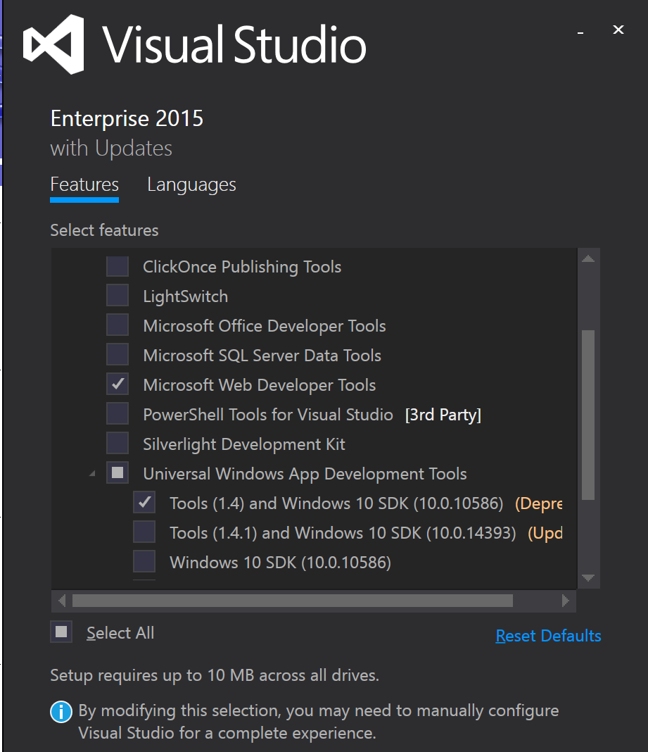
OS
VS
Open DLL with VS

Slide 18
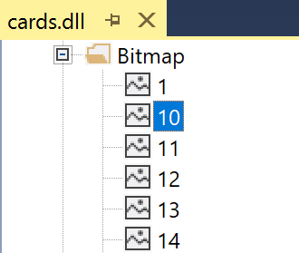
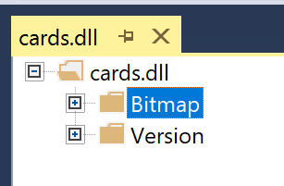
OS
VS
Open DLL with VS

Slide 19
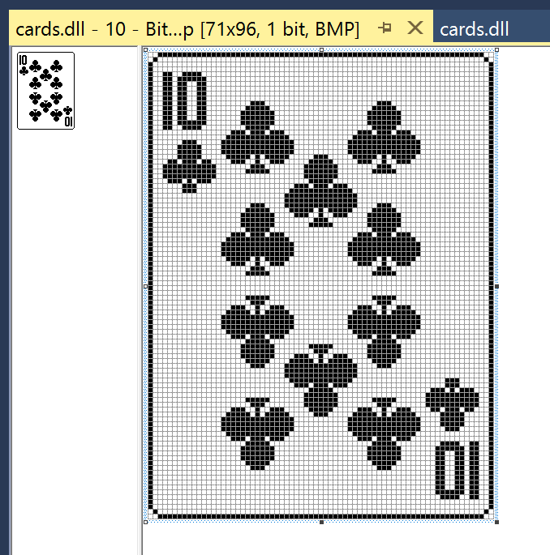
OS
VS
Open DLL with VS

