Slide 1

Dependency Walker
http://www.dependencywalker.com/
Dependency Walker is a free utility that scans any 32-bit or 64-bit Windows module (exe, dll, ocx, sys, etc.) and builds a hierarchical tree diagram of all dependent modules.
Runs on Windows 95, 98, Me, NT, 2000, XP, 2003, Vista and 7
List all dependent modules (portable executables)
Supports 64-bit and Windows CE executables
Detects if the module is programmed in C or C++
Detects modules not listed in the import address table
Color coding of the list to help highlight problems (broken dependencies are highlighted in red)
Traces dependencies recursively, and lists dependencies of all modules in a tree view

Slide 2
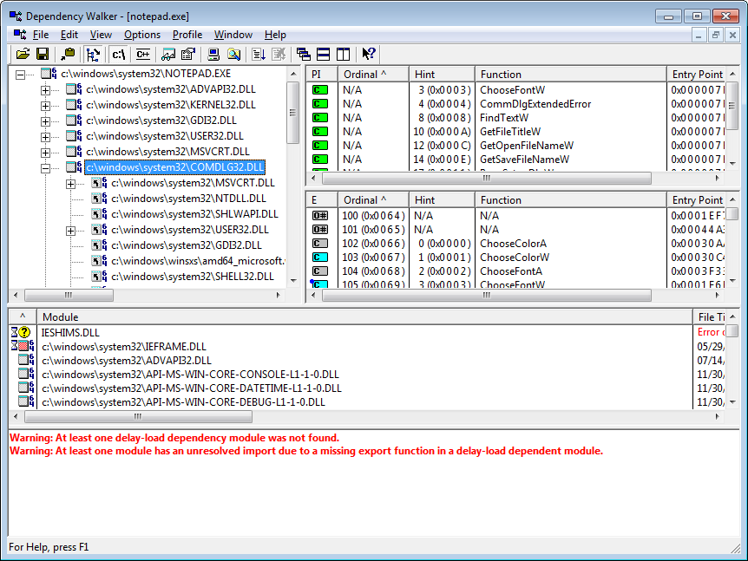
Dependency Walker
Notepad.exe
Comdlg32.dll
Ntddll.dll
Profiling
Dynamic program analysis
Files info

Slide 3
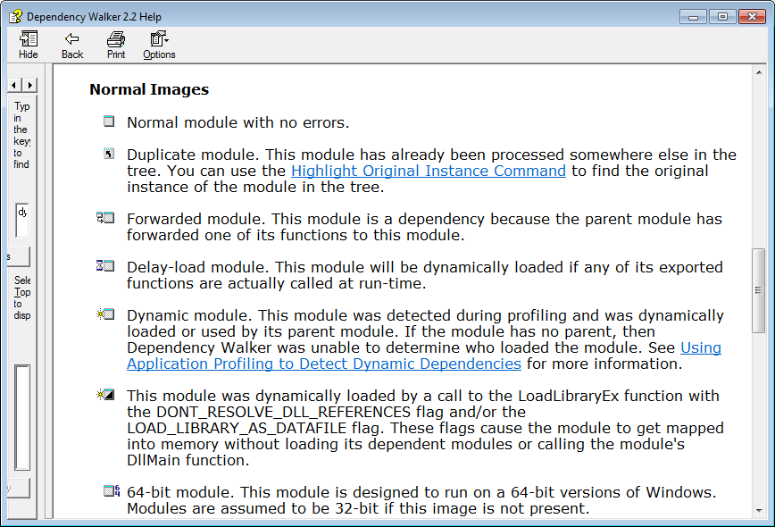
OS
DLL
Dependency Walker 2.2

Slide 4
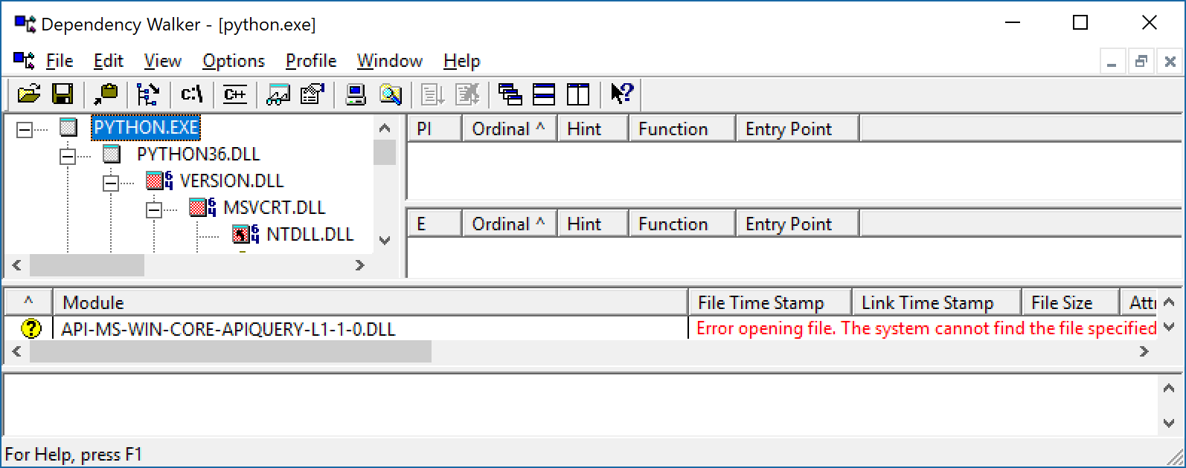
OS
DLL

Slide 5
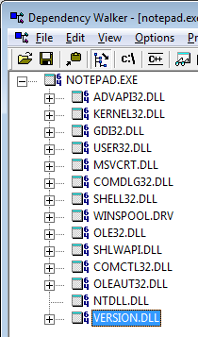
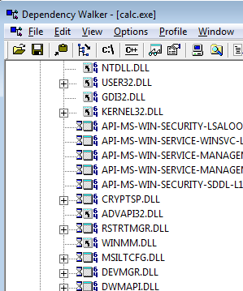
OS
DLL
Static load libraries. DLL
Dynamic load libraries. DLL

