Slide 1
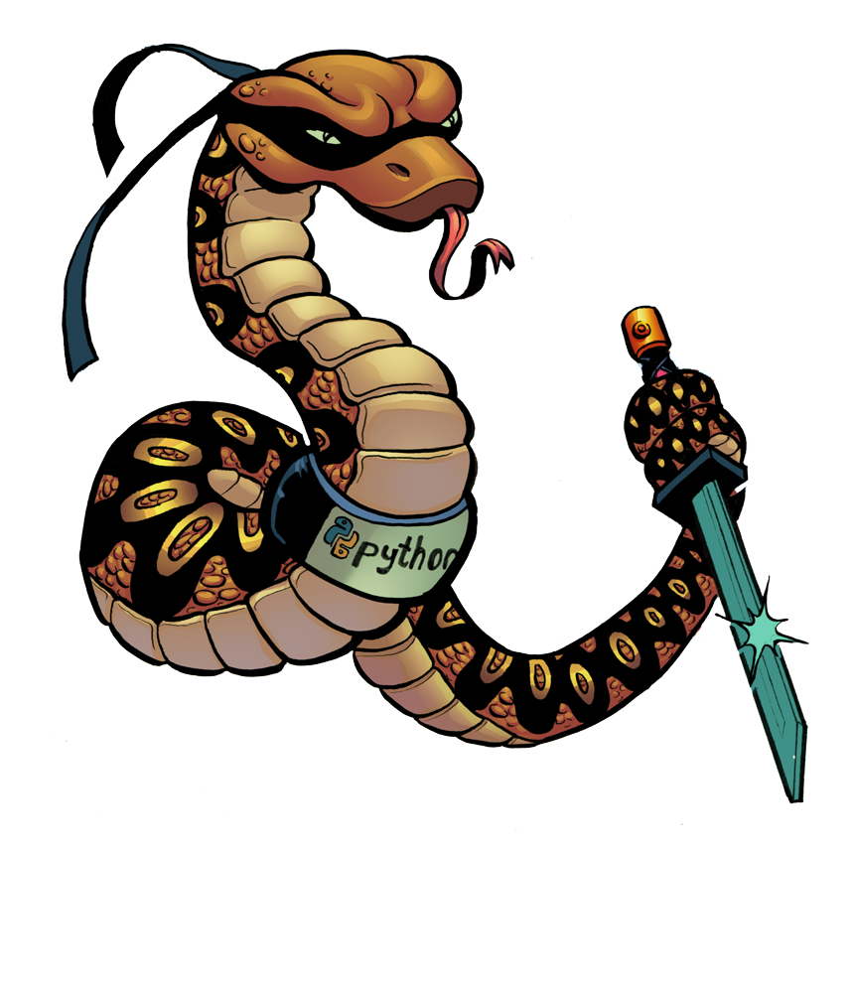
Why Python?
Feel the power of programming
The way programming should be

Slide 2
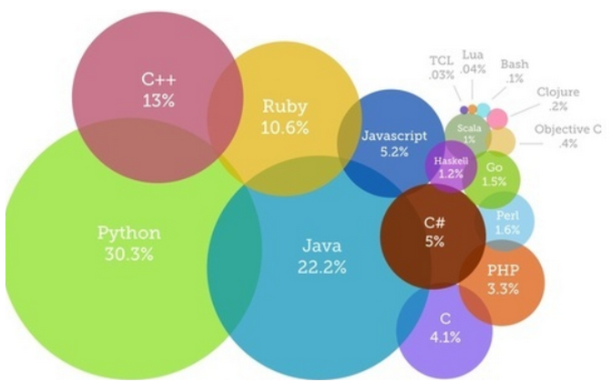
Loops – for - foreach
Array (list) colors=[‘red’, ’green’, ’blue’]
No need to declare variable types
How would you go over the array?
for i in range(len(colors):
print(colors[i])
Is there a better way ?

Slide 3
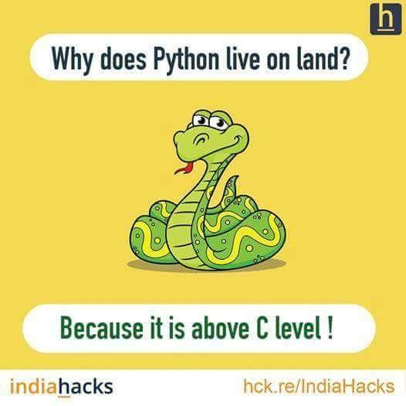
Loops
for color in colors:
print(color)
Loop backward:
for i in range(len(colors)-1,-1,-1):
print colors[i]
Looks ugly – Is there a better easier way?

Slide 4
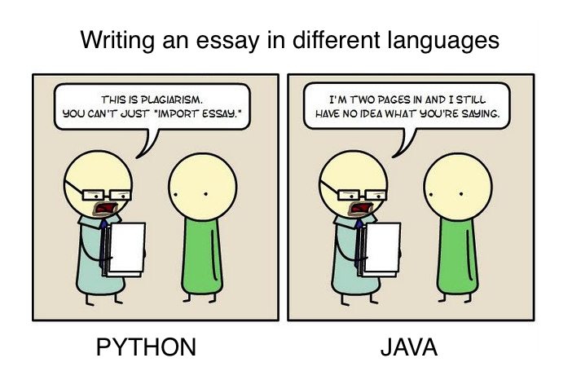
Loops
Of course there is:
for color in reversed(colors):
print(color)
What if you need the index too?
for (int i=0; i<3; i++)
print( i, color[i])
Is there a better way?

Slide 5
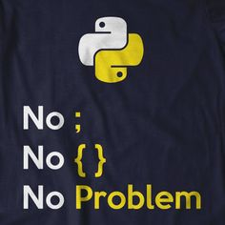
Loops
Of course here is:
for i, color in enumerate(colors):
print(i, “===>", color)
Going over 2 lists togethet :
In C#/Java/C++ we use the shorter list as the limit and use the index
names=[‘Lior’, ‘Dana’, ‘Esther’]
colors =[‘white’, ’blue’, ’green’, ’purple’]

Slide 6
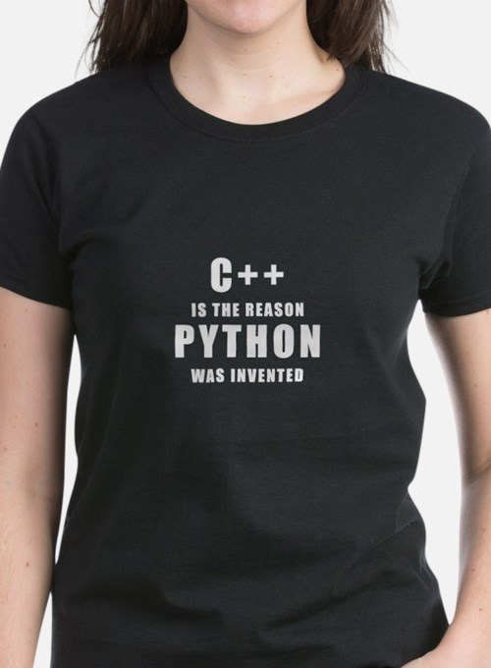
Loops
C# style:
n=min(len(names), len(colors))
for i in range(n):
print (names[i], ‘===>’, colors[i])
Is there a better way? Of course
for name , color in zip(names, colors):
print(name,’==>',color)

Slide 7

Search
How can we find a value in a list?
For i in range(len(colors)):
if colors[i] == ‘green’:
do something
Is there a better way? Surely:
if ‘green’ in colors:
do something
If you need the index: colors.index(‘blue’)

Slide 8
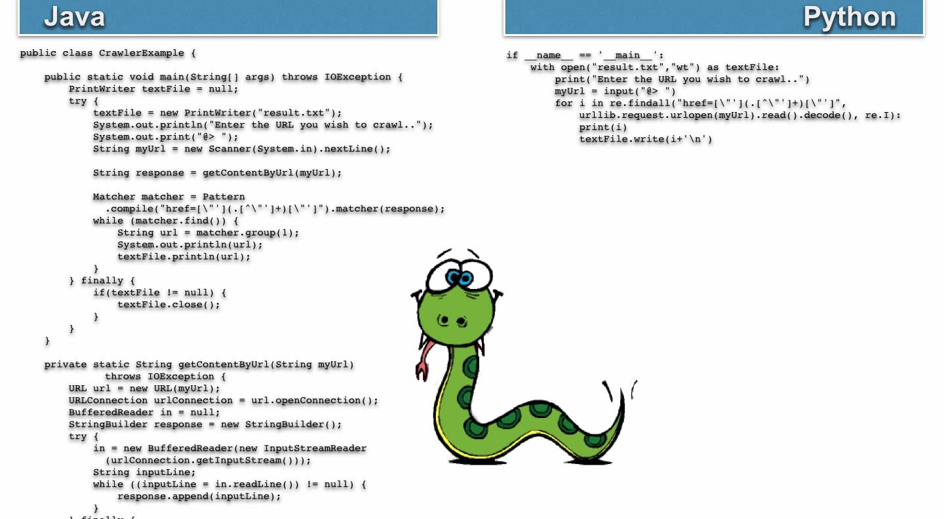
Web Crawler

Slide 9
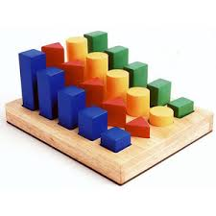
Loop in sorted order
No need to sort an array:
for name in sorted(colors)
print (name)
Reverse sort ?
for name in sorted(colors, reverse=True):
print name
(Special sorting with ‘key’ is also available and more efficient than in other languages)

Slide 10

Break out of a loop
We need a flag (found / not found)
def find(sequence, target):
found=False
for i, value in enumerate(sequence):
if target= =value:
found=True break
if not found:
return -1
return i

Slide 11

Is there a better way? (save the flag)
def find(sequence,target):
for i, value in enumerate(sequence):
if target= =value: break
else: # like: no-break
return -1
return i
After all, a loop always asks IF before looping again.

Slide 12
Hash Table / dictionary
d1={‘ke1’ : value1, ‘key2’ : ’value2’……}
Is there a better way?
d1=dict(zip(colors,names))
Concatenate strings – The ‘normal’ way
s=name[0]
for name in names[1:]:
s+=‘, ‘ + name
Is there a better way?

Slide 13
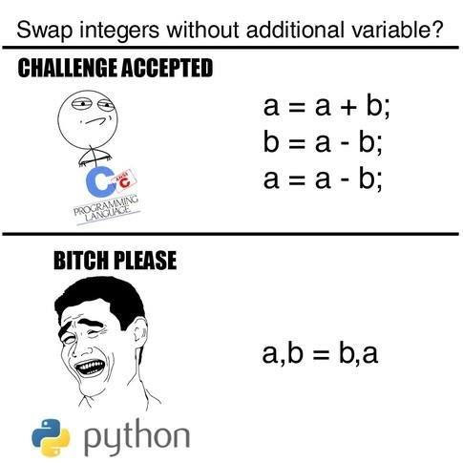
Concatenate / Function
s=‘, ‘.join(names)
We were once told that a function returns only one value, and if we want more, we need an array (forget it!)
def foo(a,b,c):
return a+b+c, a*b*c
def main():
sum, mul=foo(3,4,5)

Slide 14

Change an array
Can you do this in C#?
arr= [1,2,3,4,5]
arr=[6,7,8,9,10]
What about this?
arr=[11,12]
What about changing the type?
arr=[‘python’, ‘is’, ‘nice’]

Slide 15

Arrays (List<T> anyone?)
What about mixing types?
arr=[‘python’, ‘your’, 1, ‘language’]
How about inserting an element?
arr.insert(2,70) # Make 70 element 2
Delete an element by value
arr.remove(1) # delete the first 1 it finds (check)
Delete the last:
arr.pop()

Slide 16
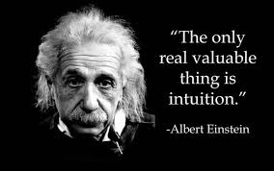
Arrays
Add an element:
arr.append(8)
Add 2 arrays into a 3rd:
arr3=arr1 + arr2
Extend an array with another:
arr1.extend(arr2)
How about extracting a part of an array:
arr4=arr1[2:4] # arr[2] and arr[3] extracted

Slide 17
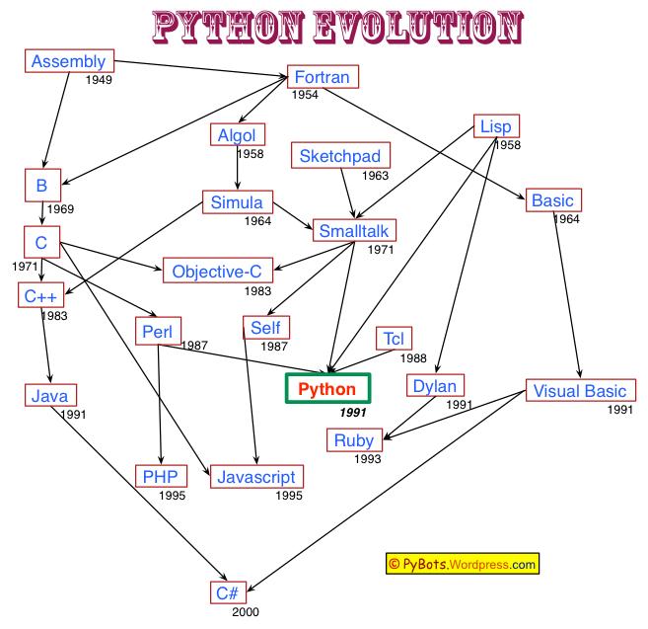
Sample program
Read a text file and list the top 10 words with highest frequency:
def main():
external_name=input("Please enter file name: ")
filein=open(external_name,"r",encoding='utf-8')
all_content=filein.read()
d={}
words=all_content.split()
for word in words:
if word in d:
d[word]=d[word]+1
else:
d[word]=1
top=10
i=0
word_frequency=sorted(d.items(), key=(lambda a:a[1]), reverse=True)
for w in word_frequency:
print(w[0], "\t",w[1])
i+=1
if i==top: break
if __name__ == '__main__':
main()

Slide 18
Word frequency
def main():
external_name=input("Please enter file name: ")
filein=open(external_name,"r",encoding='utf-8')
all_content=filein.read()
d={}
words=all_content.split()
for word in words:
if word in d:
d[word]=d[word]+1
else:
d[word]=1
top=10
i=0
word_frequency=sorted(d.items(), key=(lambda a:a[1]), reverse=True)
for w in word_frequency:
print(w[0], "\t",w[1])
i+=1
if i==top: break
if __name__ == '__main__':
main()

