Slide 1

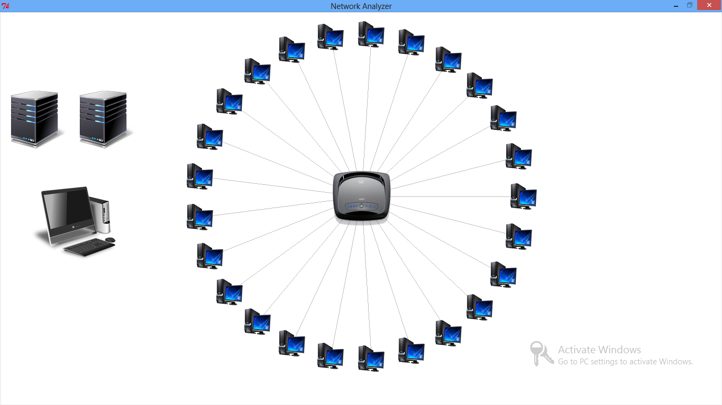
Tkinter
Canvas
Canvas widget to display graphical elements like lines or text.

Slide 2
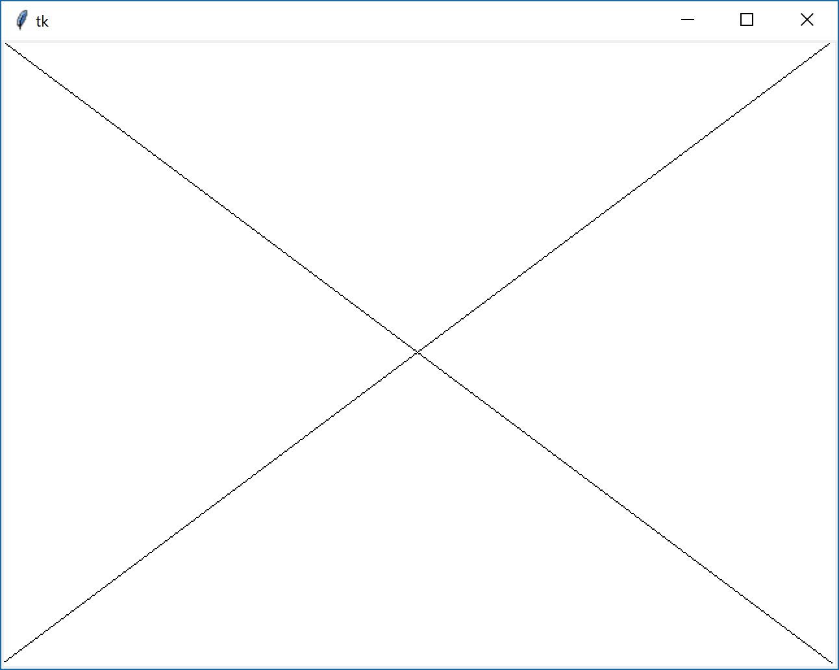
Tkinter
Canvas
Canvas widget to display graphical elements like lines or text.
from tkinter import *
tk = Tk()
c = Canvas(tk, width=640, height=480, bg="white")
c.create_line((0,0),(640,480))
c.create_line((640,0),(0,480))
c.pack()
tk.mainloop()

Slide 3
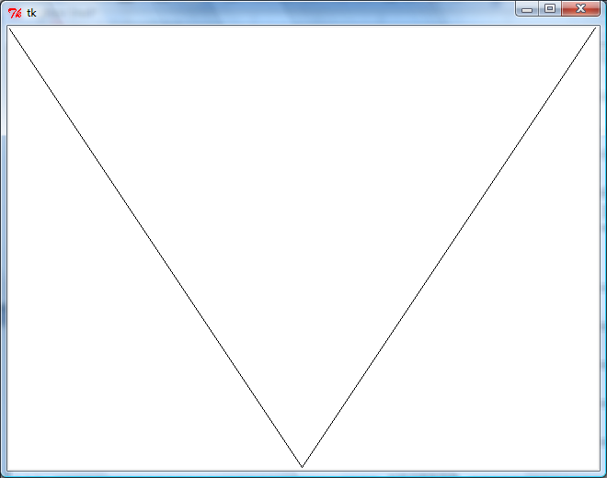
Tkinter
from tkinter import *
tk = Tk()
c = Canvas(tk, width=640, height=480, bg="white")
c.create_line((0,0),(320,480),(640,0))
c.pack()
tk.mainloop()

Slide 4
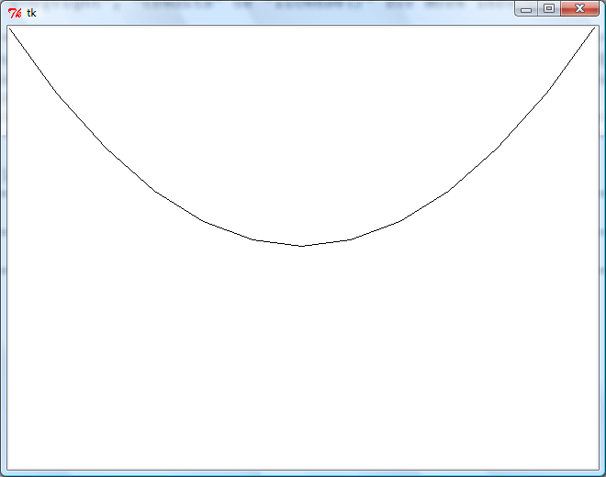
Tkinter
from tkinter import *
tk = Tk()
c = Canvas(tk, width=640, height=480, bg="white")
c.create_line([(0,0),(320,480),(640,0)],smooth=1)
c.pack()
tk.mainloop()
Smooth - חלק

Slide 5
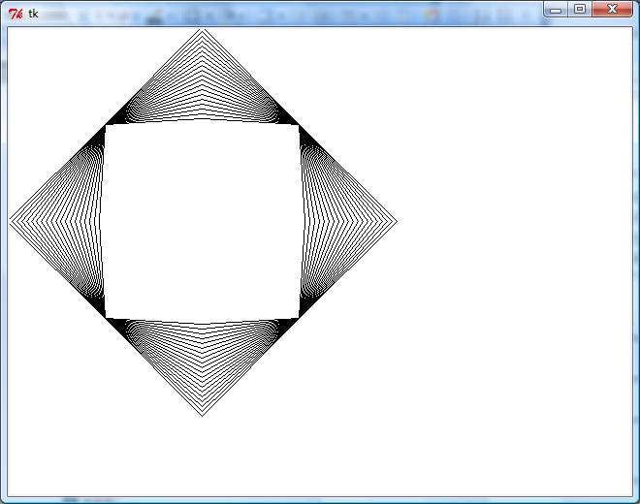
Tkinter
from tkinter import *
i=1
tk = Tk()
c = Canvas(tk, width=640, height=480, bg="white")
while i<100:
i+=5
c.create_line([(100,100),(200,100-i),(300,100),(300+i,200),(300,300),(200,300+i),(100,300),(100-i,200),(100,100)], smooth=0)
c.pack()
tk.mainloop()

Slide 6
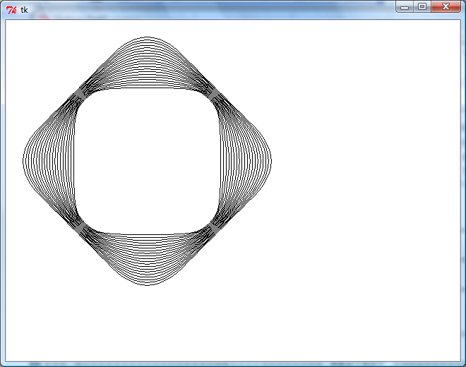
Tkinter
from tkinter import *
i=1
tk = Tk()
c = Canvas(tk, width=640, height=480, bg="white")
while i<100:
i+=5
c.create_line([(100,100),(200,100-i),(300,100),(300+i,200),(300,300),(200,300+i),(100,300),(100-i,200),(100,100)], smooth=1)
c.pack()
tk.mainloop()

Slide 7
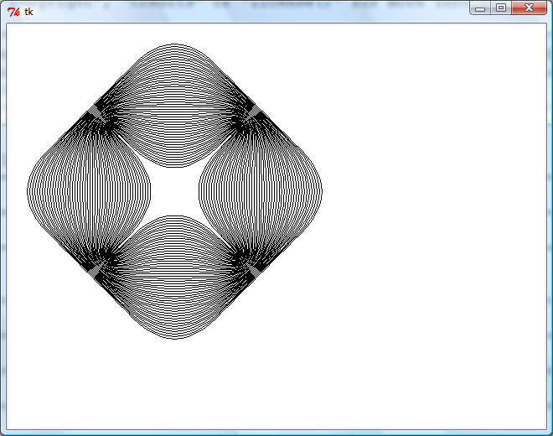
Tkinter
from tkinter import *
i=1
tk = Tk()
c = Canvas(tk, width=640, height=480, bg="white")
while i<200:
i=i+4
c.create_line([(100,100),(200,200-i), (300,100), (200+i,200),(300,300),(200,200+i),(100,300),(200-i,200), (100,100)], smooth=1)
c.pack()
tk.mainloop()

Slide 8
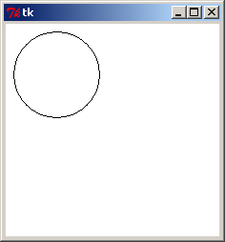
Tkinter
10,10
100,100
from tkinter import *
tk = Tk()
c = Canvas(tk, width=800, height=600, bg="white")
c.create_oval(10,10,100,100)
c.pack()
tk.mainloop()

Slide 9
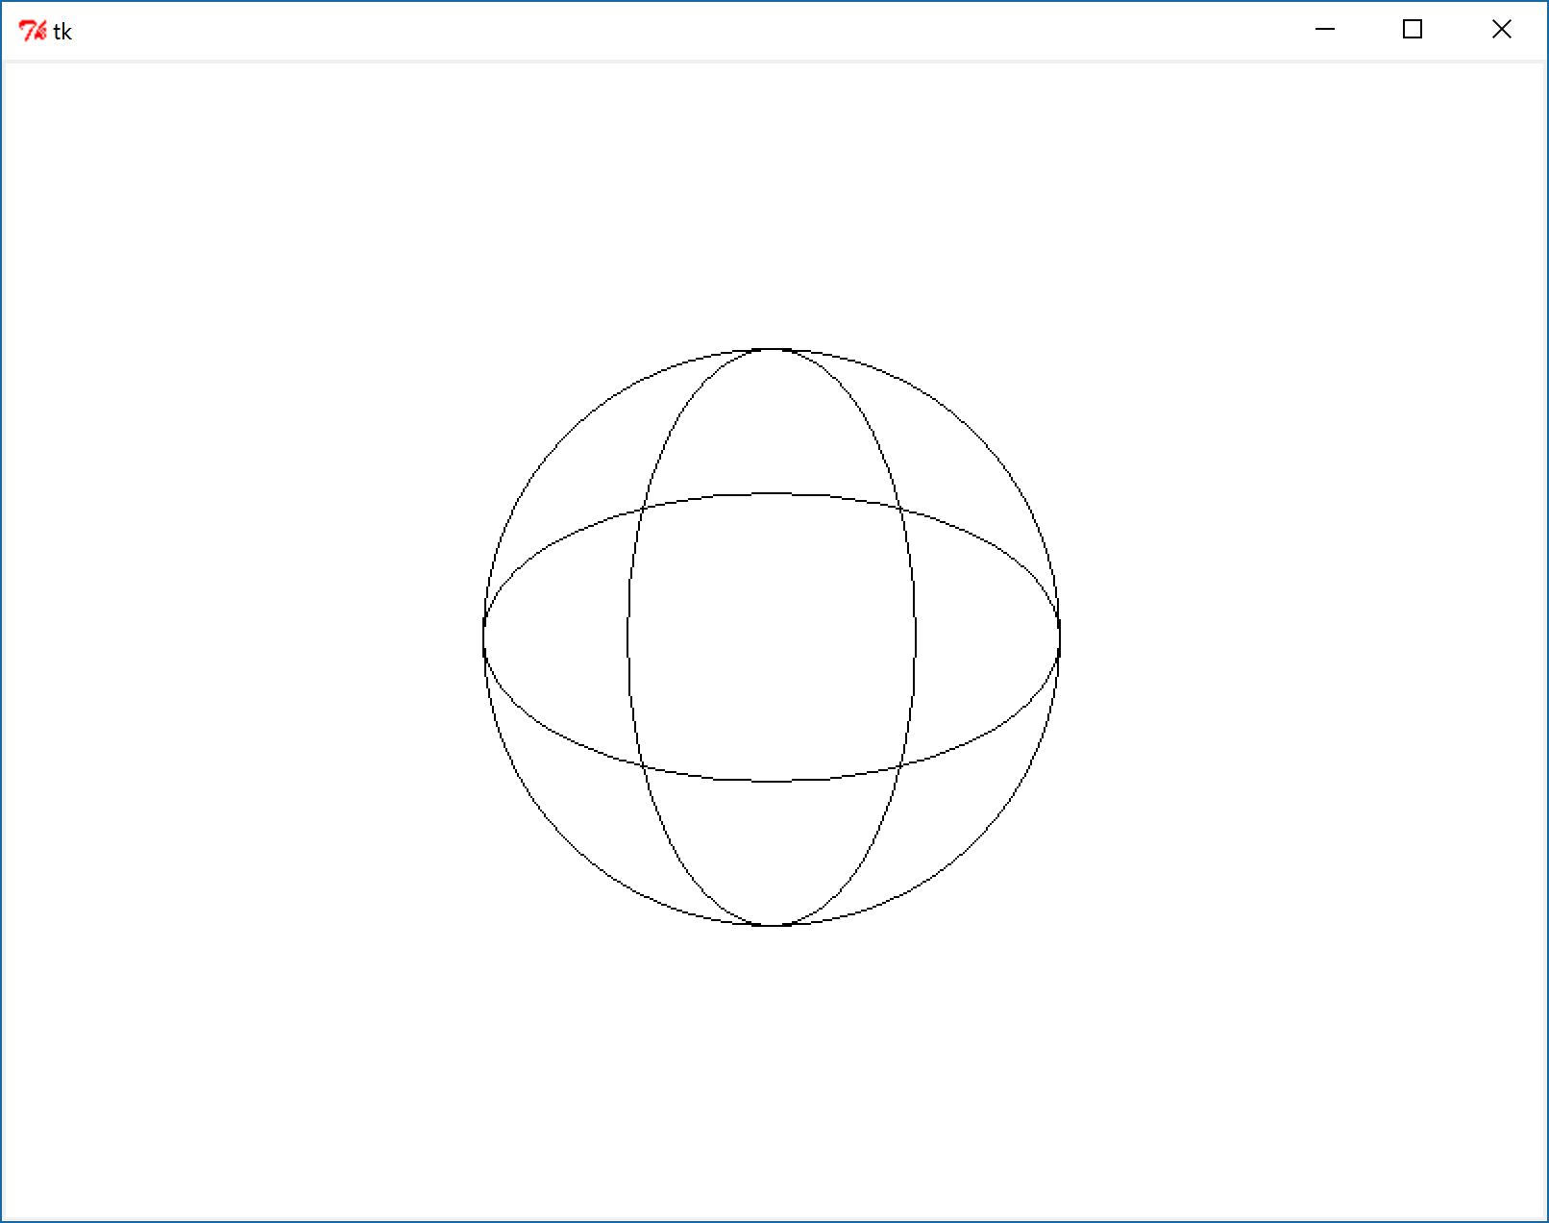
Tkinter
תרגיל:

Slide 10
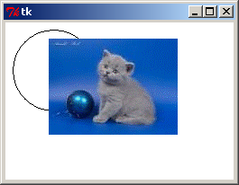
Tkinter
from tkinter import *
from PIL import Image, ImageDraw, ImageTk
tk = Tk()
c = Canvas(tk, width=800, height=600, bg="white")
c.create_oval(10,10,100,100)
img = PhotoImage(file="f:\\cat.png")
c.create_image(50, 50, image=img, anchor="nw")
c.pack()
tk.mainloop()

Slide 11
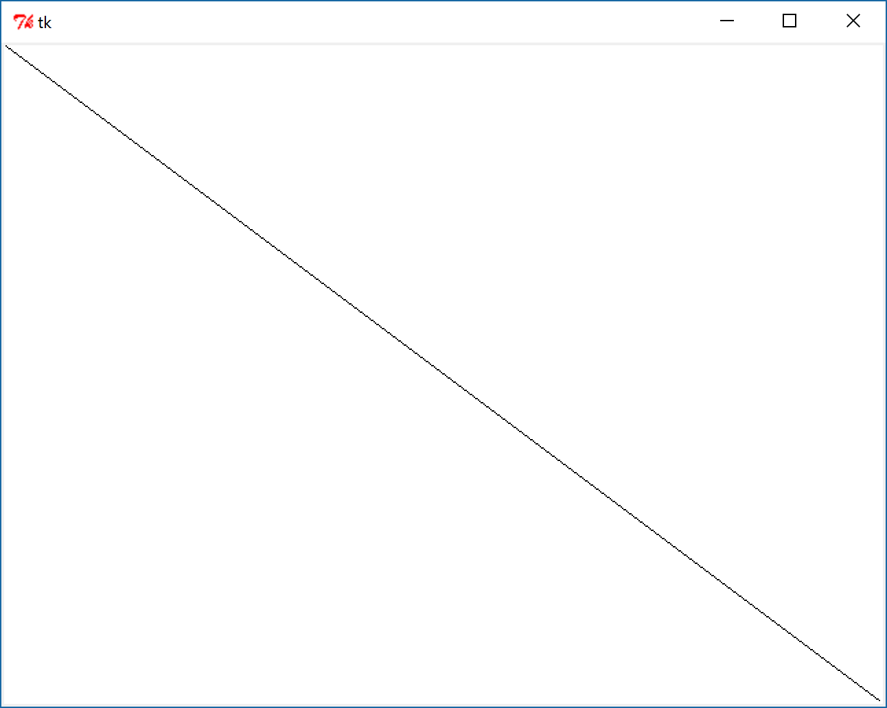
Tkinter
Undo
from tkinter import *
tk = Tk()
shapes = []
c = Canvas(tk, width=640, height=480, bg="white")
id = c.create_line((0,0),(640,480))
shapes.append(id)
print(id)
id = c.create_line((640,0),(0,480))
print(id)
shapes.append(id)
print(shapes)
if len(shapes)>0:
c.delete(shapes.pop())
#c.delete('all')
c.pack()
tk.mainloop()
1
2
[1, 2]

Slide 12
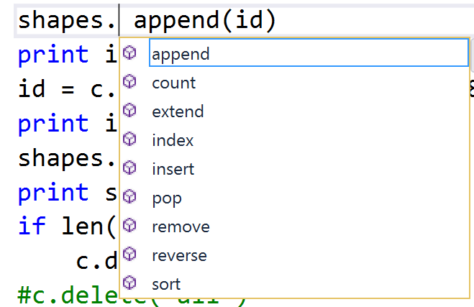
Tkinter

Slide 13
Tkinter
from tkinter import *
root = Tk()
canvas = Canvas(root, width = 500, height = 500)
canvas.pack()
new_rect = canvas.create_rectangle(0,0,100,100)
canvas.delete(new_rect)
root.mainloop()

