Slide 1
OS
Command prompt
Redirection i/o
שינוי קלט/פלט של פקודה ממיקום ברירת המחדל למיקום חדש.
השימוש העיקרי של קריאת קלט מקבצים ושליחת פלט אל קבצים.
Using command redirection operators
Redirection operator | Description
> | Writes the command output to a file or a device, such as a printer, instead of the Command Prompt window.
< | Reads the command input from a file, instead of reading input from the keyboard.
>> | Appends the command output to the end of a file without deleting the information that is already in the file.
>& | Writes the output from one handle to the input of another handle.
<& | Reads the input from one handle and writes it to the output of another handle.
| | Reads the output from one command and writes it to the input of another command. Also known as a pipe. (dir | more)

Slide 2
OS
Command prompt
Redirection i/o
Handle | Numeric equivalent of handle | Description
STDIN | 0 | Keyboard input
STDOUT | 1 | Output to the Command Prompt window
STDERR | 2 | Error output to the Command Prompt window
UNDEFINED | 3-9 | These handles are defined individually by the application and are specific to each tool.

Slide 3
OS
Command prompt
Redirection i/o
C:\> sort < list.txt
C:\>help > help.txt
C:\>systeminfo >> d:\systeminfo.txt
C:\>type names.txt | find "Jones"
C:\>ipconfig /all | FIND "DNS"
C:\>sort test.txt /o output.txt

Slide 4
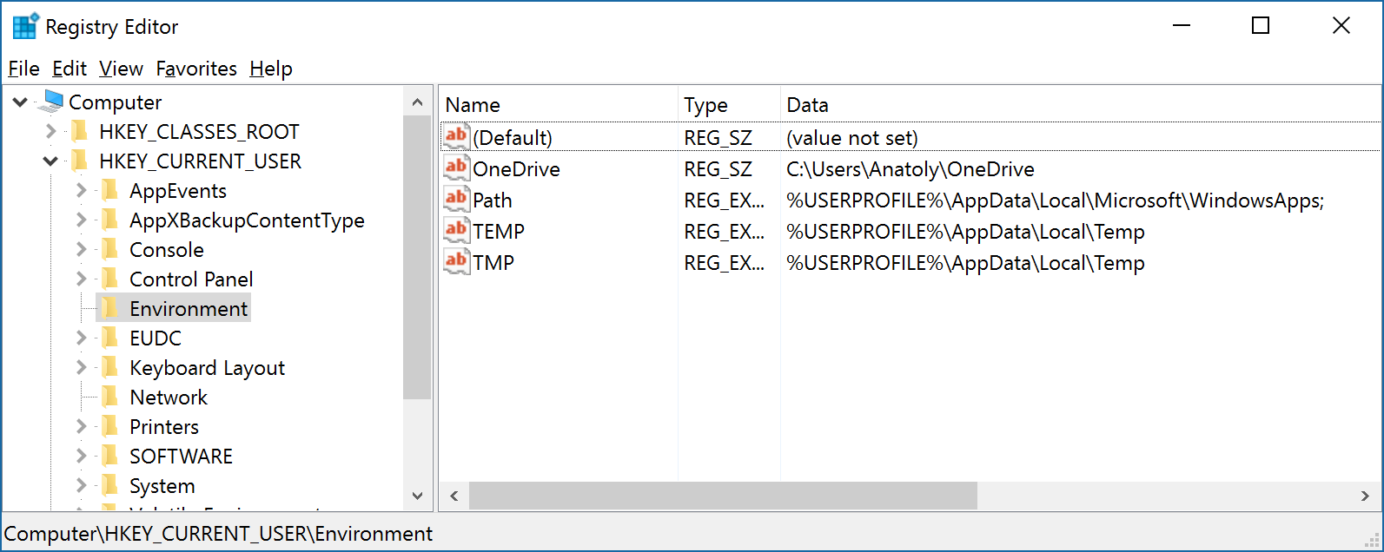
OS
Command prompt
Environment variables
http://ss64.com/nt/syntax-variables.html
User Variables

Slide 5
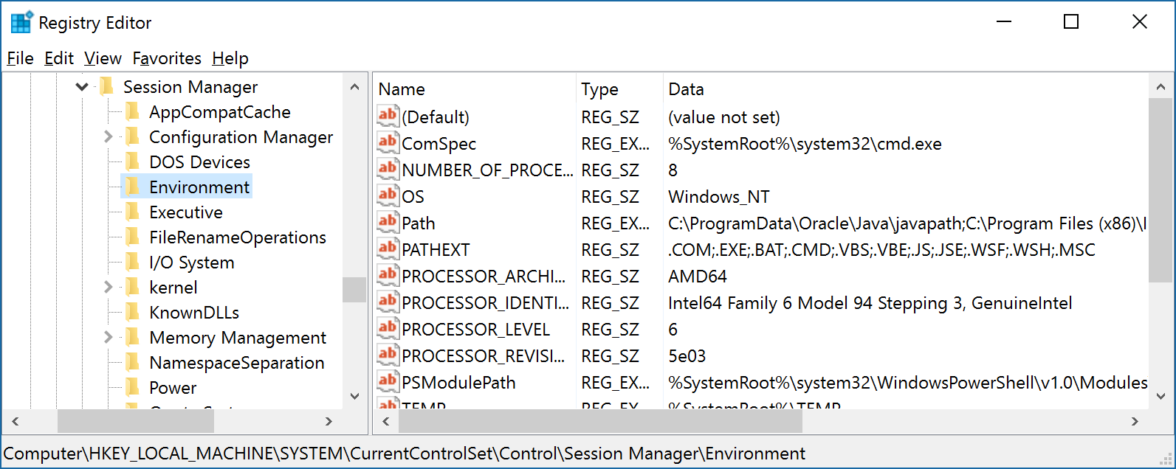
OS
Command prompt
Environment variables
System Variables

Slide 6
OS
Command prompt
Environment variables
SET myname=Anatoly
echo date
date
echo %date%
Fri 08/08/2014
echo myname
myname
echo %myname%
Anatoly
echo path
path
echo %path%
C:\Windows\system32;C:\Windows;C:\Windows\System32\Wbem;
http://ss64.com/nt/syntax-variables.html

Slide 7
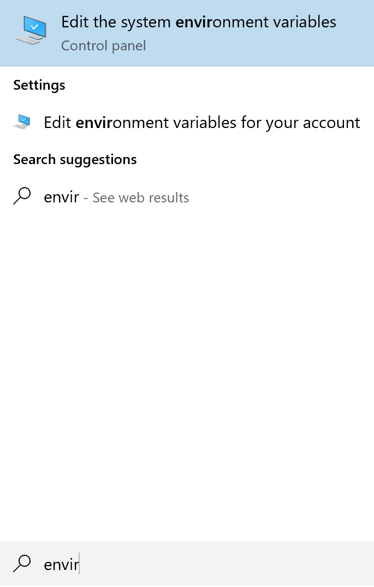
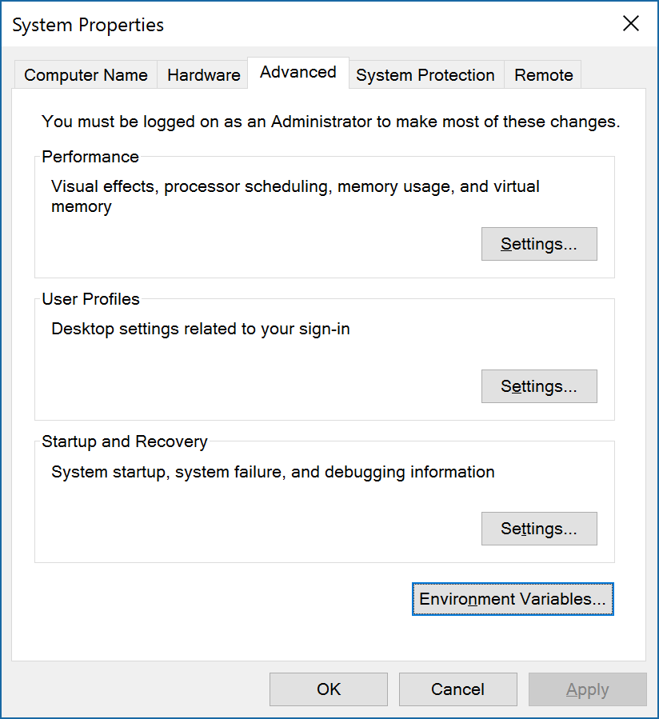
OS
Command prompt
Environment variables

Slide 8
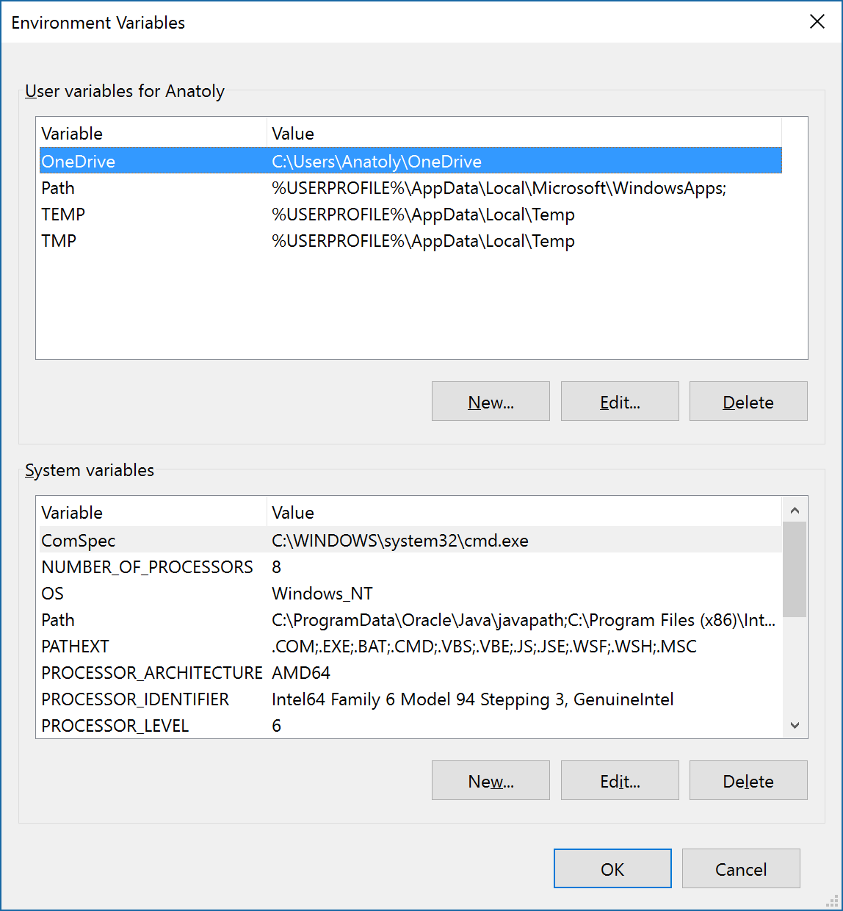
OS
Command prompt
Environment variables

Slide 9
OS
Command prompt
Command SET
SET PATH=c:\python26;%path%
C:\Users\Anatoly-PC>set
ALLUSERSPROFILE=C:\ProgramData
APPDATA=C:\Users\Anatoly-PC\AppData\Roaming
CommonProgramFiles=C:\Program Files\Common Files
CommonProgramFiles(x86)=C:\Program Files (x86)\Common Files
CommonProgramW6432=C:\Program Files\Common Files
COMPUTERNAME=ANATOLY-PC-PC
ComSpec=C:\Windows\system32\cmd.exe
FP_NO_HOST_CHECK=NO
HOMEDRIVE=C:
HOMEPATH=\Users\Anatoly-PC
LOCALAPPDATA=C:\Users\Anatoly-PC\AppData\Local
LOGONSERVER=\\ANATOLY-PC-PC
myname=Anatoly
NUMBER_OF_PROCESSORS=8
OS=Windows_NT

Slide 10
OS
Command prompt
Batch file
קובץ אצווה
קובץ אצווה הוא קובץ המכיל שורות טקסט של פקודות למערכת ההפעלה, לשם הפעלתן של תכניות שונות.

Slide 11
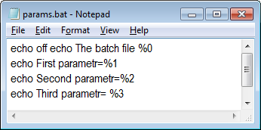
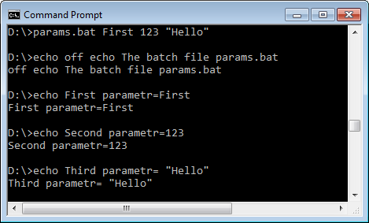
OS
Command prompt
Passing parameters to a batch file

Slide 12
OS
Command prompt
Basic Batch Virus Prank
http://www.instructables.com/id/Basic-Batch-Virus-Prank/
Batch Files - the art of creating viruses
Simple - Batch - File - Viruses - Explained!

Slide 13
OS
Command prompt
Command IF
if "%1" EQU "" goto error .... ... :error Echo Must be set at least one input parameter exit

Slide 14
OS
Command prompt
Command history
Displays all commands stored in memory
>doskey /history
F7

