Slide 1
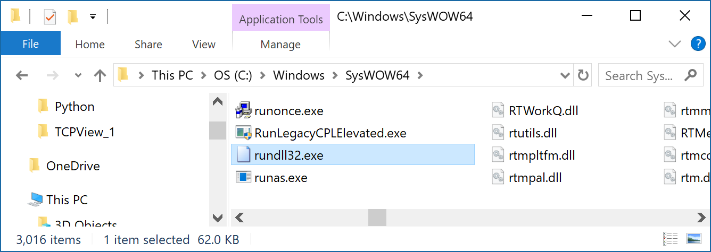
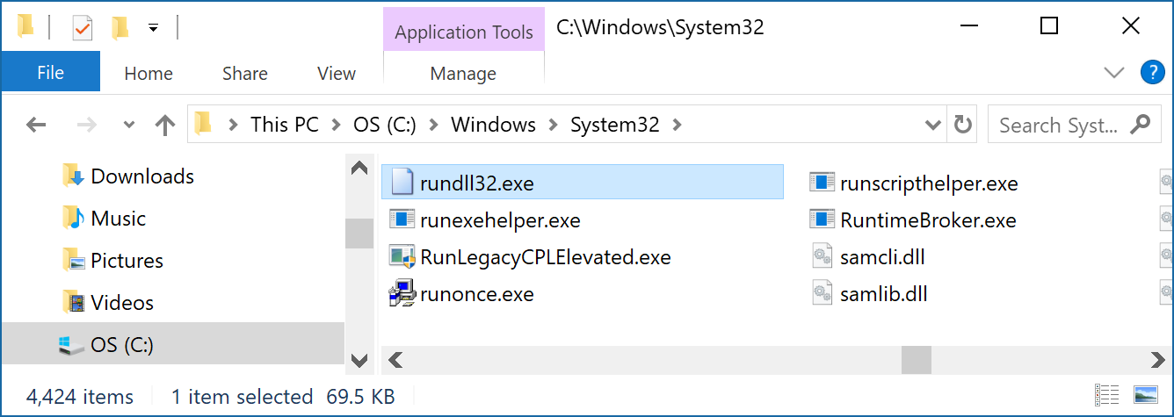
OS
DLL
RunDLL32
Rundll32 loads and runs DLLs.

Slide 2
OS
DLL
RunDLL32
The file is always located in the directory C: \ Windows \ System32. In case of a file with the same name in any other directory it should be removed immediately. Worms W32 / Lovgate-AB, W32 / Deloder-A, Trojans Troj / Lineage-AR, Troj / LegMir-AS and Troj / Delf-AC and many other malicious programs using the name rundll32.exe to conceal its presence in the system.

Slide 3
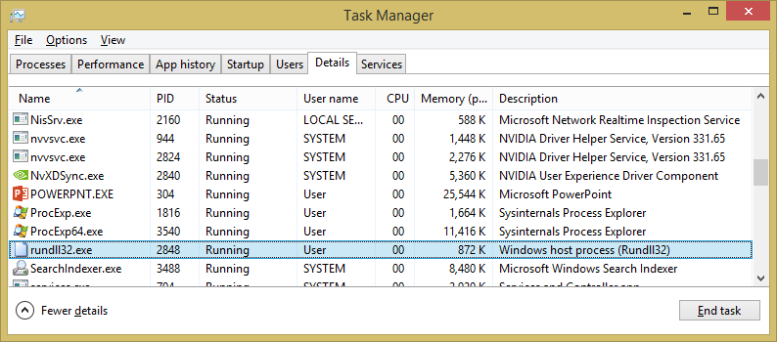
OS
DLL

Slide 4
OS
DLL
RunDLL32
Rundll32 loads and runs 32-bit DLLs.
The command line for RunDLL is as follows:
RUNDLL.EXE <dllname>,<entrypoint> <optional arguments>
Add/Remove Programs
RunDll32.exe shell32.dll,Control_RunDLL appwiz.cpl,,0
Content Advisor
RunDll32.exe msrating.dll,RatingSetupUI

Slide 5
OS
DLL
Control Panel
RunDll32.exe shell32.dll,Control_RunDLL
Delete Temporary Internet Files
RunDll32.exe InetCpl.cpl,ClearMyTracksByProcess 8
Delete Cookies
RunDll32.exe InetCpl.cpl,ClearMyTracksByProcess 2
Delete History
RunDll32.exe InetCpl.cpl,ClearMyTracksByProcess 1
Delete Form Data
RunDll32.exe InetCpl.cpl,ClearMyTracksByProcess 16
Delete Passwords
RunDll32.exe InetCpl.cpl,ClearMyTracksByProcess 32

Slide 6
OS
DLL
Delete All
RunDll32.exe InetCpl.cpl,ClearMyTracksByProcess 255
Delete All + files and settings stored by Add-ons:
RunDll32.exe InetCpl.cpl,ClearMyTracksByProcess 4351
Date and Time Properties
RunDll32.exe shell32.dll,Control_RunDLL timedate.cpl
Display Settings
RunDll32.exe shell32.dll,Control_RunDLL access.cpl,,3
Device Manager
RunDll32.exe devmgr.dll DeviceManager_Execute
Folder Options – General
RunDll32.exe shell32.dll,Options_RunDLL 0

Slide 7
OS
DLL
Folder Options – File Types
RunDll32.exe shell32.dll,Control_Options 2
Folder Options – Search
RunDll32.exe shell32.dll,Options_RunDLL 2
Folder Options – View
RunDll32.exe shell32.dll,Options_RunDLL 7
Forgotten Password Wizard
RunDll32.exe keymgr.dll,PRShowSaveWizardExW
Hibernate
RunDll32.exe powrprof.dll,SetSuspendState
Internet Explorer’s Internet Properties dialog box.
Rundll32 Shell32.dll,ConBring up trol_RunDLL Inetcpl.cpl,,6

Slide 8
OS
DLL
Keyboard Properties
RunDll32.exe shell32.dll,Control_RunDLL main.cpl @1
Lock Screen
RunDll32.exe user32.dll,LockWorkStation
Mouse Button – Swap left button to function as right
Rundll32 User32.dll,SwapMouseButton
Mouse Properties Dialog Box
Rundll32 Shell32.dll,Control_RunDLL main.cpl @0,0
Map Network Drive Wizard
Rundll32 Shell32.dll,SHHelpShortcuts_RunDLL Connect
Network Connections
RunDll32.exe shell32.dll,Control_RunDLL ncpa.cpl

Slide 9
OS
DLL
Organize IE Favourites
Rundll32.exe shdocvw.dll,DoOrganizeFavDlg
Open With Dialog Box
Rundll32 Shell32.dll,OpenAs_RunDLL Any_File-name.ext
Printer User Interface
Rundll32 Printui.dll,PrintUIEntry /?
Printer Management Folder.
Rundll32 Shell32.dll,SHHelpShortcuts_RunDLL PrintersFolder
Power Options
RunDll32.exe Shell32.dll,Control_RunDLL powercfg.cpl
Process Idle Tasks
rundll32.exe advapi32.dll,ProcessIdleTasks

Slide 10
OS
DLL
Regional and Language Options
Rundll32 Shell32.dll,Control_RunDLL Intl.cpl,,0
Stored Usernames and Passwords
RunDll32.exe keymgr.dll,KRShowKeyMgr
Safely Remove Hardware Dialog Box
Rundll32 Shell32.dll,Control_RunDLL HotPlug.dll
Sound Properties Dialog Box
Rundll32 Shell32.dll,Control_RunDLL Mmsys.cpl,,0
System Properties Box
Rundll32 Shell32.dll,Control_RunDLL Sysdm.cpl,,3
System Properties – Advanced
RunDll32.exe shell32.dll,Control_RunDLL sysdm.cpl,,4

Slide 11
OS
DLL
System Properties: Automatic Updates
RunDll32.exe shell32.dll,Control_RunDLL sysdm.cpl,,5
Taskbar Properties
RunDll32.exe shell32.dll,Options_RunDLL 1
User Accounts
RunDll32.exe shell32.dll,Control_RunDLL nusrmgr.cpl
Unplug/Eject Hardware
RunDll32.exe shell32.dll,Control_RunDLL hotplug.dll
Windows Security Center
RunDll32.exe shell32.dll,Control_RunDLL wscui.cpl
Windows – About
RunDll32.exe SHELL32.DLL,ShellAboutW

Slide 12
OS
DLL
System Properties: Automatic Updates
RunDll32.exe shell32.dll,Control_RunDLL sysdm.cpl,,5
Taskbar Properties
RunDll32.exe shell32.dll,Options_RunDLL 1
User Accounts
RunDll32.exe shell32.dll,Control_RunDLL nusrmgr.cpl
Unplug/Eject Hardware
RunDll32.exe shell32.dll,Control_RunDLL hotplug.dll
Windows Security Center
RunDll32.exe shell32.dll,Control_RunDLL wscui.cpl
Windows – About
RunDll32.exe SHELL32.DLL,ShellAboutW

Slide 13
OS
DLL
Windows Fonts Installation Folder
Rundll32 Shell32.dll,SHHelpShortcuts_RunDLL FontsFolder
Windows Firewall
RunDll32.exe shell32.dll,Control_RunDLL firewall.cpl
Wireless Network Setup
RunDll32.exe shell32.dll,Control_RunDLL NetSetup.cpl,@0,WNSW
Open the associated application
Rundll32.exe url.dll,FileProtocolHandler http:\\www.rgagnon.com
Open the associated application
Rundll32.exe url.dll,FileProtocolHandler d:\Payments.pdf

Slide 14
OS
DLL
Rundll32 keyboard,disable
Rundll32 mouse,disable
Rundll32 krnl386.exe,exitkernel
Rundll32 shell32,ShellAboutA WINHOWTO.RU
Rundll32 shell32,SHExitWindowsEx 0
Rundll32 user,disableoemlayer
Rundll32 …..

